Slide 1


The work of
Christian Peacemaking
Lesson 1: A Christian Response
to Conflict

Slide 2
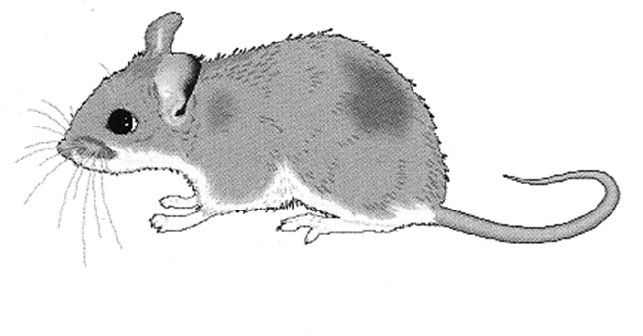
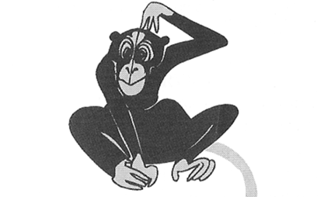
Looking at the images
around the room
Stand near the animal which best represents how you respond to conflict.

Slide 3
Looking at the images
around the room
Why have you chosen your animal?
What are the advantages and disadvantages of this style of response?
Is this method likely to solve the problem?

Slide 4
Read Matthew 5: 38-41
³⁸ You have heard that it was said, ‘Eye for eye, and tooth for tooth.’ ³⁹ But I tell you, do not resist an evil person. If anyone slaps you on the right cheek, turn to them the other cheek also. ⁴⁰ And if anyone wants to sue you and take your shirt, hand over your coat as well. ⁴¹ If anyone forces you to go one mile, go with them two miles.

Slide 5
Read Matthew 5: 38-41
³⁸ You have heard that it was said, ‘Eye for eye, and tooth for tooth.’ ³⁹ But I tell you, do not resist an evil person. If anyone slaps you on the right cheek, turn to them the other cheek also. ⁴⁰ And if anyone wants to sue you and take your shirt, hand over your coat as well. ⁴¹ If anyone forces you to go one mile, go with them two miles.
What is Jesus’ message here?

Slide 6
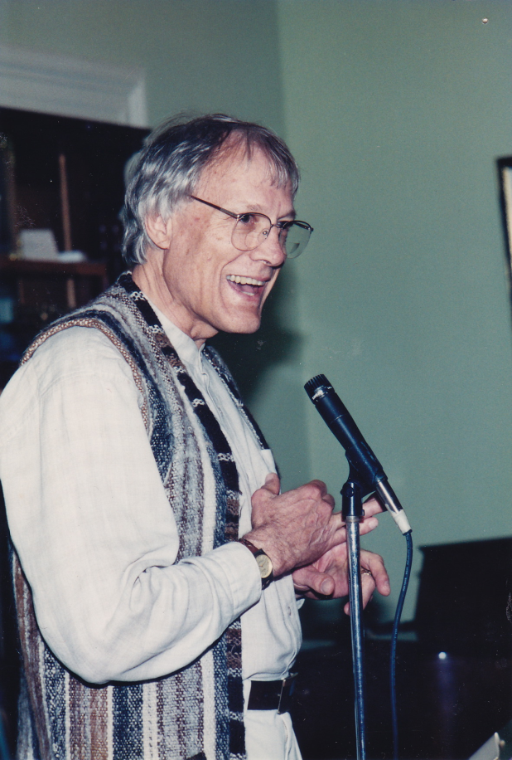
We are going to look at one interpretation of this passage, by a bible scholar called Walter Wink.

Slide 7
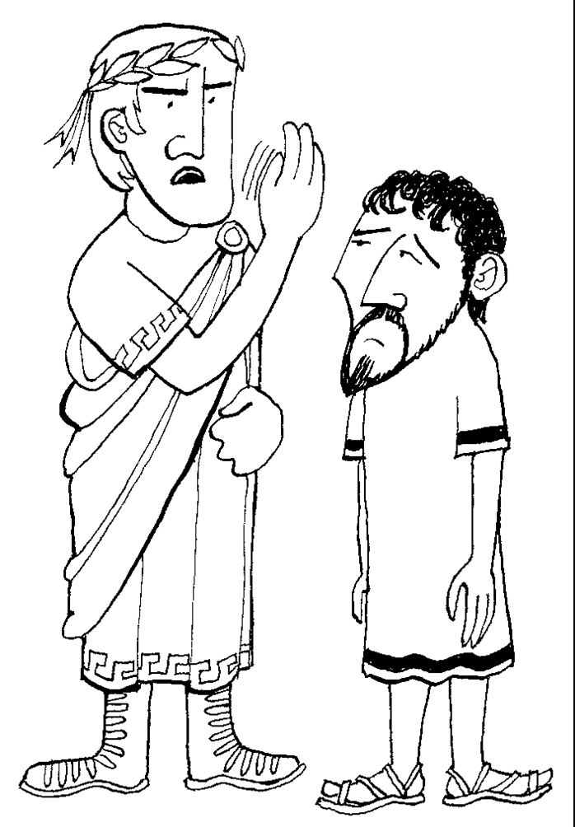
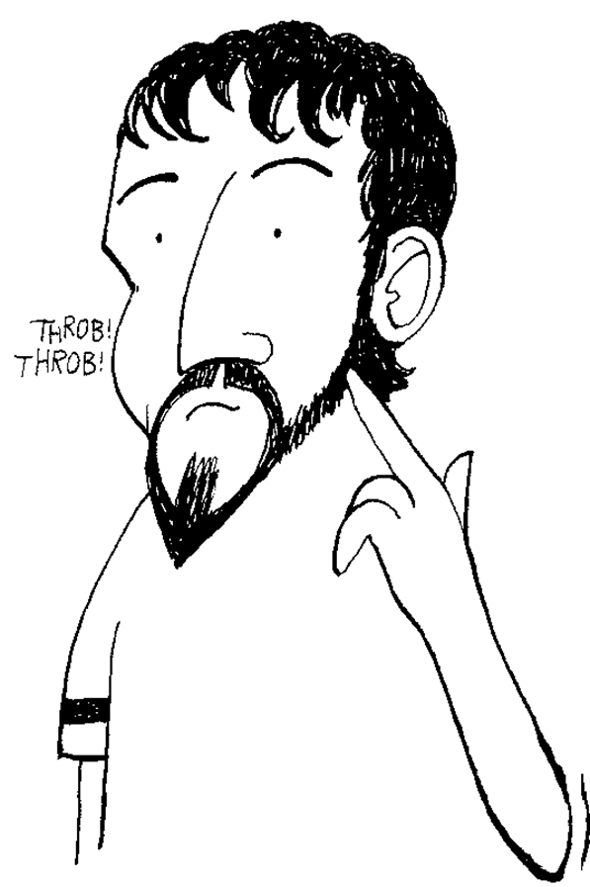
Turn the other cheek

Slide 8
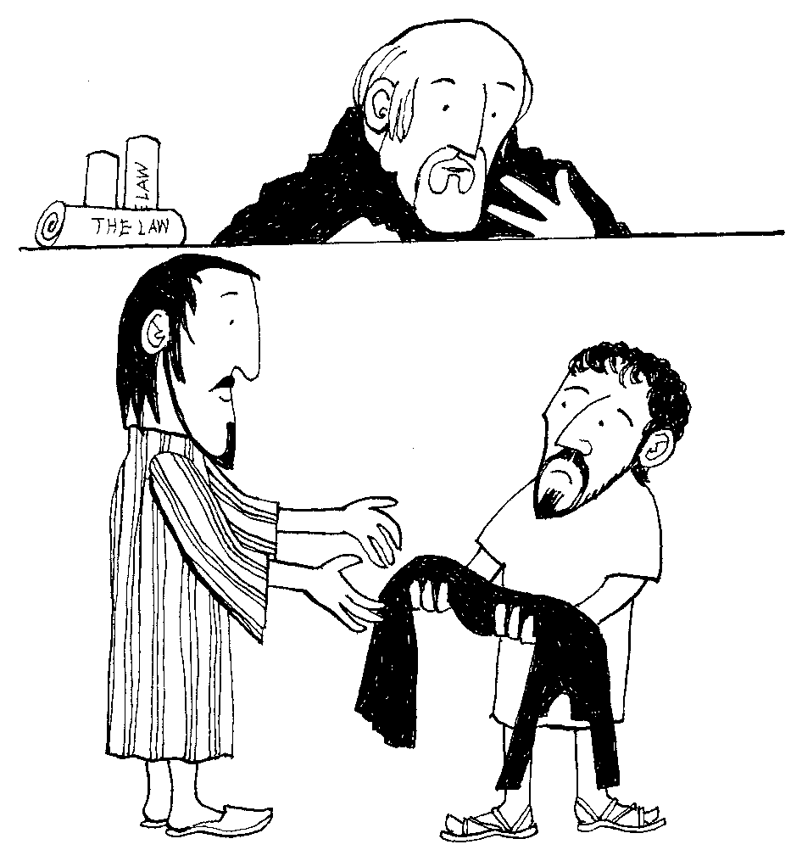
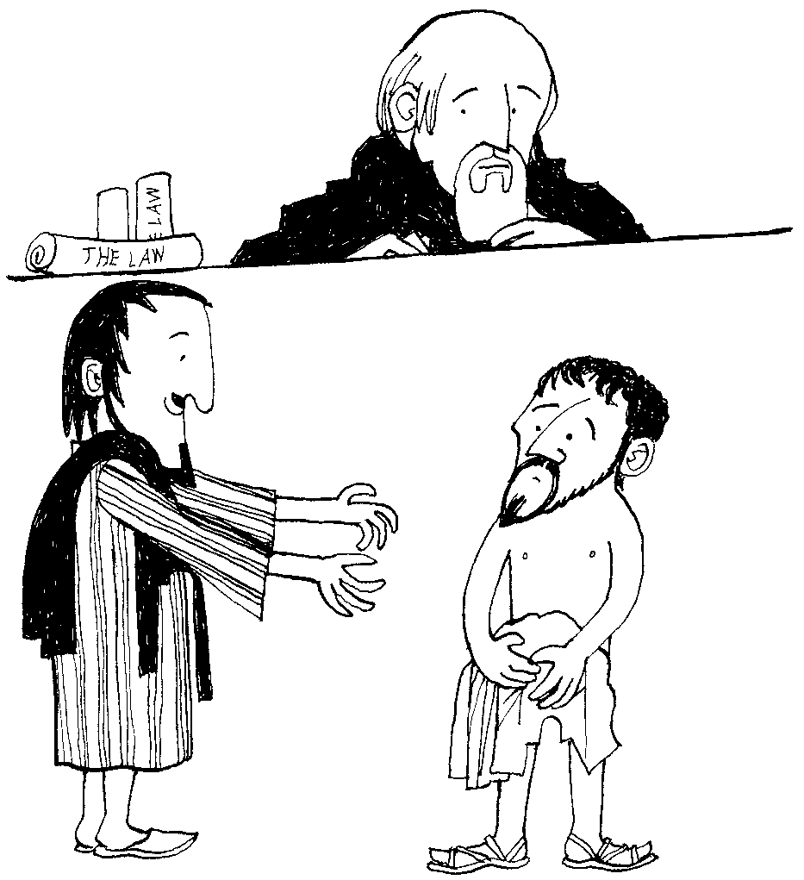
If anyone wants to sue you and take your shirt, hand over your coat as well

Slide 9
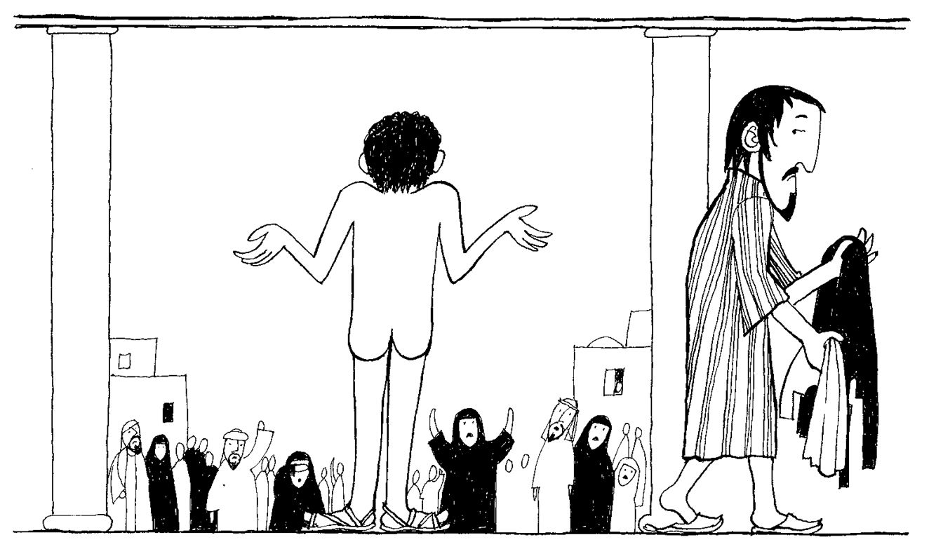

Slide 10
South Africa
Under the Apartheid regime, the authorities had been looking for a way to remove a shanty town.
One day, whilst the men and most of women were at work, the bailiffs moved in with the bulldozers.
They told the women who were still there that they had five minutes to gather up their possessions.
The women protested by stripping off their clothes.
The embarrassed bailiffs fled.

Slide 11
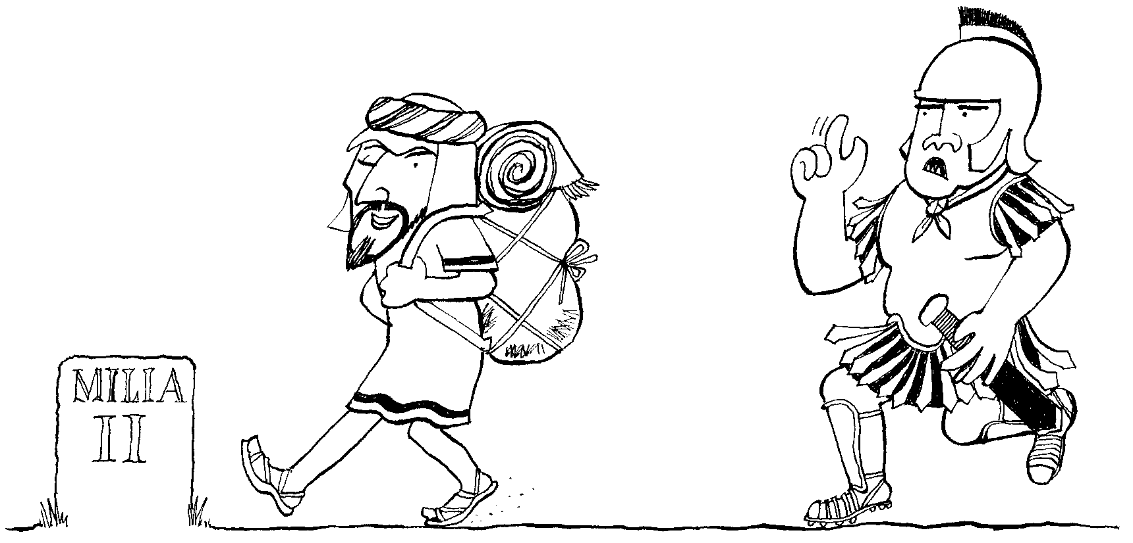
Walk the extra mile

Slide 12
Walk the extra mile
You are a Roman Soldier
By law, you can ask a Palestinian civilian to carry your pack (weighing approximately 70kg) for one mile.
After one mile you must take it back, otherwise you will face severe punishment.
How would you react to the person who insisted on carrying your pack that extra mile?

Slide 13
Next in Matthew’s gospel Jesus tells us…
⁴³You have heard that it was said, ‘you shall love your neighbour and hate your enemy.’ ⁴⁴But I say to you, Love your enemies and pray for those who persecute you, ⁴⁵so that you may be children of your Father in heaven.

Slide 14
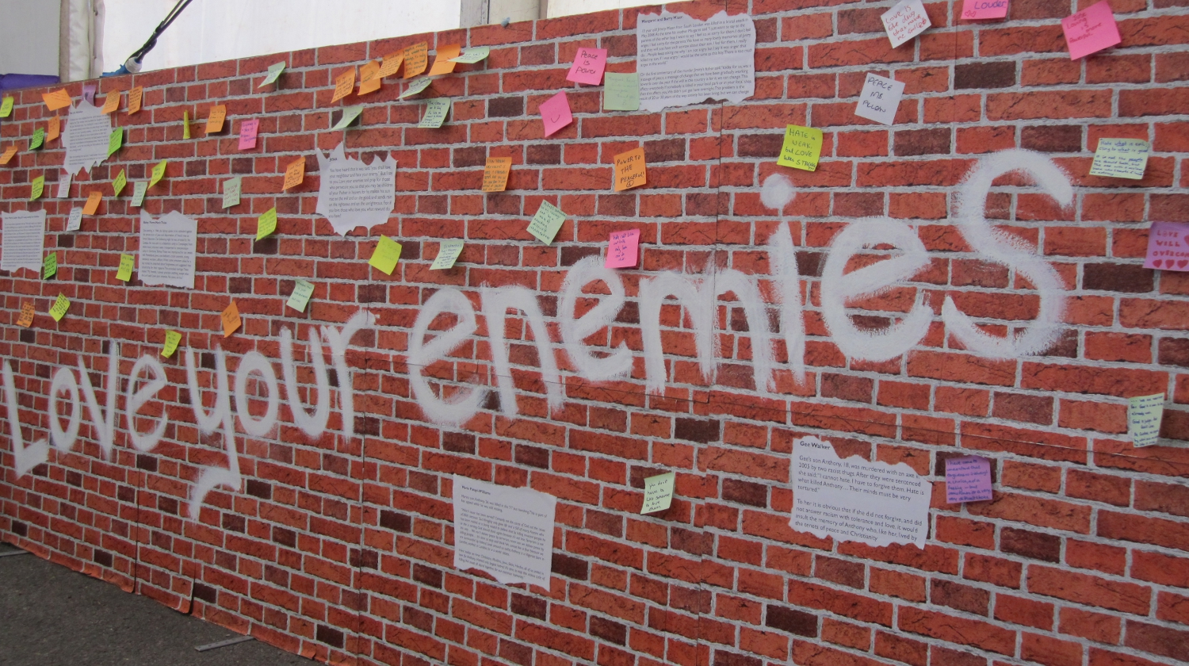
What does it mean to love your enemies?

Slide 15
Read the story carefully.
Add your own thoughts and reflections beneath it.
You will have three minutes with each story.

Slide 16




What are the messages of
Matthew 5:38-41 & 43-45
Look back at your thoughts on these passages at the start of the lesson. Has your opinion changed? Why/Why not?
What do these teachings tell us about how Christians should respond to conflict?

Slide 17
Lesson 1: A Christian Response
to Conflict
Credits
Animal Conflict Styles are from, Peacebuilding: a Caritas Training Manual, (Vatican City, Caritas Internationalis, 2002)
Photo of Walter Wink is from the Fellowship of Reconciliation USA and is used with permission through the Creative Commons Attribution-ShareAlike license
Illustrations of Turn the other cheek, Give them your cloak also, and Walk the extra mile are by David Rumsey
Scripture quotations are from the New Revised Standard Version
All other images and materials are by Pax Christi UK

