Slide 1
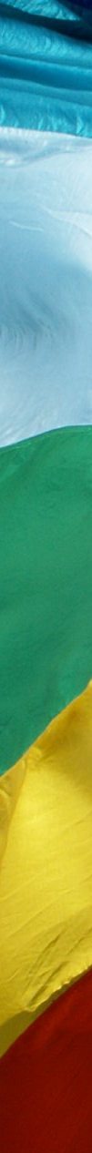

The work of
Christian Peacemaking
Lesson 4: Military Spending

Slide 2
How should the government spend its money?
What do you think are the most important things our government spends its money on?
In small groups look at the list of 24 and decide between you which 8 are the most important. You can also add your own ideas if they are not listed.

Slide 3
Now we need to agree as a class on a final list of eight priorities…

Slide 4
How would you spend
£40 billion?
Eight containers have been labelled with each of the spending priorities we have just decided upon.
You will be given four tokens – each one represents £10 billion – and you have to decide how to spend your money.

Slide 5
“Countries squander cash to boost their pride while millions starve. The money spent on arms is scandalous while schools, and homes, and hospitals remain unbuilt.”
(Pope Paul VI, Populorum Progressio #53)

Slide 6
“He shall judge between the nations, and shall arbitrate for many peoples; they shall beat their swords into ploughshares, and their spears into pruning hooks; nation shall not lift up sword against nation, neither shall they learn war any more.”
(Isaiah 2:4)

Slide 7
Finish the sentences
I used to think….
Now I think…

Slide 8
Lesson 4: Military Spending
Credits
Scripture quotations are from the New Revised Standard Version
All other images and materials are by Pax Christi UK

