Slide 1


The work of
Christian Peacemaking
Lesson 5: Christian Peace
Activism

Slide 3
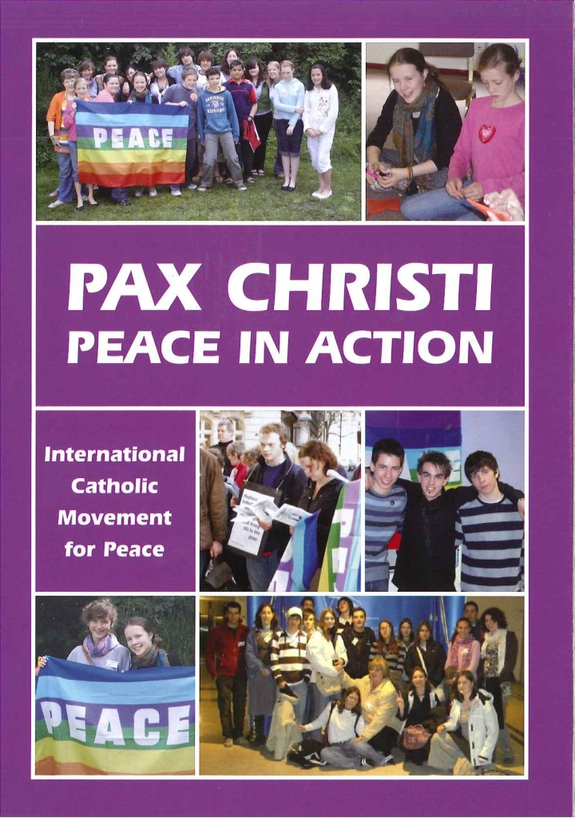
You have been given a copy of this pamphlet – a guide to the work of Pax Christi.
You have 5 minutes to familiarise yourselves with the content before they will be collected and there will be a quiz about what you have read.

Slide 4
The Quiz

Slide 5

Question 1
What does the Latin phrase Pax Christi mean?

Slide 6
Question 2
In what year was Pax Christi founded?

Slide 7
Question 3
Pax Christi believes in peace based on … what?

Slide 8
Question 4
Name three issues about which Pax Christi campaigns

Slide 9
Question 5
Pax Christi’s three principal values are Peace, Nonviolence, and … what?

Slide 10
Question 6
In what year did the Pope give official recognition to Pax Christi’s work?

Slide 11
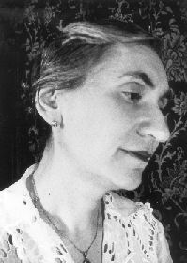
Question 7
Who is this?

Slide 12
Question 8
“Movements like yours are precious. They help draw attention to the violence which shatters the harmony between human beings which is at the heart of Creation.”
Who said this about Pax Christi?

Slide 13
The Quiz
Answers

Slide 14
Question 1
What does the Latin phrase Pax Christi mean?
The Peace of Christ

Slide 15
Question 2
In what year was Pax Christi founded?
1945

Slide 16
Question 3
Pax Christi believes in peace based on … what?
Justice

Slide 17
Question 4
Name three issues about which Pax Christi campaigns
Israel and Palestine
The Arms Trade
Nuclear Weapons

Slide 18
Question 5
Pax Christi’s three principal values are Peace, Nonviolence, and … what?
Reconciliation

Slide 19
Question 6
In what year did the Pope give official recognition to Pax Christi’s work?
1952

Slide 20
Question 7
Who is this?
Marthe Dortel-Claudot

Slide 21
Question 8
“Movements like yours are precious. They help draw attention to the violence which shatters the harmony between human beings which is at the heart of Creation.”
Who said this about Pax Christi?
Pope John Paul II

Slide 22
Pax Christi is one of many Christian organisations working for peace. We will now go on to look at some of the campaigning activities that Christians do as they strive to build peace.

Slide 23
You will be given information on six types of action Christians may take in their work for peace. For each strategy you should complete a connect-extend-challenge sheet

Slide 24
How does this connect to what you already know?
How has it extended your knowledge?
What are you still finding challenging?
You should also note the advantages and disadvantages of each approach.

Slide 25
Next week you will be designing their own campaigning action. Now you need to decide:
Who will you work with?
In these groups: Select one issue of injustice which you particularly care about. This could be one of the issues examined in this course or some other local, national or global issue.

Slide 26
Next week: You will be getting on and planning your campaigning action.

Slide 27
Lesson 5: Christian Peace
Activism
Credits
Kairos Britain logo is from the Kairos Britain Network of which Pax Chirsti is a member www.kairosbritain.org.uk
Image of the Iraq War demonstration is used with permission under the terms of the Creative Commons Attribution-ShareAlike license
Scripture quotations are from the New Revised Standard Version
All other images and materials are by Pax Christi UK

