Slide 1
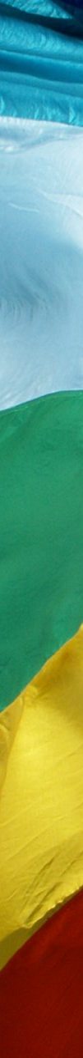

World Peace Day 2015
No longer slaves, but brothers and sisters

Slide 2
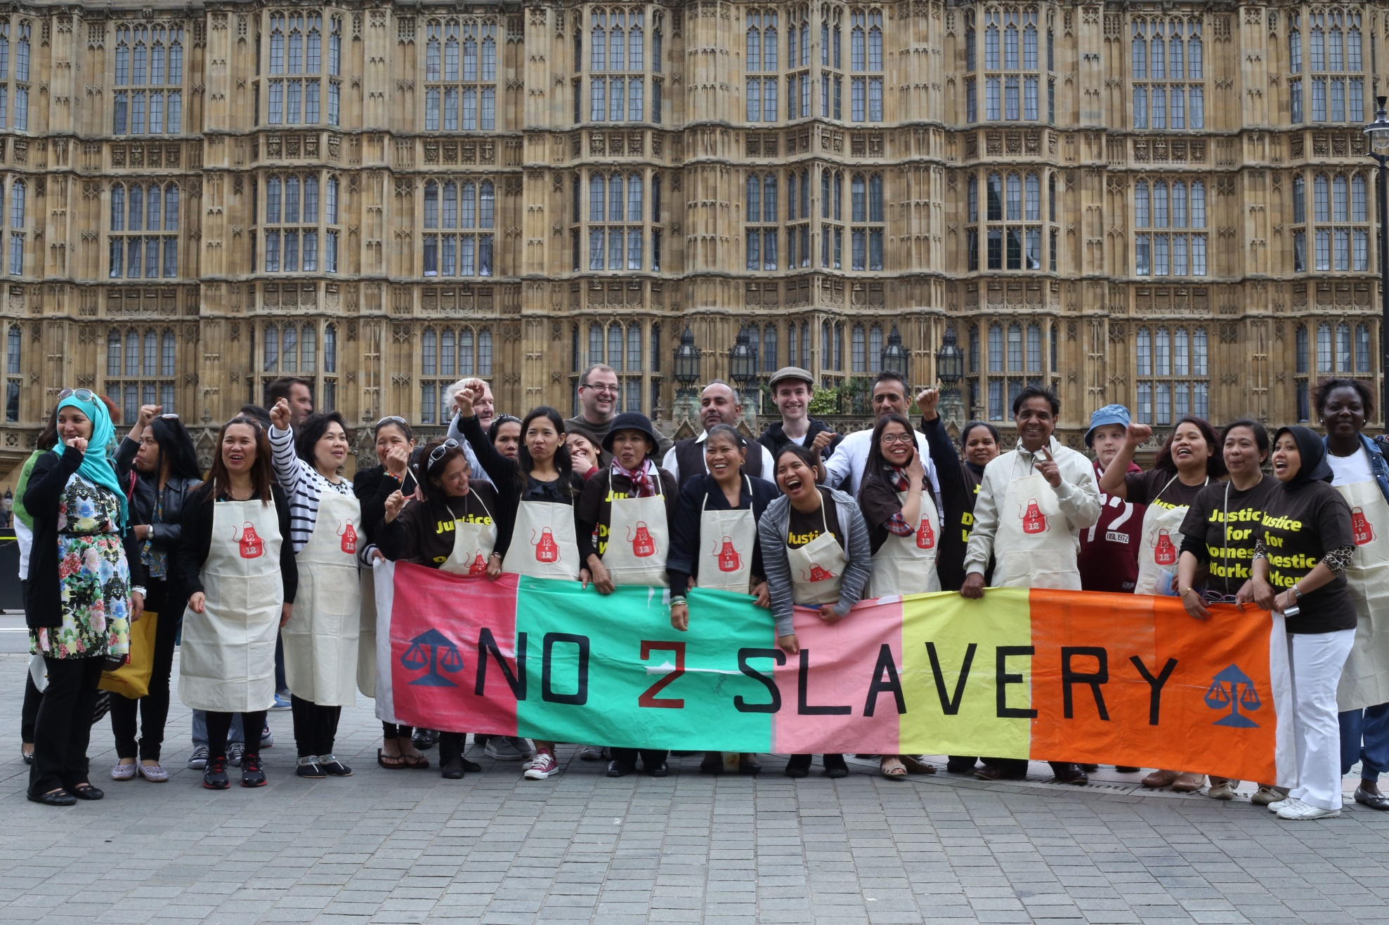
Notes:
Introduction
We might think that slavery is a thing of the past, a problem ended in the British Empire through the efforts of William Wilberforce and long since driven from the plantations and factories producing our food and goods.
Yet in recent years we have begun to see new forms of slavery; child soldiers in many foreign wars, and, more shocking still, people trafficked for domestic service, sexual exploitation, and the drugs trade hidden in our own communities.
What all slavery has in common is a lack of respect for the God given dignity of each person.

Slide 3
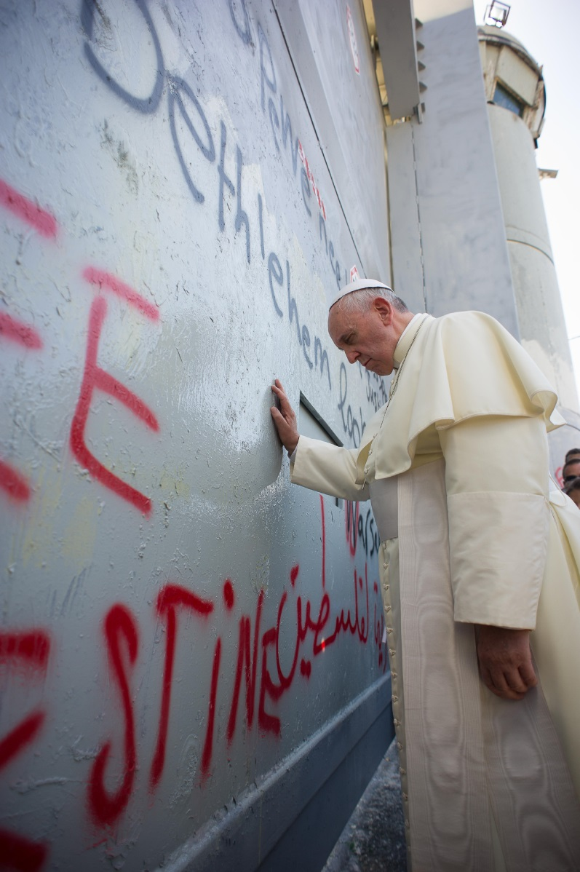
Prayer of Pope Francis
Lord, God of Abraham,
God of the prophets, God of love,
You created us and you call us to live as brothers and sisters.
Give us the strength daily to be instruments of peace.
Enable us to see everyone who crosses our path as our brother or sister.
Amen
Notes:
Opening Prayer (of Pope Francis)
Lord, God of Abraham,
God of the prophets, God of love,
You created us and you call us to live as brothers and sisters.
Give us the strength daily to be instruments of peace.
Enable us to see everyone who crosses our path as our brother or sister.
Amen

Slide 4
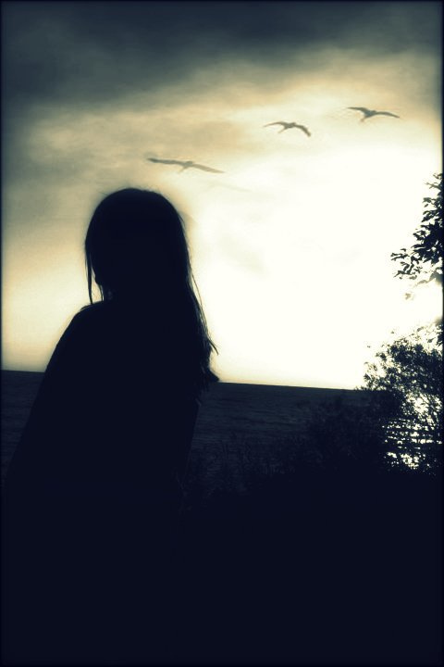
Sophie’s Story
Notes:
Sophie’s Story
Two years ago everything changed. I was trafficked. I was fooled. I was deceived by a man who said that he loved me. The tragedy is that I believed him. Now I know that love is not shown by forcing me to work on the streets, beating me up, force feeding me and turning me into someone with no mind of my own. I had become like a frightened rabbit. I was terrified that he would kill me. Death too often felt like my only way to escape.
People are product.
I was one of them.
But I am a survivor.
I have a new life but I am haunted by the faces of those who used me, those whom I did not choose, those for whom I was nothing more than a ten-minute thing.

Slide 5
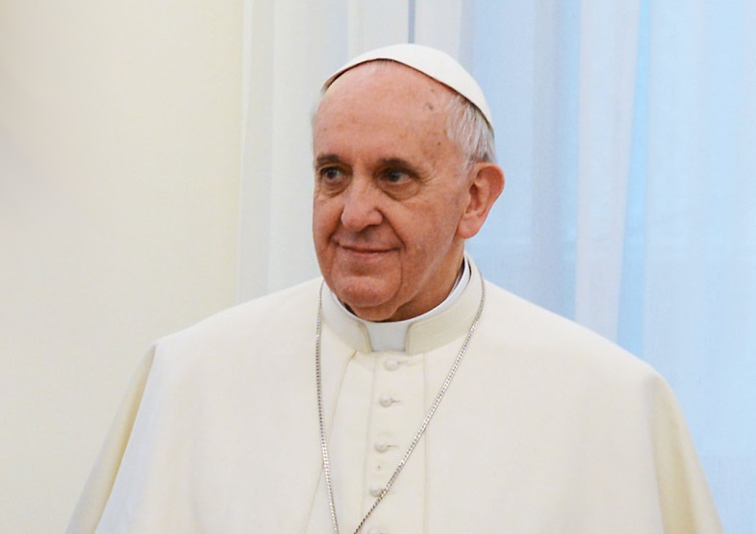
Pope Francis’s Message
for World Peace Day

Slide 6
…yet millions are deprived of their freedom and live in conditions akin to slavery.
Slavery today is seen as a crime against humanity...
Notes:
Slavery today is seen as a crime against humanity.
Yet millions of people – children, men, and women of all ages – are deprived of freedom and forced to live in conditions akin to slavery.

Slide 7

Workers... forced to labour, poorly paid, endangered
Notes:
Workers who are forced to labour, poorly paid, endangered

Slide 8
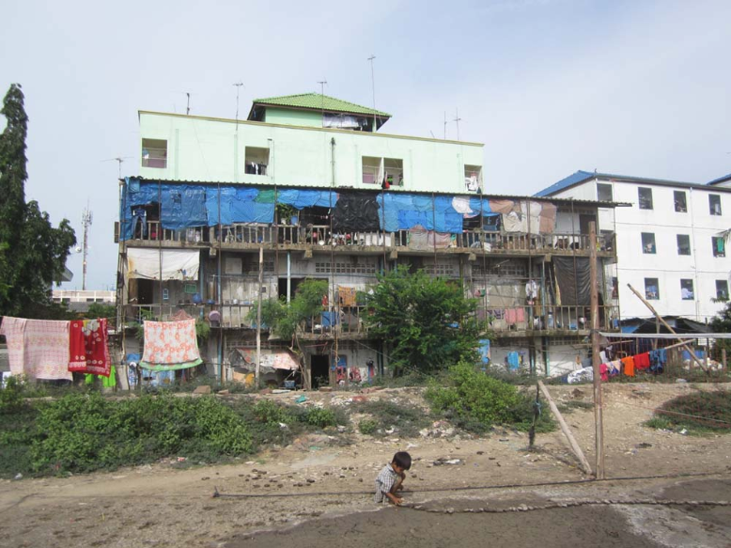
Migrants… living and working in inhumane conditions
Notes:
Migrants who are forced to live and work in inhumane conditions

Slide 9
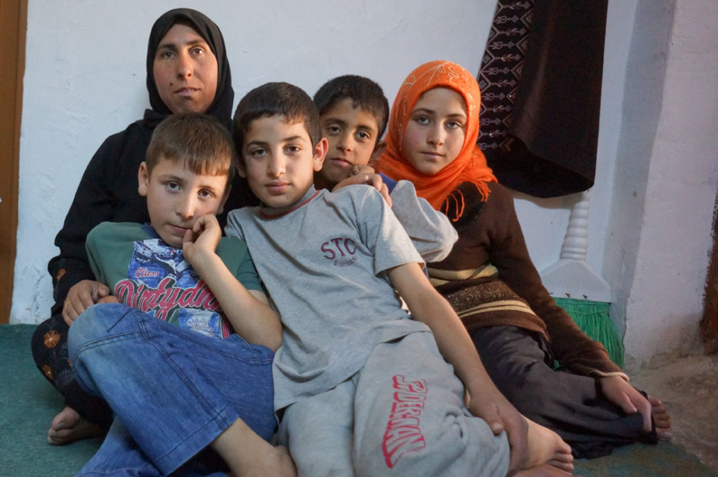
Asylum seekers… robbed of their freedom and dignity
Notes:
Asylum seekers – abused on their journey, imprisoned on arrival: robbed of their freedom and dignity

Slide 10

Women forced into prostitution
Notes:
Women forced into prostitution

Slide 11
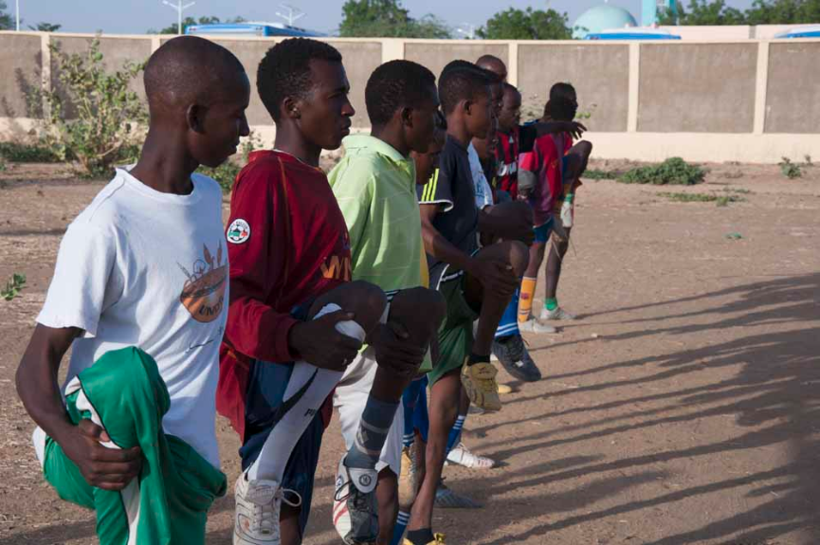
Children as soldiers
Notes:
Children as soldiers

Slide 12
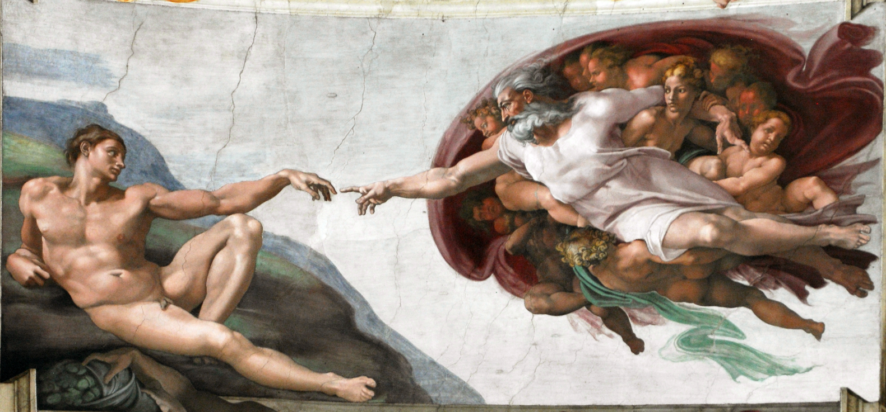
Slavery is rooted in the idea that people can be treated as an object. A means to an end.
Not as human beings created in the image and likeness of God
Notes:
Slavery is rooted in the idea that people can be treated as an object. A means to an end
Not as human beings created in the image and likeness of God

Slide 13
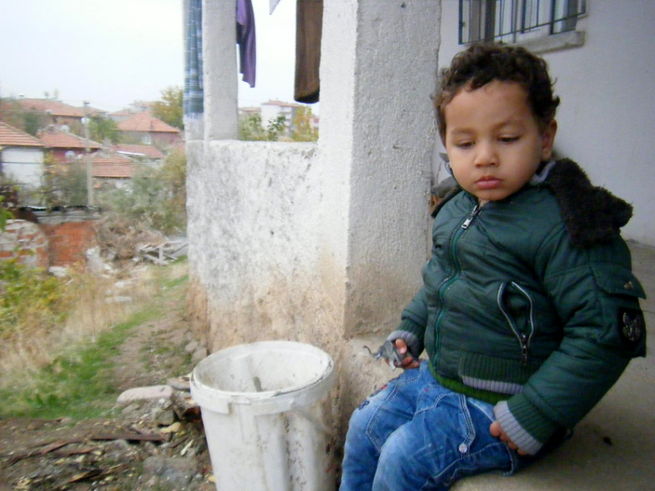
Let us not be indifferent to their suffering
Notes:
Let us not be indifferent to their suffering
In your own lives, as a community, let us stand in solidarity with victims of slavery
When we meet people who could be victims of human trafficking.
When we are tempted to buy cheap clothes, technology, which may have been produced through exploitation.

Slide 14
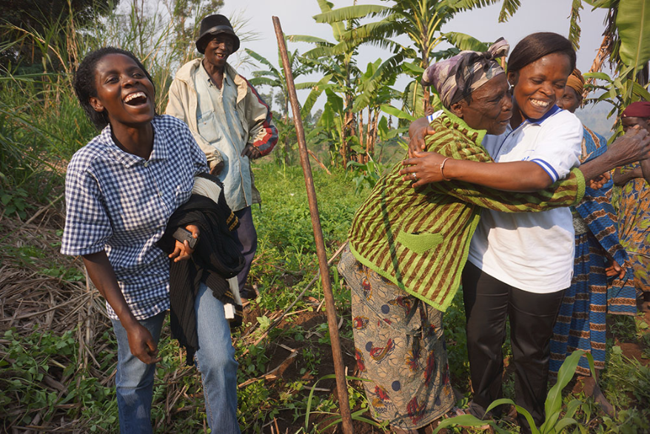
A kind word, a greeting, and a smile cost nothing but can offer hope, open doors, and transform lives.
Notes:
A kind word, a greeting, and a smile cost nothing but can offer hope, open doors, and transform lives.
I appeal to all people of good will: Do not turn away from the suffering of our brothers and sisters

Slide 15
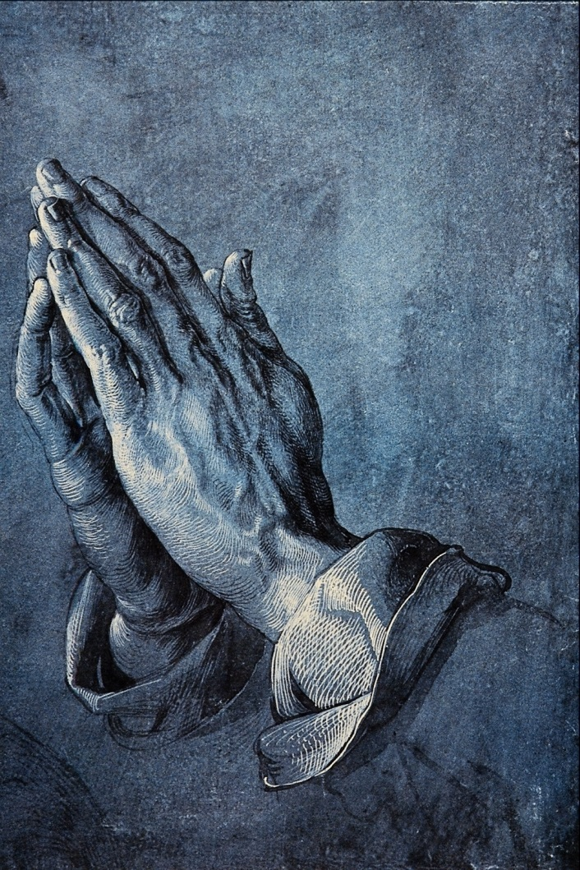
Bidding prayers
We pray for victims of modern slavery; those denied their rights, for those denied a voice.
Lord in your mercy… Hear our prayer
Notes:
We pray for victims of modern slavery; those denied their rights, for those denied a voice.
Lord in your mercy… Hear our prayer

Slide 16
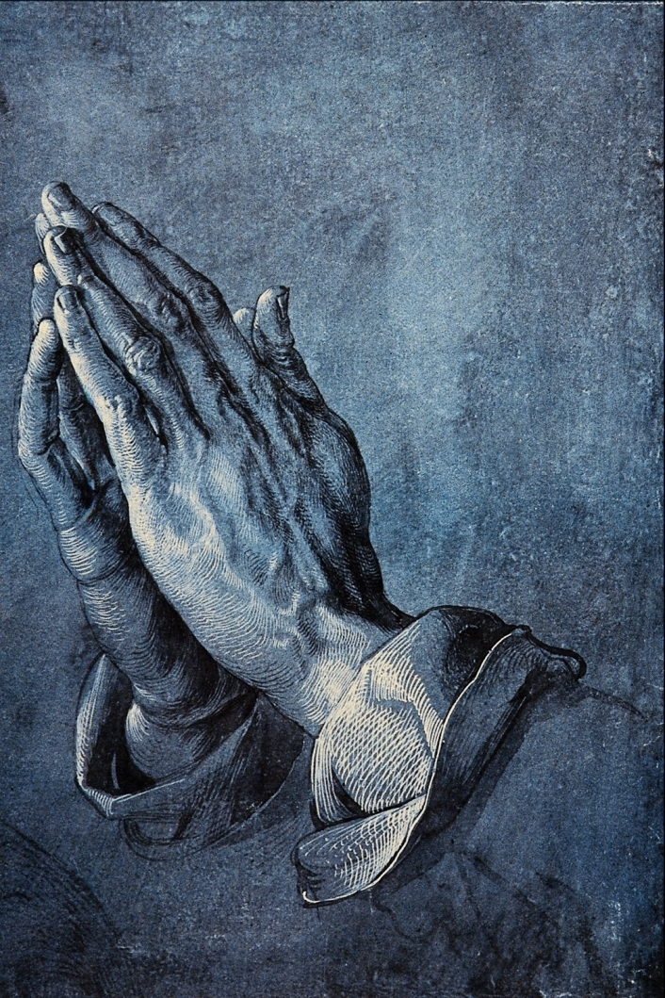
Bidding prayers
We pray for those working to oppose exploitation; those who welcome asylum seekers, support victims of trafficking, and combat criminal gangs exploiting people’s desperation.
Lord in your mercy… Hear our prayer
Notes:
We pray for those working to oppose exploitation; those who welcome asylum seekers, support victims of trafficking, and combat criminal gangs exploiting people’s desperation.
Lord in your mercy… Hear our prayer

Slide 17
Bidding prayers
We pray for ourselves; as we recognise all people as brothers and sisters may we be inspired in our own work for justice and peace.
Lord in your mercy… Hear our prayer
Notes:
We pray for ourselves; as we recognise all people as brothers and sisters may we be inspired in our own work for justice and peace.
Lord in your mercy… Hear our prayer

Slide 18
Bidding prayers
Let us pray together that prayer which reminds us that we are all beloved children of God…
Our Father, who art in heaven...
Notes:
Let us pray together that prayer which reminds us that we are all beloved children of God…
Our Father, who art in heaven...

Slide 19
Give us courage Lord, to stand up and be counted;
to stand up for those who cannot do it for themselves;
to stand up for ourselves when needed to do so.
Let us fear nothing more than we fear you.
Let us love nothing more than we love you.
Let us have no other God before you, whether party, state, or church.
Let us seek no other peace except the peace which is yours,
and make us your instruments, your eyes, ears, and arms.
So that we should always know what work of peace and love you call us to do for you.
Amen
Notes:
Give us courage Lord, to stand up and be counted;
to stand up for those who cannot do it for themselves;
to stand up for ourselves when needed to do so.
Let us fear nothing more than we fear you.
Let us love nothing more than we love you.
Let us have no other God before you,
whether party, state, or church.
Let us seek no other peace except the peace which is yours,
and make us your instruments, your eyes, ears, and arms.
So that we should always know what work of peace and love you call us to do for you.
Amen

Slide 20
World Peace Day 2015
No longer slaves, but brothers and sisters

Slide 21
Credits
Sophie’s Story is from Stop the Traffik www.stopthetraffik.org/
The reflection on Pope Francis’s message for World Peace Day is adapted from w2.vatican.va/content/francesco/en/messages/peace/documents/papa-francesco_20141208_messaggio-xlviii-giornata-mondiale-pace-2015.html
Concluding prayer is from Action by Christians Against Torture www.acatuk.org.uk/
Images from JRS (http://en.jrs.net) and Pax Christi. Others images are in the public domain.

