Slide 1
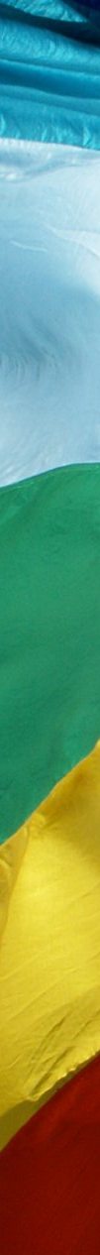
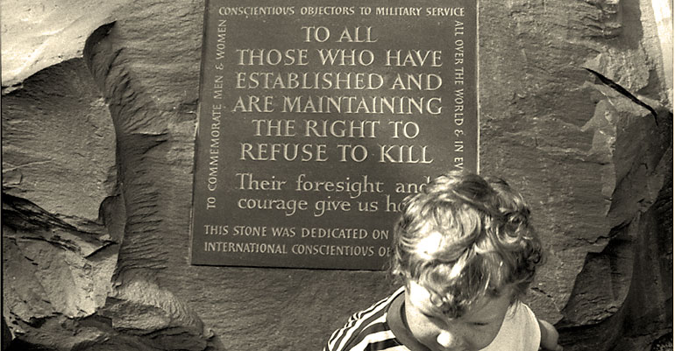

International Conscientious Objectors’ Day

Slide 2
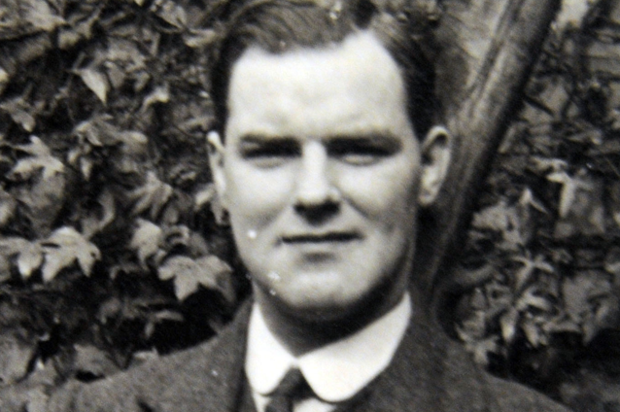
Bert Brocklesby

Slide 3
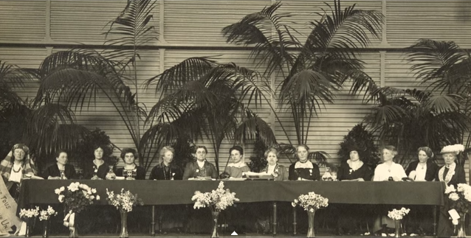
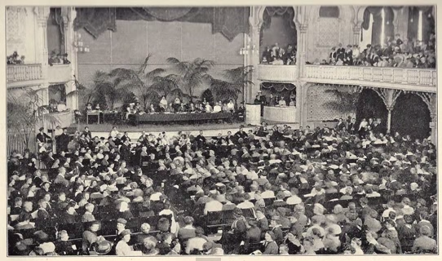

Slide 4
Heavenly Father, you have endowed us with the wonderful gifts of reason and free will. Help us to use these in distinguishing between good and evil in today’s world.
Remind us that the only obedience required of us is to your Word, however unpopular the consequences may be.
We ask this through Christ our Lord
Amen

Slide 5

International Congress of Women
The Hague, 1915

Slide 6
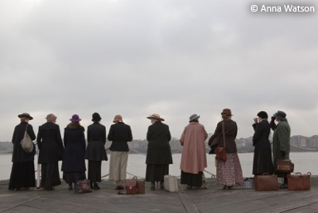
The women wait at Tilbury for ships that do not arrive
(filmed re-enactment)

Slide 7
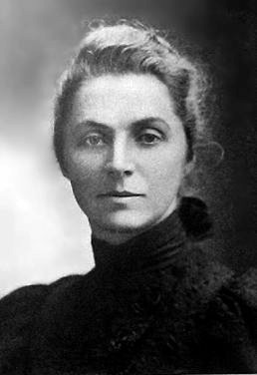
The brunt of modern war falls upon non-combatants, and the conscience of the world cannot bear the sight…
Do not humanity and common sense alike prompt us to join hands with the women of neutral countries, and urge our rulers to stay further bloodshed?
Emily Hobhouse

Slide 8

We women, in International Congress assembled, protest against the madness and the horror of war, involving as It does a reckless sacrifice of human life and the destruction of so much that humanity has laboured through centuries to build up.

Slide 9

What is heroic is when people come together to save the planet… If we really want to transform the world we need to reclaim peace…
“Nobody changes the world alone. We need to come together” reiterates Nobel Peace Laureate Jody Williams
From the WILPF centenary conference, 2015

Slide 10

Violence is not inevitable. It is a choice. We choose non-violence, as means and as end. We will liberate the strength of women and, in partnership with likeminded men, bring to birth a just and harmonious world.
We will implement peace, which we believe to be a human right.

Slide 11
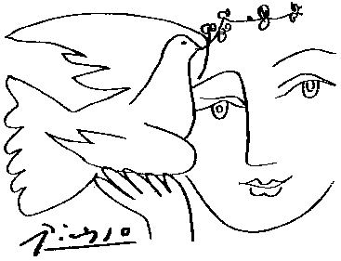
Bidding prayers
The women gathered in The Hague protested against the madness and horror of war…. may we be people of peace, speaking out against violence in all of its forms.
Lord in your mercy… Hear our prayer
Notes:
We pray for victims of modern slavery; those denied their rights, for those denied a voice.
Lord in your mercy… Hear our prayer

Slide 12
Bidding prayers
The women in the Hague saw international co-operation and understanding as crucial to the building of a lasting peace… may we be people of peace, willing to listen to those we disagree with.
Lord in your mercy… Hear our prayer
Notes:
We pray for those working to oppose exploitation; those who welcome asylum seekers, support victims of trafficking, and combat criminal gangs exploiting people’s desperation.
Lord in your mercy… Hear our prayer

Slide 13
Bidding prayers
The women gathered at The Hague were determined to do their bit to build a just and lasting peace… may we be people of peace, giving our time and energy willingly to help others.
Lord in your mercy… Hear our prayer
Notes:
We pray for ourselves; as we recognise all people as brothers and sisters may we be inspired in our own work for justice and peace.
Lord in your mercy… Hear our prayer

Slide 14
And we pray as Jesus taught us…
Our Father, who art in heaven...
Notes:
Let us pray together that prayer which reminds us that we are all beloved children of God…
Our Father, who art in heaven...

Slide 15
Lord, you are the Prince of Peace,
you are the light of the world.
In you we find peace,
and in the doing of your will is our peace.
Grant us your peace in our hearts,
and may this peace go out from us to inspire others.
Fill us with a passion for righteousness
and a zeal to serve where there is need.
Fill us with a purpose that is holy, and right, and just.
Amen
Notes:
Let us pray together that prayer which reminds us that we are all beloved children of God…
Our Father, who art in heaven...

Slide 16
International Conscientious Objectors’ Day

