Slide 1

The Work
of Pax Christi
How does Pax Christi work to create world peace?

Slide 2
Think…
Work in pairs to decide if you think the following statement is true.
What evidence can you think of to support your answer….?
Christians should work for peace.

Slide 3
In this lesson we are going to look at the work of one Christian organisation which believes that work for peace is fundamental to life as a Christian.

Slide 4
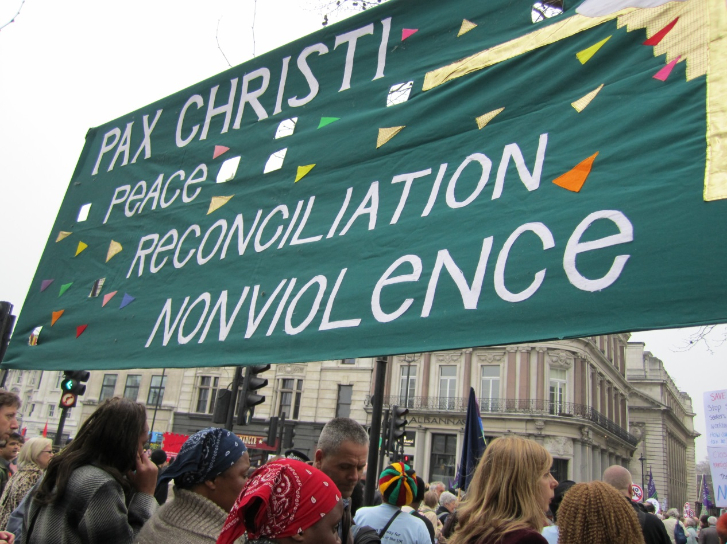
Pax Christi
Peace In Action

Slide 5
What is Pax Christi?
Watch the following slideshow.
There will be a quiz at the end to test how much you can recall.
play

Slide 6

The Beginnings
Pax Christi – The Peace of Christ - was founded by Catholic Christians in France in 1945 to promote reconciliation with the German people after the Second World War.

Slide 7
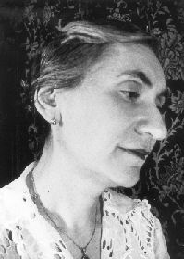
The inspiration for Pax Christi came from two people…
Marthe Dortel-Claudot, a schoolteacher, who began a campaign of prayer for reconciliation and peace.

Slide 8
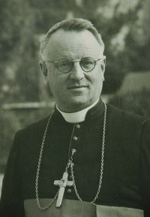
The inspiration for Pax Christi came from two people…
Bishop Pierre-Marie Théas, bishop of Montauban in the South of France, who had spent time in prison during the war for protesting against the Nazis.

Slide 9
Marthe and Bishop Théas met in March 1945
and Pax Christi was established.

Slide 10
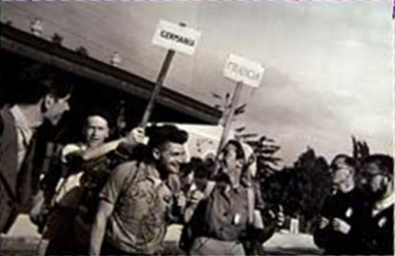
Peace Walks were an important part of the early work of Pax Christi.
It was recognised that meeting people in other countries was vital if they wanted to build a peaceful Europe.

Slide 11
1958
Inspired by their experiences on these peace walks a group of young people set up a Pax Christi group in London – the beginning of Pax Christi UK.

Slide 12
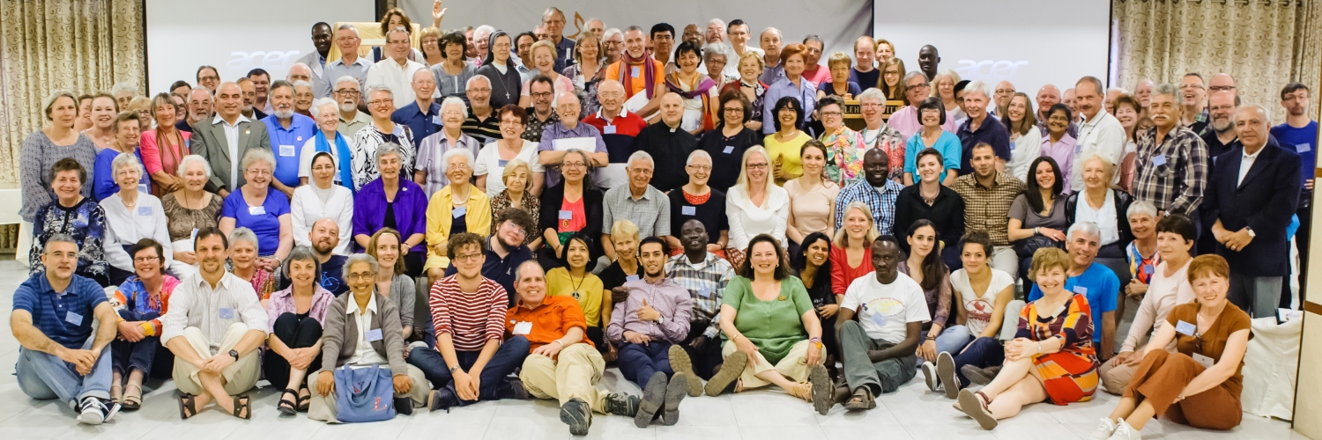
2015
As Pax Christi celebrated its 70th birthday there were over 100 Pax Christi organisations in 59 countries around the world.

Slide 13
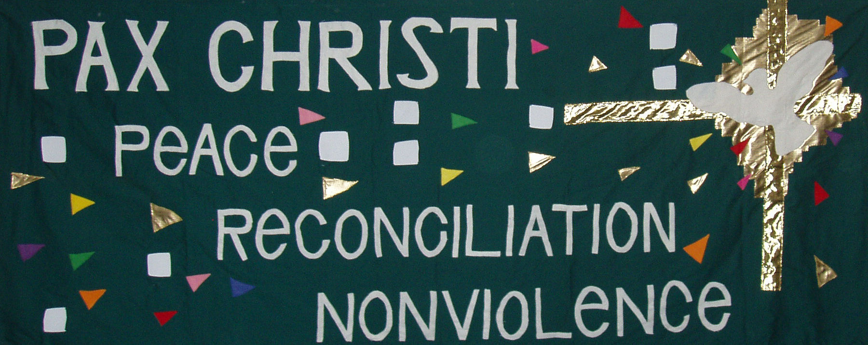
Vision and Values
Pax Christi’s vision is for a world where people can live in peace, free from the fear of violence in any form.
Peace - Reconciliation - Nonviolence

Slide 14
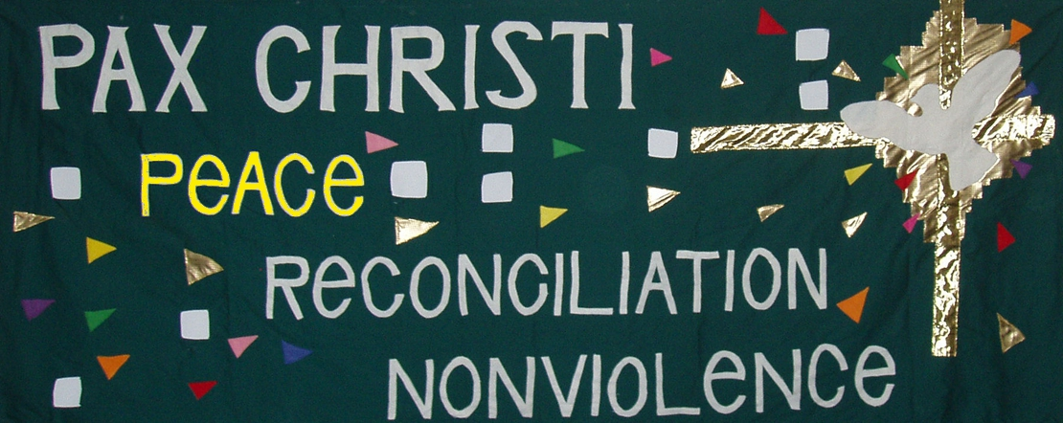
Peace
A world where human rights are respected
Where basic needs are met
Where people feel safe and valued.

Slide 15
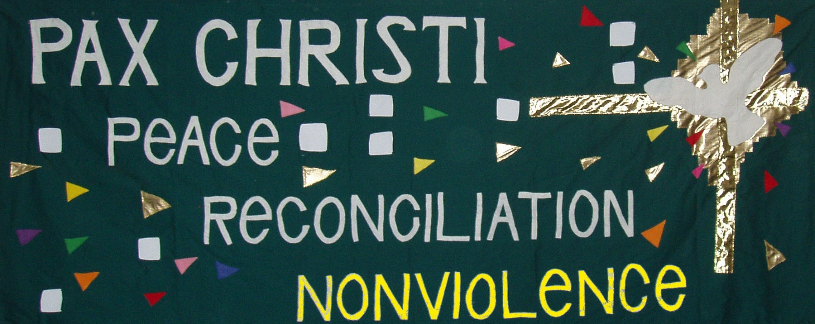
Nonviolence
Respects the lives of others
Challenges what is not fair or just
Offers alternatives to violence and war.

Slide 16
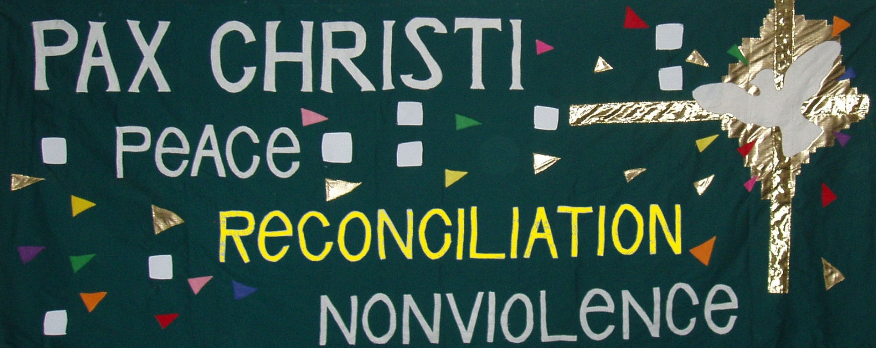
Reconciliation
Mends damaged relationships.

Slide 17
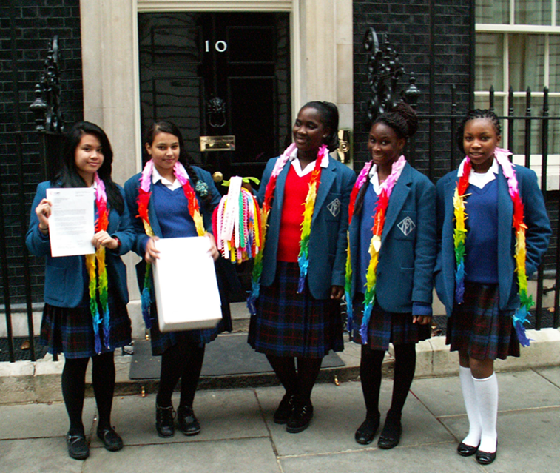
Pax Christi People
People join Pax Christi because they believe that Christians should work towards an end to war and violence and find better ways of resolving conflicts.

Slide 18
Members draw strength and encouragement from the Bible and the teachings of the Catholic Church.

Slide 19
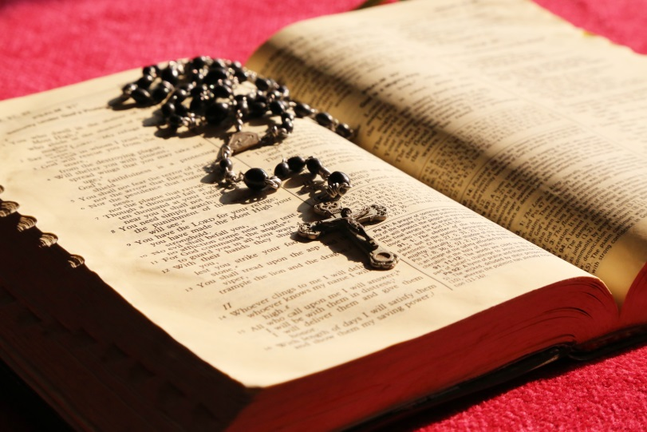
My friends, what good is it for someone to say they have faith if their actions do not prove it?
James 2: 14
Seek peace, and pursue it.
Psalm 34: 14
Blessed are the peacemakers, for they will be called children of God.
Matthew 5: 9

Slide 20
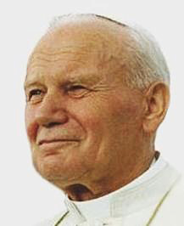
“Movements like yours are precious. They help draw people’s attention to the violence which shatters the harmony between human beings which is at the heart of creation.”
Pope John Paul II to Pax Christi International

Slide 21
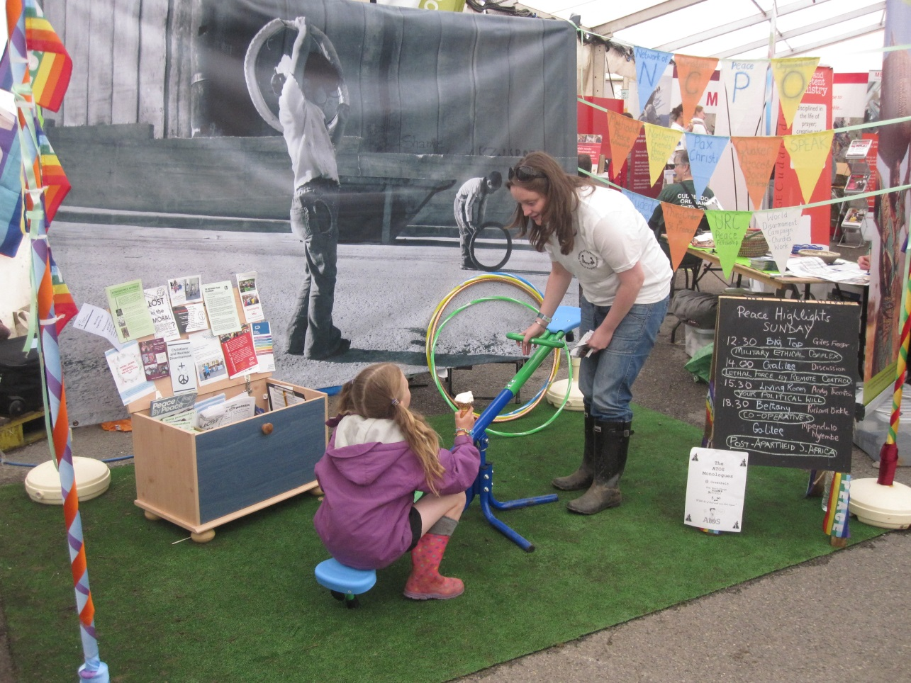
“Peace is the fruit of anxious daily care to see that everyone lives in the justice that God intends.”
Populorum Progressio #76

Slide 22
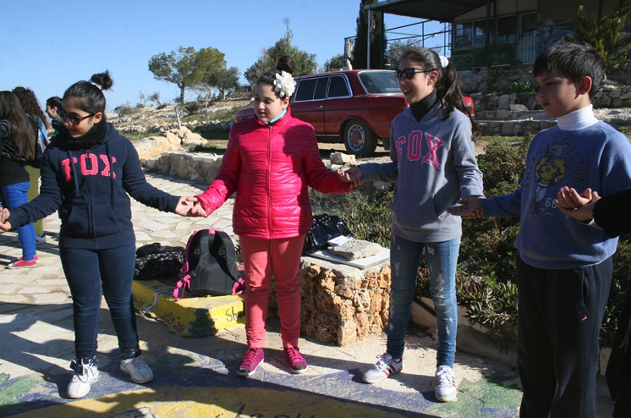
“Peace remains an empty word unless it is translated into social structures which rest on truth and justice, on freedom and love.”
Pacem in Terris #167

Slide 23
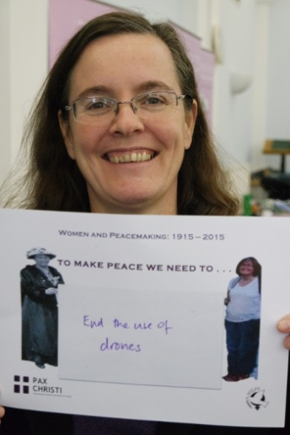
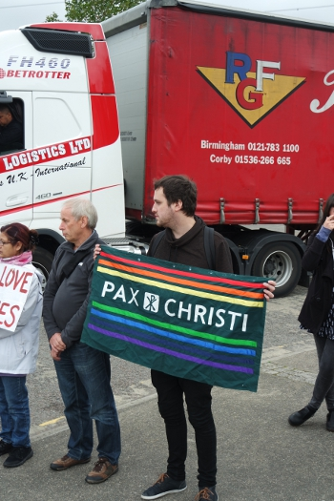
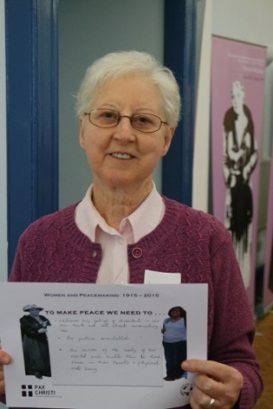
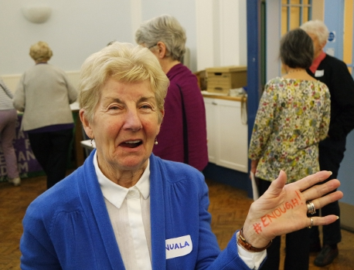
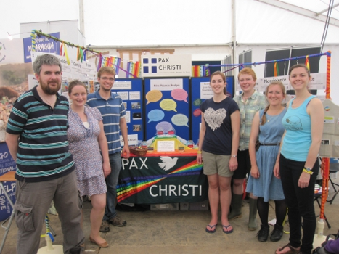
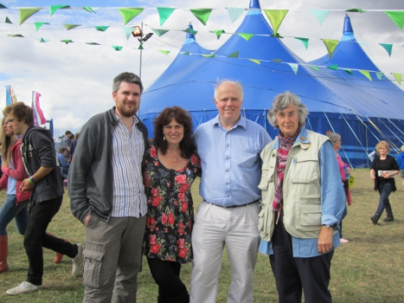
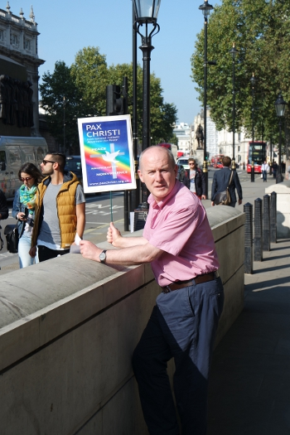
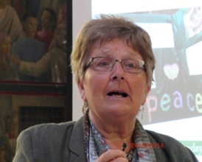
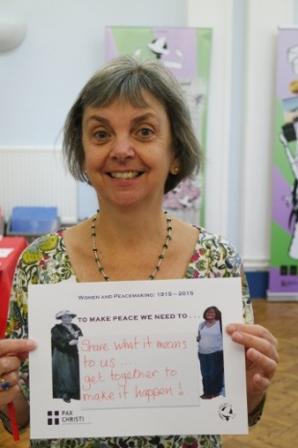
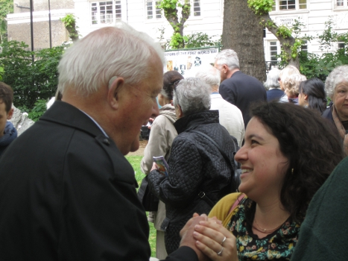
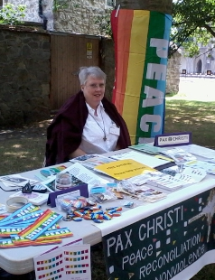
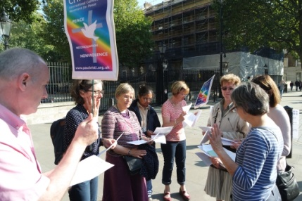
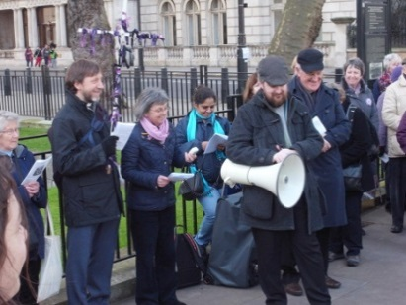
Inspired by the teachings of Christ and the church, Pax Christi members work tirelessly for peace in their homes and families, their communities and places of work, and in the wider world.

Slide 24
You now have 3 minutes to complete the quiz.
Play Again
Answers

Slide 25
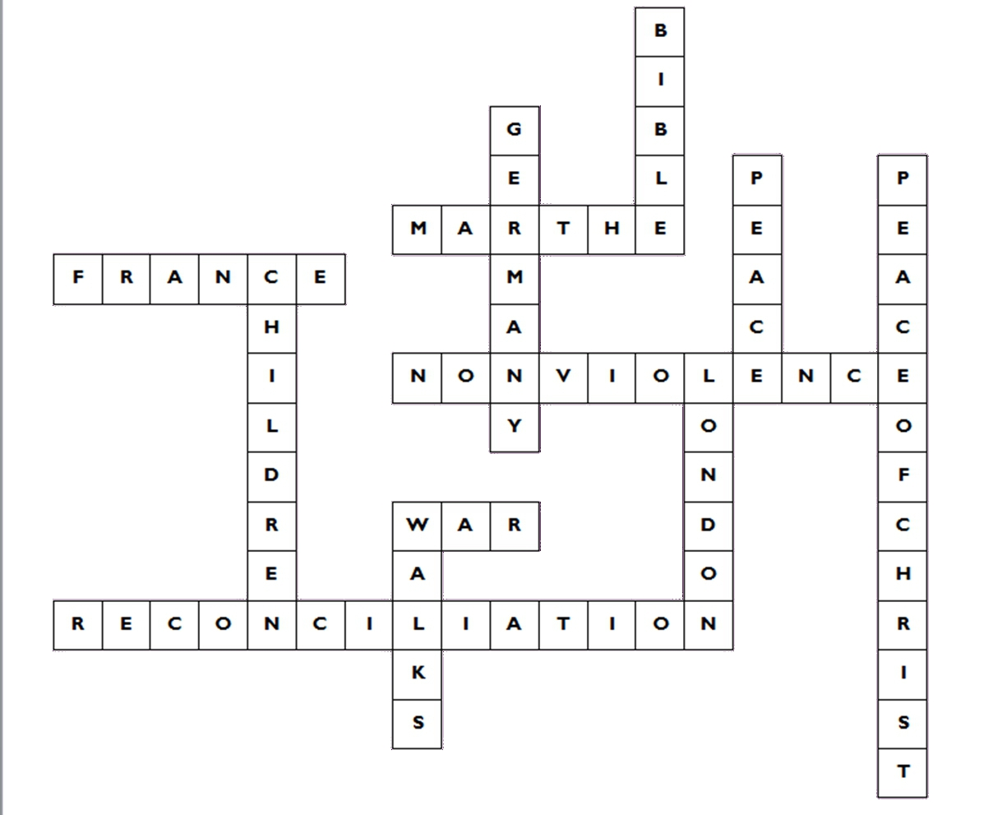

Slide 26
How does Pax Christi
work for peace?
We are now going to take a closer look at the ways in which Pax Christi works for peace by looking at the work of four Pax Christi members, Kate, Chris, Ann, and Christopher.

Slide 27
How does Pax Christi
work for peace?
Looking at the stories of Chris, Ann, Kate, and Christopher…
What do they do for peace?
What is their motivation?
What are the risks involved?
What do they hope to achieve?
Do you think they will be successful?
Is there anything more would you want to know?

Slide 28
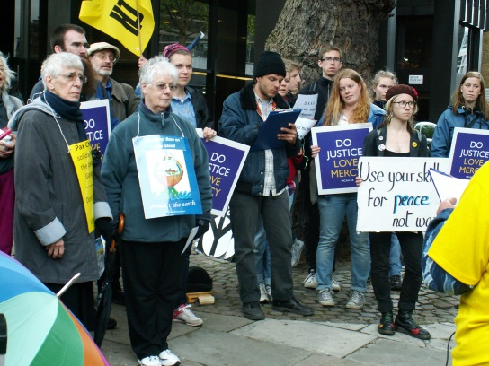
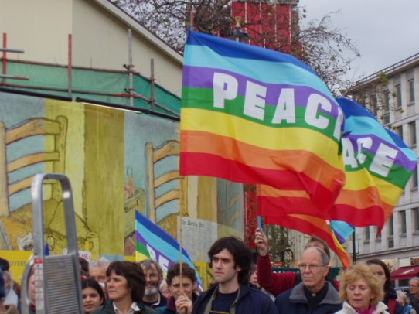
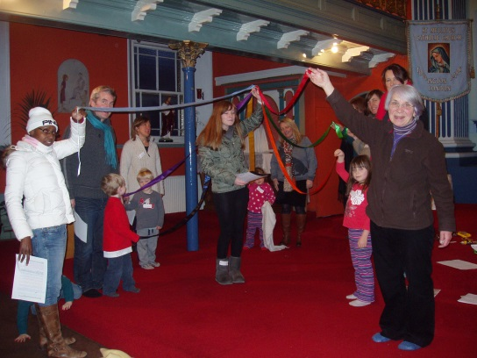
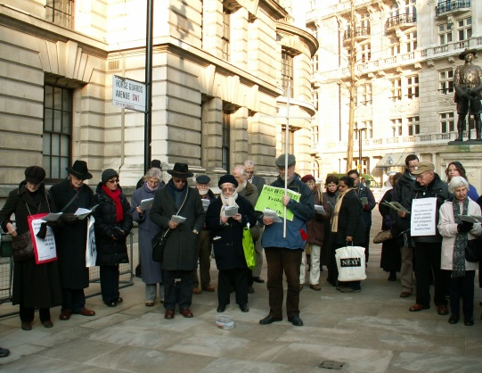
How Pax Christi works
for peace
Campaigning
Solidarity
Education
Prayer

Slide 29
What do you think is the most important area of Pax Christi’s work and why?
Campaigning
Solidarity
Education
Prayer

Slide 30
Putting peace into action since 1945
More information
www.paxchristi.org.uk
www.paxchristi.net
Twitter: @paxchristiuk
Peace - Reconciliation - Nonviolence

