Slide 1

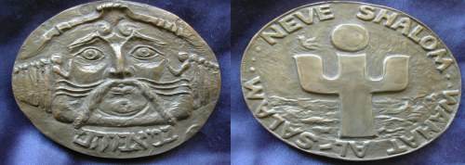
In praise of Peace People
The first Peace Award medal –
depicting spirit of Neve Shalom- Wahat al Salam

Slide 2
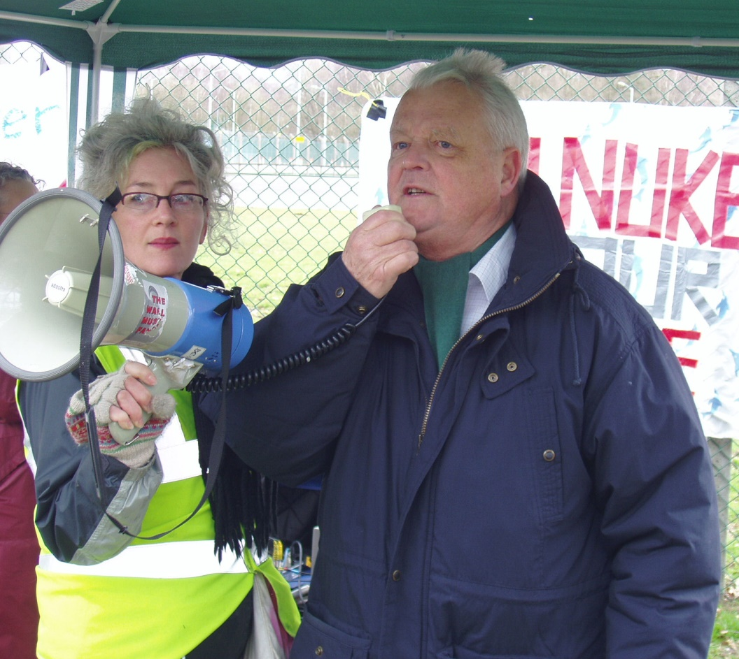
Bruce Kent
2001

Slide 3
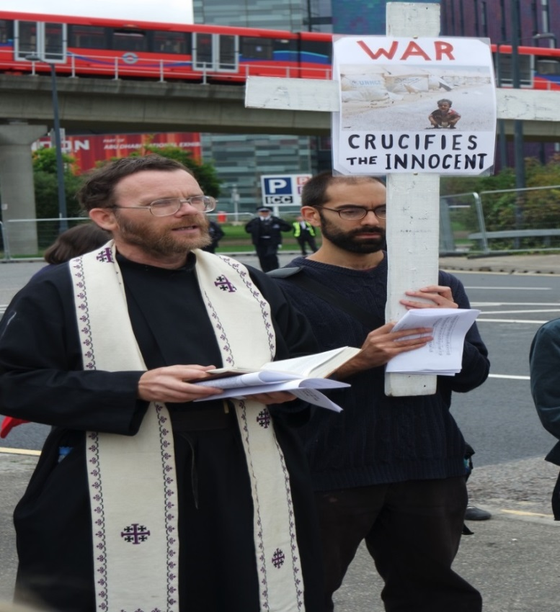
Martin Newell
2001

Slide 4
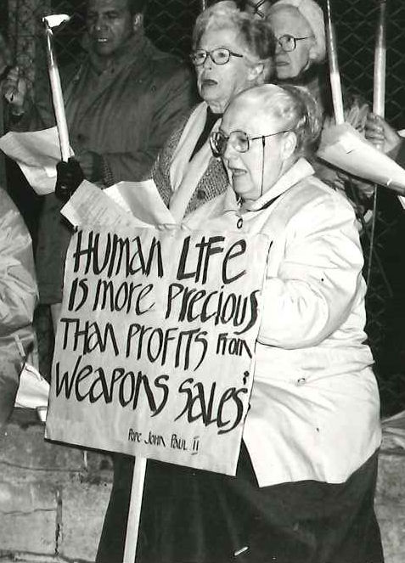
Doreen Evered
2001

Slide 5
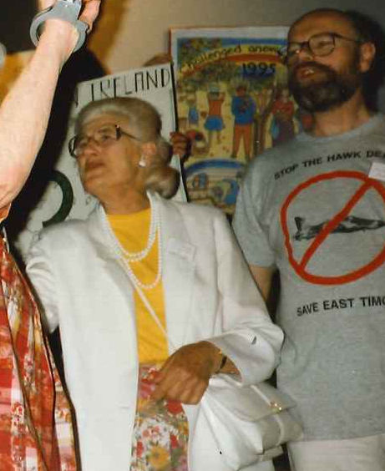
Mary Thompson
2001

Slide 6
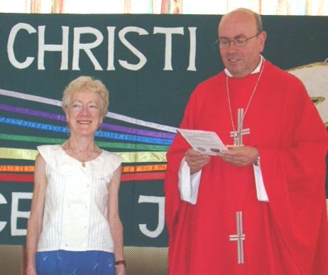
Clare Edwards
2003

Slide 7
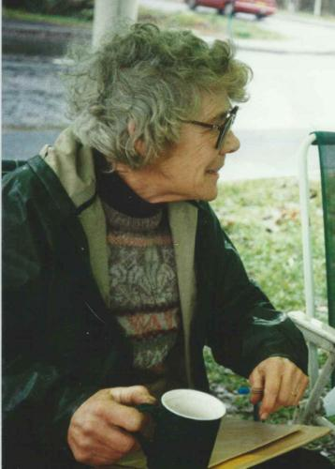
Jean Kaye
2003

Slide 8
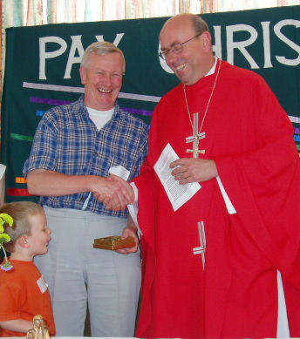
Mark James
2003

Slide 9
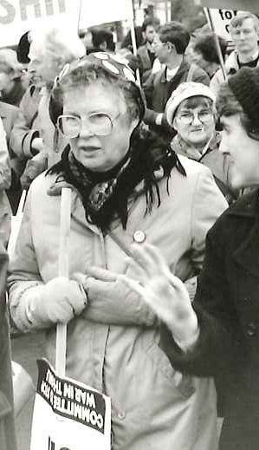
Margot Hutchinson
2005

Slide 10
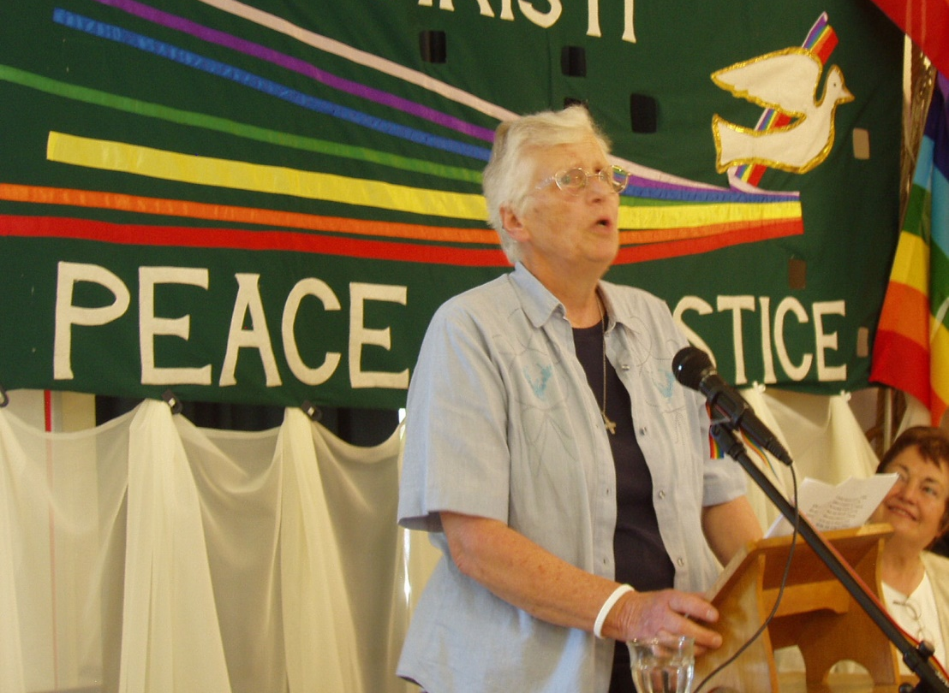
Sr Pat Robb
2005

Slide 11
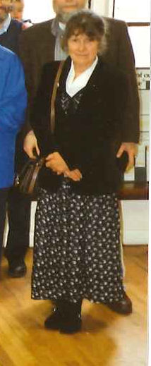
Judith Dawes
2005

Slide 12
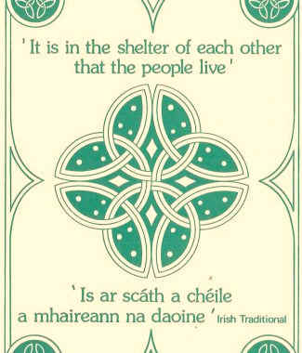
Tom Mallon
Northern Ireland community building and play schemes -
Protestant & Catholic encounter
2007

Slide 13
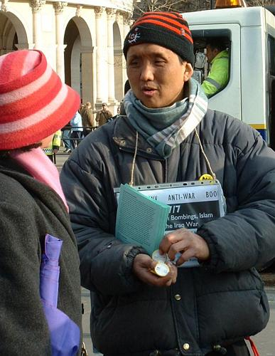
Milan Rai
2007

Slide 14
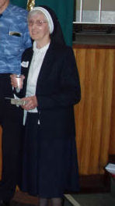
Sister Lelia Newman O.P.
2007

Slide 15
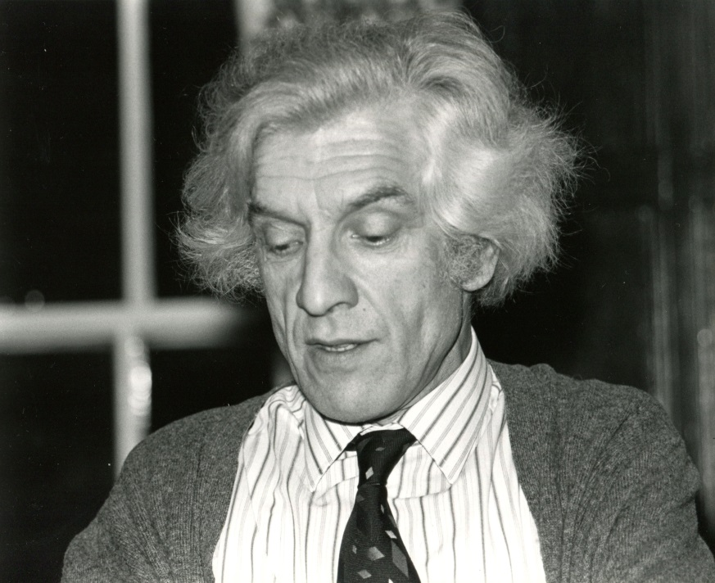
Brian Wicker
2007

Slide 16
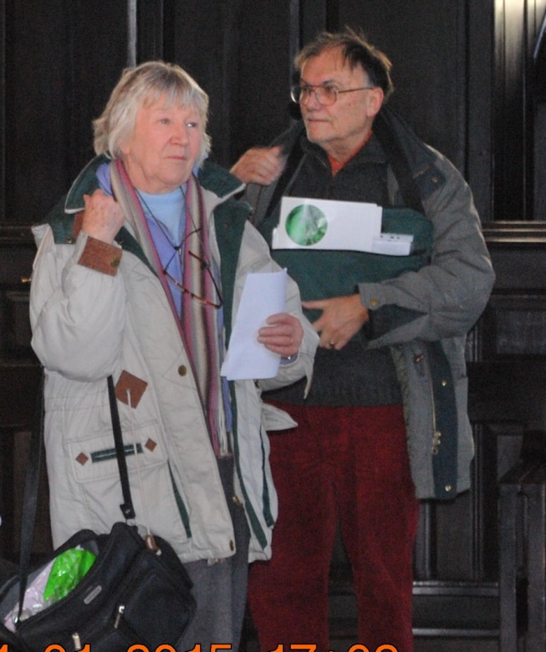
Patricia & Michael Pulham
2007

Slide 17
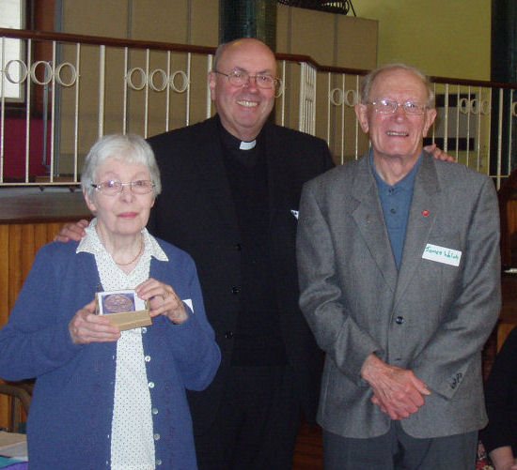
James & Marjorie Welch
2009

Slide 18
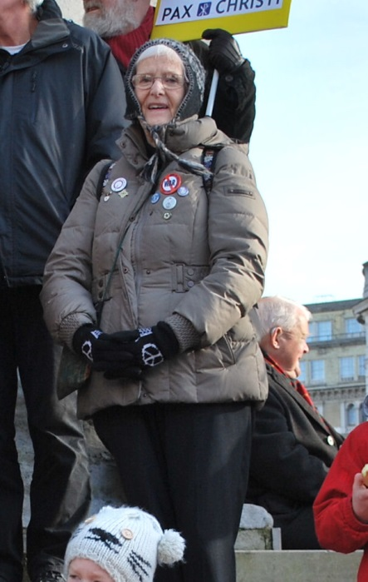
Alison Williams
2013

Slide 19
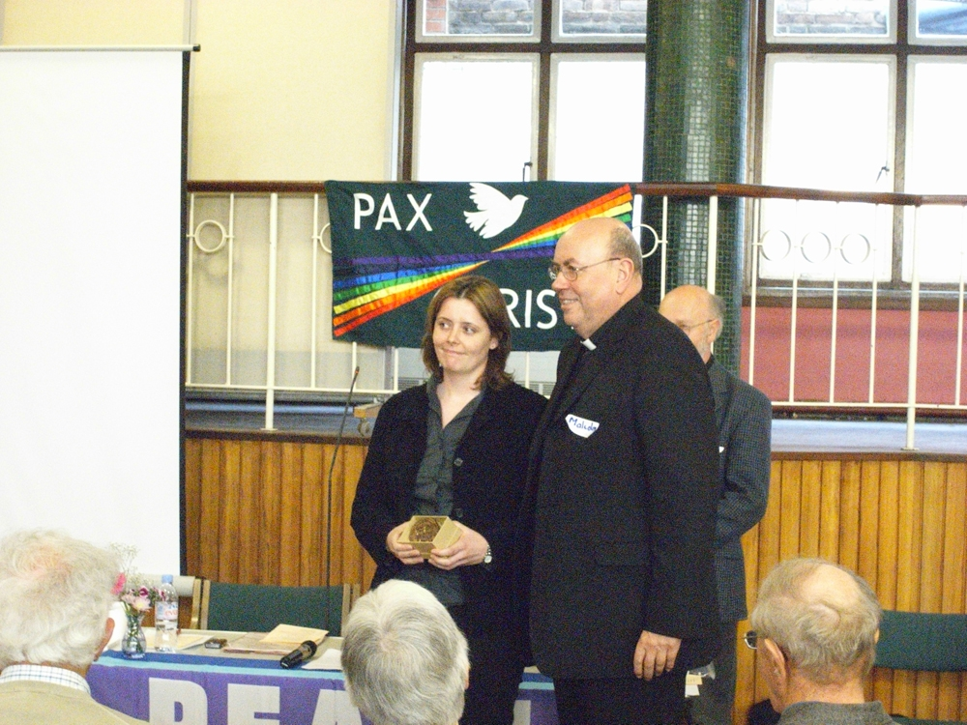
Rachel Kane
2009

Slide 20
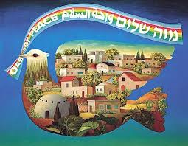
Theresa & Hans Kohen
Support for Neve Shalom:
Wahat al Salaam / Oasis of Peace
Committed to work for peace and Christian Jewish encounter
2009

Slide 21
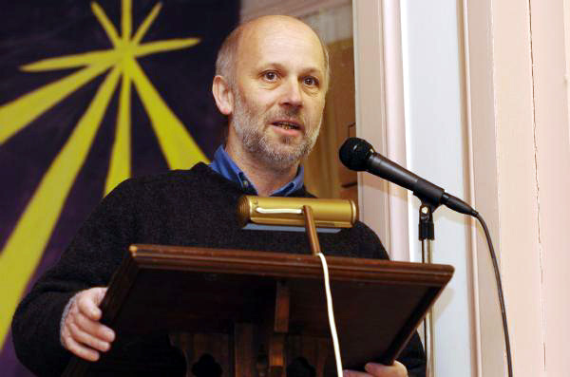
Dave Webb
2011

Slide 22
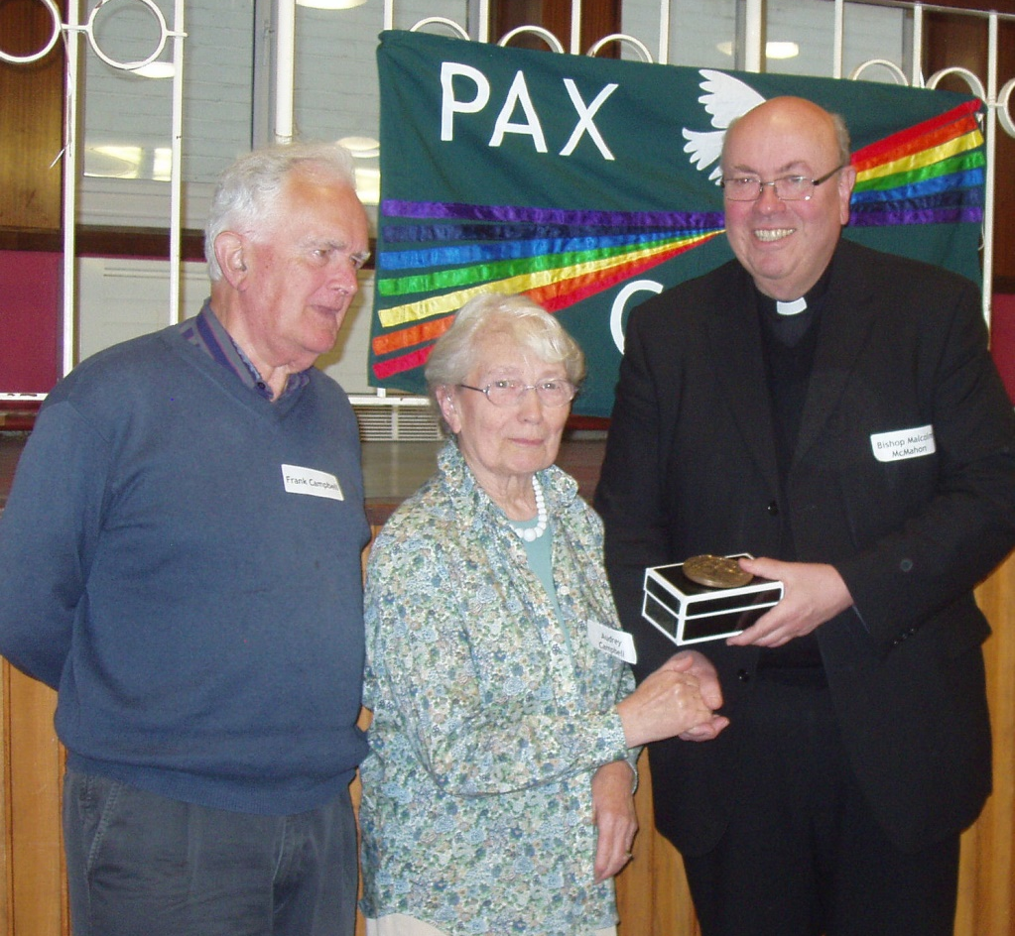
Audrey & Frank Campbell
2011

Slide 23
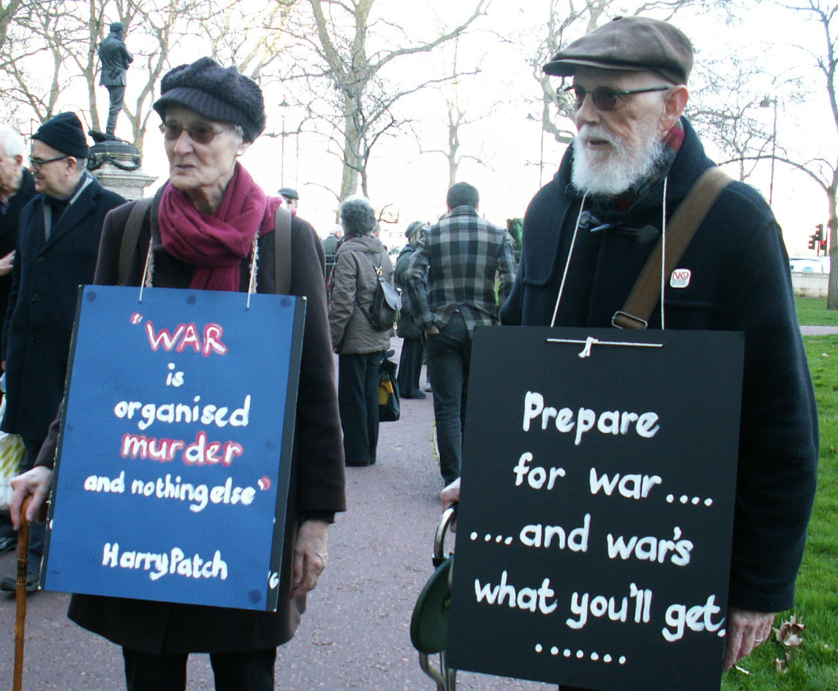
Stewart & Anne Hemsley
2013

Slide 24
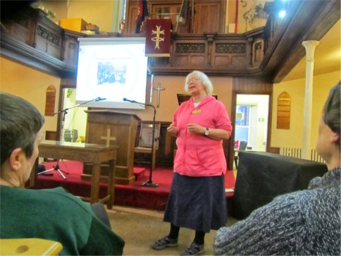
Susan Clarkson
2013

Slide 25
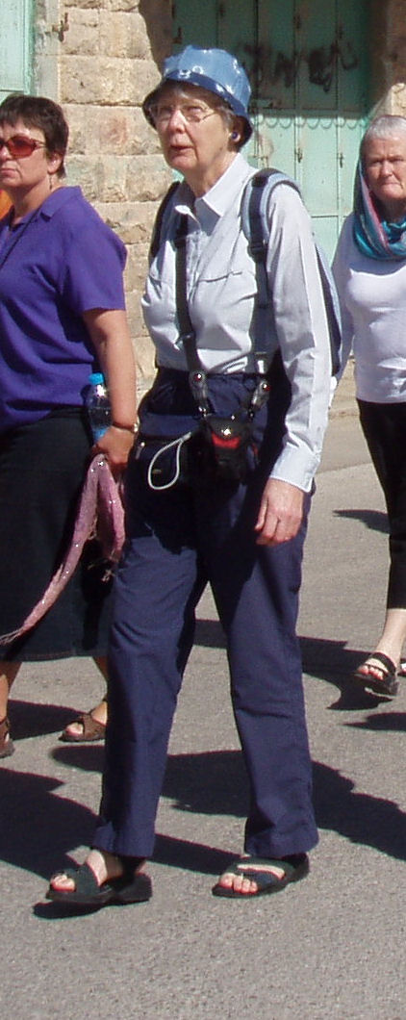
Sue Scott
2015

Slide 26
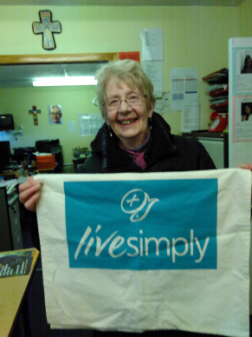
Sheila Gallagher
2015

Slide 27
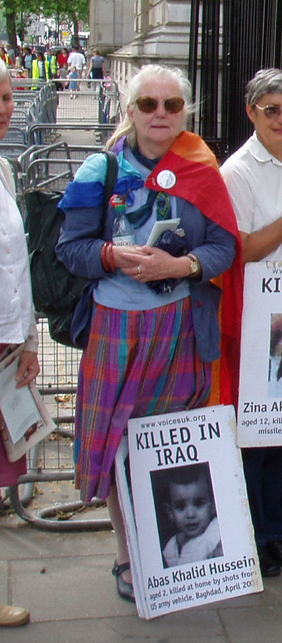
Ann Kobayaski
2015

Slide 28
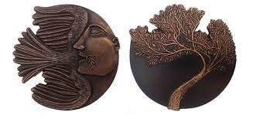
Our new Peace Award Medal
Artist: Natasha Ratcliffe
P(lease) E(ngage) A(ll) C(ommunities on) E(arth), 2011

Slide 29
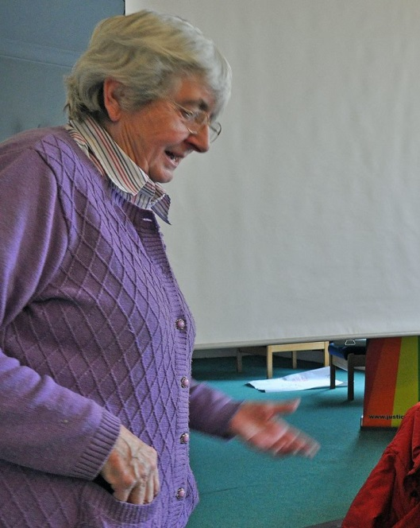
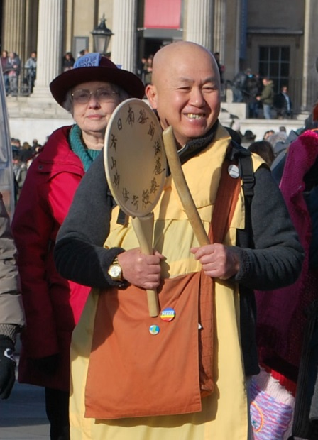
Those receiving the 2017 Award
Nan Saeki
Rev. Nagase

Slide 30
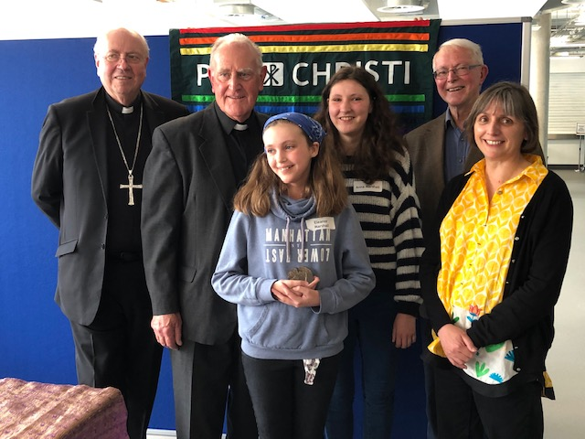
2019 Award Winners
Fr Joe Ryan, Peter van den Dungen, Anna and Eleanor Marshall
(with Archbishop Malcolm McMahon and Theresa Alessandro)

