Slide 1

“Peace as a Journey of Hope: Dialogue, Reconciliation and Ecological Conversion”
A series of ideas for discussion and reflection around the Pope’s Peace Message for 2020

Slide 2
Peace Message
Each year the Pope releases a Peace Message on 1st January. Pax Christi promotes this message each year on the Second Sunday of Ordinary Time.
This year the theme is ‘Peace as a Journey of Hope: Dialogue, Reconciliation and Ecological Conversion’.

Slide 3






What kind of things make us scared?
How might we react when we’re scared?

Slide 4
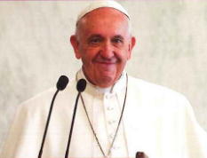
In his peace message, the Pope says that fear can sometimes lead to conflict and distrust. This can then drive people away from one another and it becomes a vicious circle.
We can’t build peace on fear. But hope can help us to overcome this.
How could we stop being so fearful?
What could give us hope?

Slide 5
Prayer
Dear Lord,
You said to us “Do not be afraid”.
Grant us the courage to be open to one another, to see each other as brothers and sisters. Grant us the strength to face the challenges of being peacemakers and to overcome those fears that lead us into conflict.
Amen

Slide 6
Imagine there are two children.
One of the children decides to get a stick for protection.
The other them wants a stick for protection too.

Slide 7
Do the sticks make the children safer?
What else could the children do to feel safe?

Slide 8
The story on the slides is a simplified version of the argument for nuclear weapons, an idea called “nuclear deterrence”.
In November 2019 Pope Francis went to Japan and met some Hibakusha, the people that survived the atomic bomb that fell on Hiroshima and Nagasaki during the second world war. During this visit he said that peace and security can’t be built on mutual fear and mistrust.
What might help us to build true peace and security?

Slide 9
Prayer
Dear Lord,
Let us pray, not for the continuation of hostilities, but for peace in our world, in our communities and in our hearts.
Let us pray for a world in which world leaders promote the safety of their citizens through dialogue, diplomacy and inclusiveness.
Amen

Slide 10
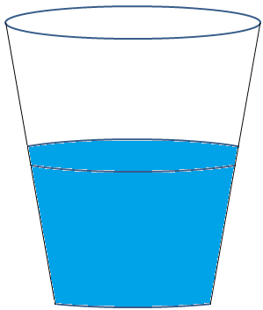
Is this cup half full or half empty?

Slide 11
It all depends on your perspective!
In his message, Pope Francis says that dialogue is important to both keep memory alive and to act as inspiration for us to create a better future.

Slide 12
In his peace message the Pope says that dialogue is important as it helps us to see each other as brothers and sisters and to break down barriers between each other.
Why might this be important for peace?

Slide 13
Pope Francis says that dialogue can help us as sometimes just small acts support can inspire people to do courageous things. Listening is an important part of that dialogue and learning to understand each other.
In partners, partner A is going to say two interesting things about themselves. Partner B will listen and, when A is finished, thank partner A. B will then say what they found interesting about what A said. Once you have finished, swap roles.
How did the activity make you feel? Was it easy or difficult? What could you learn from that?

Slide 14
Prayer
Dear Lord,
Help us to listen more closely to those around us to help us to understand what they are saying.
We pray now for our own intentions and the intentions of those around us. (You are now invited to pray for your own intentions)
Amen

Slide 15

Jesus said that we should forgive someone 70x7 times- is this possible?
What do you think he meant?

Slide 16
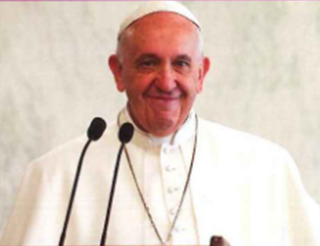
In his peace message, the Pope says that forgiving others can also help to see them as our brothers and sisters.
If we learn to forgive each other, we can come to see people for who they are and not just for what they’ve done.
This coming together to build a relationship can be seen as a form of reconciliation. By being reconciled to one another, we can make the world more peaceful.
What might help us to forgive others?

Slide 17
Prayer
Dear Lord,
We pray that broken relationships may be healed, that neighbours will learn to love one another and that peace will be in our homes and communities.
Grant us the grace to be able to forgive those around us and see other people as brothers and sisters.
Amen

Slide 18

Do we have a responsibility towards creation?
Yes
No

Slide 19
We are called to protect creation but so often we see the earth being exploited and threated with a lack of respect. The Pope says we need to come to an ‘ecological conversion’- to change the way we relate to creation, not just how we relate to each other.
What could we do to respect the earth?

Slide 20
Prayer
Dear Lord,
We pray for your creation. We pray that we may live in harmony with the earth, listening and reflecting on what it tells us. May we take up the challenge of taking responsibility for the way we treat creation and helping to nurture and protect it.
Amen

Slide 21


