Slide 1


Spreading the word and vision!
A project of
Notes:
Before slide:
Welcome from Theresa. Zoom housekeeping. Pass over to Pat – slide

Slide 2
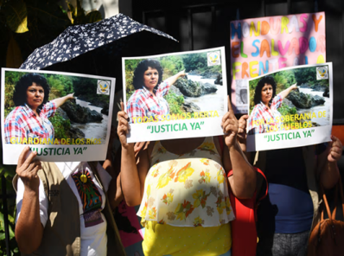
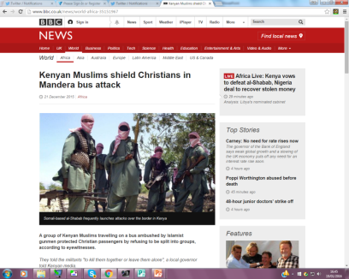
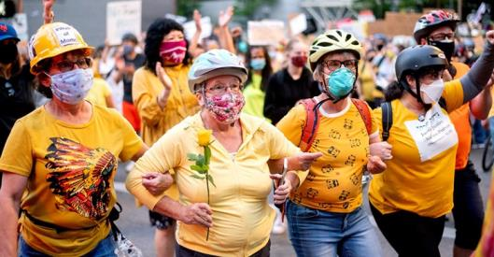
Starting from experiences

Slide 3
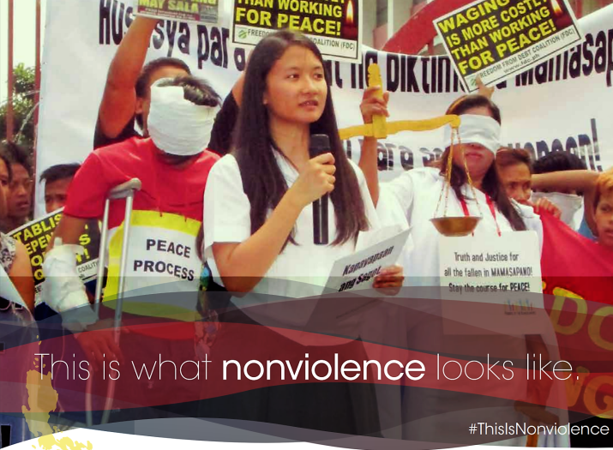
Pax Christi Philippines

Slide 4
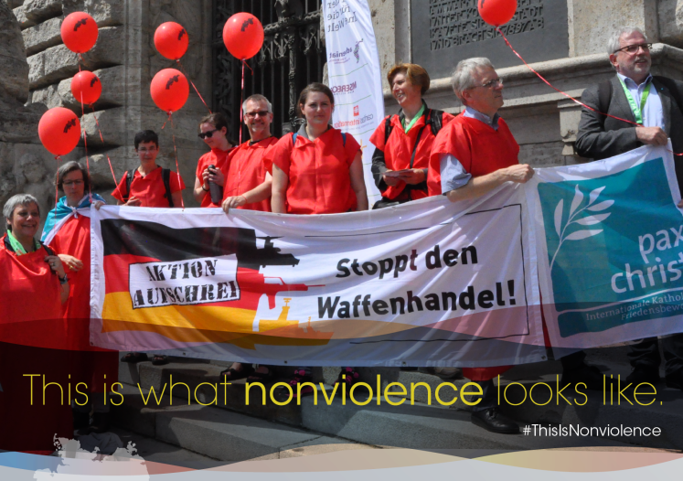
Pax Christi Germany

Slide 5
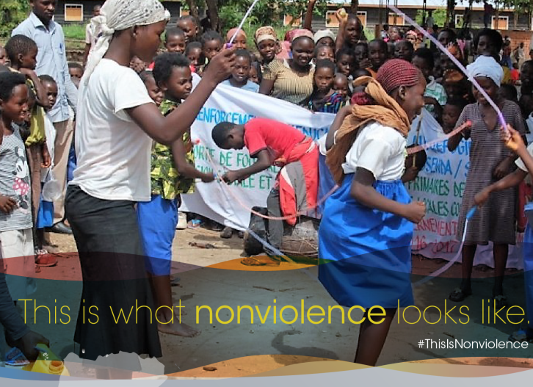
Pax Christi Uvira, DRC

Slide 6
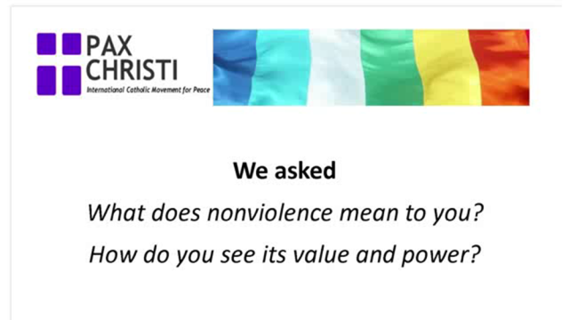
UK Voices
Video from Pax Christi member Carol Burns
https://www.youtube.com/watch?v=Yqd8P4FSF9Q&t=5s

Slide 7

UK Voices
Video from Kate Monkhouse
https://www.youtube.com/watch?v=7UYOPfesUMQ

Slide 8

Where are we with our project?
2017 Peace Sunday
Seminar series on Nonviolence Works,
Workshops
Conferences in Scotland
Post Easter scriptural reflections on peace/nonviolence
Promotion of Choosing Peace – study guide
Celebrated International Day of Nonviolence
Web resources and videos

Slide 9
International cooperation
Religious communities
Theology & nonviolence
Advocacy
Media & Communication
People of God / grassroots engagement
Bishops
Integrating nv into church structures/
institutions

Slide 10
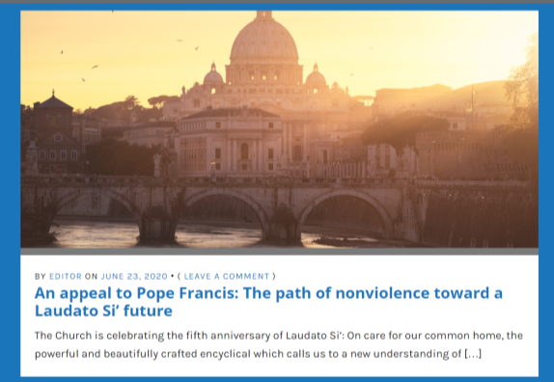
What we offer now

Slide 11

Advancing Nonviolence

Slide 12

Making active nonviolence our way of life
5 session discussion/reflection resource for groups
Cultivating Nonviolence
Seeing Violence in our World Today
Discerning and Judging based on the Good News of Jesus
Acting with a force more powerful than violence
Invitation to take up “active nonviolence” –
Taster offered between
August – September

Slide 13
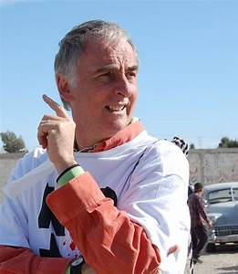
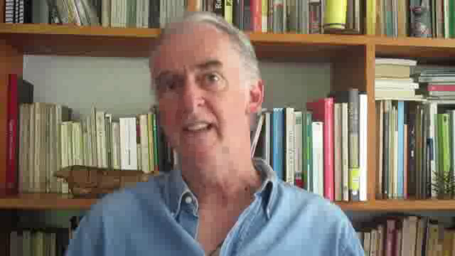
The value of the Catholic Nonviolence Initiative
https://www.youtube.com/watch?v=0FVU4Dfldr8
Pietro Ameglio. SERPAZ Mexico

Slide 14
Group work
What has encouraged you in what you have heard?
How do YOU see nonviolence, what is its power for you?

Slide 15
Catholic Nonviolence Days of Action
21 September – 2 October (Int Day of Nonviolence)
Invitation to study, pray, act and celebrate the power of nonviolence.
We are encouraging solidarity actions around the globe to promote and celebrate nonviolence ending in common commitment on 2 October
These dates align with the Season of Creation, which runs from 1 September

Slide 16
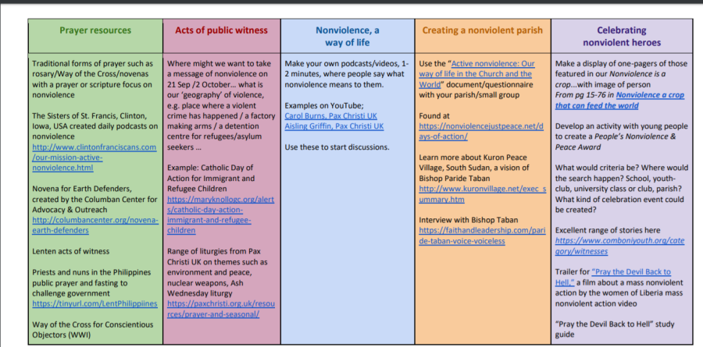
Framework for actions/events

Slide 17
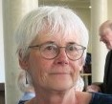
Advocacy opportunities
Hearing from Joan Sharples, member of Pax Christi Executive Committee
and the CNI Advocacy working group

Slide 18
Timeline
Sept – Oct
Days of nonviolence
July – launch of
Advancing Nonviolence
Dec – Jan : Prepare for World Peace Day
Aug 20 /27
Sept 3/10/17
Taster course
Dedicated issue of Justpeace
Advent:
YOU run course in group/community!
17 Jan
Peace Sunday

Slide 19
Reflection
So, what is nonviolence?
Voice 1: It is a strategy for social change that rejects violence.
Voice 2: It is a philosophy of active peacemaking.
Voice 1: It is a spiritual discipline.
Voice 2: It is a pragmatic choice based on what works.
Voice 1: It is an active response to violence.
Voice 2: It is a force more powerful than violence.
How do Christians walk the talk of nonviolence in everyday life?
Voice 1: By working for justice.
Voice 2: By trusting in God rather than trusting in weapons.
Voice 1: By practising creative and disarming ways of responding to a crisis.
Voice 2: By actively and publicly resisting war.
Voice 1: By building relationships with those who are supposed to be enemies.
Voice 2: By showing more love.

Slide 20
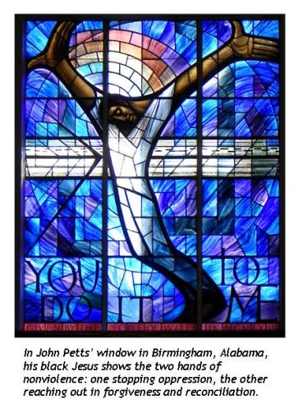
Prayer
How I wish that all men and
women of good will would look at
the Cross if only for a moment!
There, we can see God’s reply:
violence is not answered
with violence,
death is not answered with the
language of death
In the silence of the cross,
The uproars of weapons ceases
And the language of reconciliation,
Forgiveness, dialogue and peace is spoken
Pope Francis

Slide 21
This is nonviolence
You share YOUR ideas in our ZOOM photo op as we capture these as a record of our gathering
Websites
Catholic Nonviolence Initiative: https://nonviolencejustpeace.net/
Pax Christi International : https://paxchristi.net/
Pax Christi England and Wales : https://paxchristi.org.uk/

