Slide 1
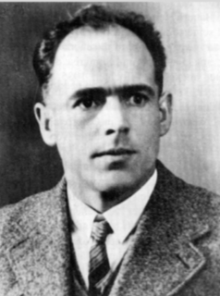
Blessed Franz Jägerstätter
Commemorating his
Life and Witness
9th August 2020

Slide 2
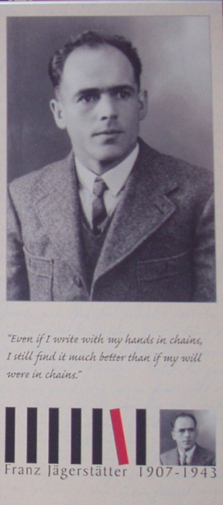
Our Gathering
Reader: We meet in the presence of God on the 77th anniversary of the execution of Franz Jägerstätter
All: Let us be encouraged and inspired
Reader: As we reflect on his witness
All: We pray for the strength to be peacemakers in our troubled world
‘Even if I write with my hands in chains, I still find it much better than if my will were in chains.’

Slide 3
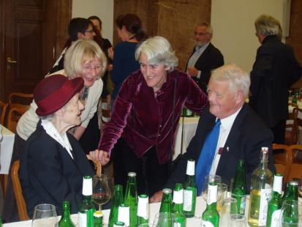
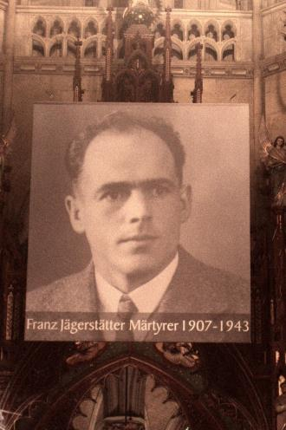
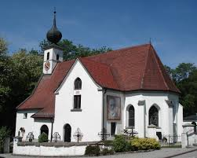

Slide 4
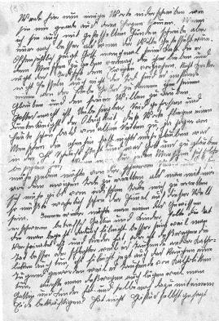
From the writings of Franz Jägerstätter
“If the Church stays silent
in the face of what is happening,
what difference would it make,
if no church were ever opened again?”
"Let us love our enemies,
bless those who curse us,
pray for those who persecute us.
For love will conquer
and will endure for all eternity.
And happy are they who live
and die in God's love."
1943

Slide 5
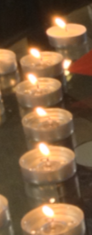
A Reading from the Gospel
You have heard that it was said,
‘You shall love your neighbour and hate your enemy.’
But I say to you: Love your enemies
and pray for those who persecute you,
so that you may be children of your Father who is in heaven;
for he makes his sun rise on the evil and on the good,
and sends rain on the just and on the unjust.
For if you love those who love you, what reward have you?
Do not even the tax collectors do the same?
And if you greet only your brothers and sisters,
what more are you doing than others?
Do not even the Gentiles do the same?
You, therefore, must be perfect, as your heavenly Father is perfect.
Matthew 5: 44-48

Slide 6


Slide 7
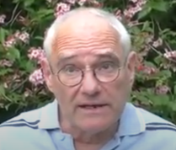
A message from Michael Huber-Kirchberger of Pax Christi Austria
The first time I heard about Franz Jägerstätter was when I was still at school. My Religion teacher told me about him.
Franz Jägers statt er is a role model for somebody following their conscience.
He is also somebody who can show us how to follow a cause against mainstream opinion, to keep on thinking the right thing.
For that he can also be a model for today in other cases where we are fighting against an unjust government.
Mag. Michael Huber-Kirchberger

Slide 8
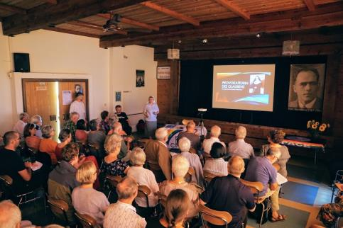
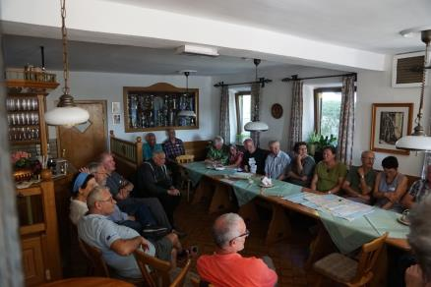
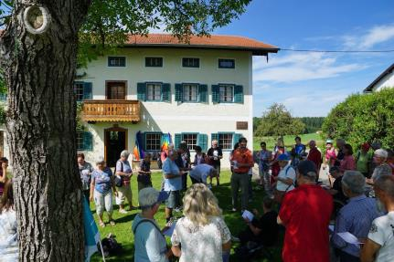
Lecture on Sister Restituta Kafka, another martyr during the Nazi regime
José Ignacio Davila
A meeting between Austrians and Italians – bridging the language gap
Outside the Jägerstätter house

Slide 9
Sharing our own thoughts about the influence of
Franz Jägerstätter

Slide 10
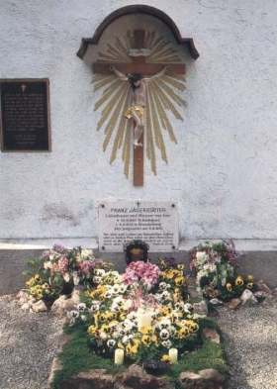
We remember in prayer all those who have given their lives nonviolently in the cause of peace.
The response to each is We remember you
Franz Jägerstätter
Josef Mayr Nusser
Franz Reinisch
Max Josef Metzger
Otto Schimek
All other conscientious objectors from
World War One and World War Two
All conscientious objectors since 1945
Members of the Society of Friends
Followers of the Anabaptist tradition
The conscientious objectors of the wars with
Iraq, Afghanistan and in countries now at war
The conscientious objectors of Israel & Palestine
Please mention names of other war resisters

Slide 11
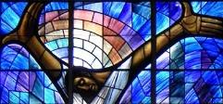
We pray together
We give thanks for the witness of Franz Jägerstätter, beatified and recognised by the Church as a martyr for peace. We pray that people throughout the world will be inspired to follow their conscience, to go against the stream and stand up for peace.
All: Lord hear our prayer for peace
We give thanks for the life of Franziska. We pray that her spirit of perseverance in keeping the story of Franz alive and her faithfulness to his witness may encourage us all in times of hopelessness and despair.
All: Lord hear our prayer for peace
We remember all victims of nuclear weapons especially the people of Nagasaki where the atomic bomb was dropped 75 years ago. We pray for a change of heart for those who cling to the myth that nuclear weapons protect us, including our own government. All: Lord hear our prayer for peace

Slide 12
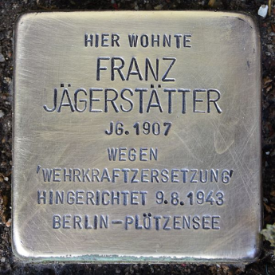
Prayer asking for the intercession
of Blessed Franz Jägerstätter
Dear God,
You filled the blessed martyr and father of a family,
Franz Jägerstätter,
with great love for You, his family and all people.
In a time of violence and political contempt for humanity
he formed for himself
an unerring and clear judgement.
You gave him the grace to resist evil.
In closeness to your Son, and by following his conscience,
he said a decisive “No” to the denial of your presence,
to the disregard for human dignity,
and to the unjust war.
Trusting in you, he sacrificed his life
because he loved you above everything.
With the power of your Spirit, and the intercession of blessed Franz,
strengthen our love for you and all people.
Help us to stand up for justice, peace and human dignity,
through Christ our Lord.
Amen

Slide 13
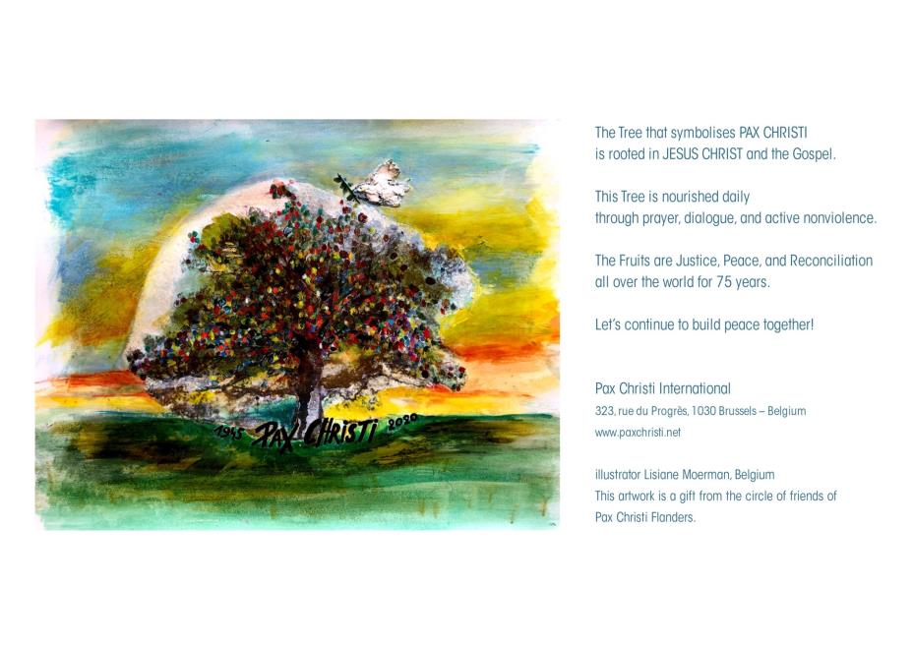

Slide 14
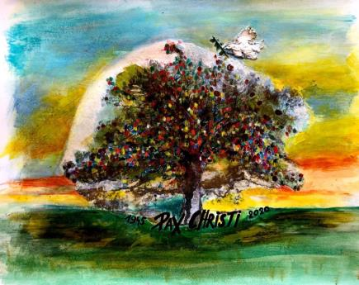
Blessing
As we prepare to leave each other this evening,
we ask God’s blessing.
May the Lord bless us
and keep us;
May the Lord’s face shine upon us,
and be gracious to us
May the Lord’s face
turn towards us
and give us peace
Amen

