Slide 1
We Remember Hiroshima
We Remember Nagasaki
75 years of nuclear weapons

Slide 2
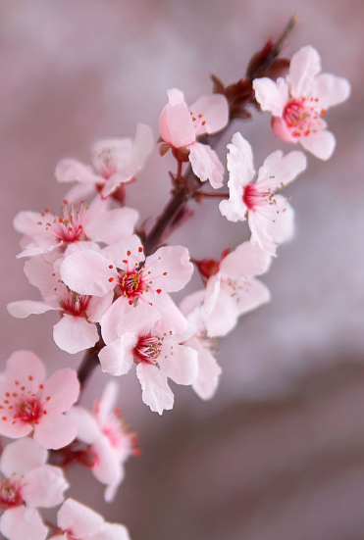
Isaiah 40:31
But those who hope in the Lord will renew their strength.
They will soar on wings like eagles;
they will run and not grow weary;
they will walk and not be faint.

Slide 3
Nuclear war has nothing good. Whether you win or lose, it leaves you feeling futile with only your rage and with fear about the aftereffects of radioactivity. The survivors have to live with this fear. At times I have thought I should have died then, it would have been better. But I must live for the sake of the people, all the people who lost their lives then.
So I relate my experiences hoping that my talk would discourage people from making war. Our experience must not forgotten. What we believed in during the war turned out to be worth nothing. We don't know to whom we should turn our rage. I went through hell on earth. Hiroshima should not be repeated again.
From the testimony of Hiroshima survivor, Toshiko Saeki

Slide 4
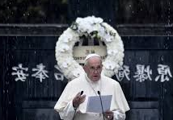
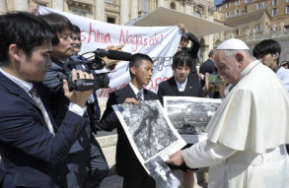
This place makes us deeply aware of the pain and horror that we human beings are capable of inflicting upon one another.
The damaged cross and statue of Our Lady recently discovered in the Cathedral of Nagasaki remind us once more of the unspeakable horror suffered in the flesh by the victims of the bombing and their families.
One of the deepest longings of the human heart is for security, peace and stability.
The possession of nuclear and other weapons of mass destruction is not the answer to this desire; indeed they seem always to thwart it.
Pope Francis, Nagasaki, 2019

Slide 5
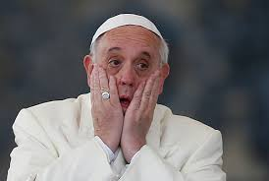
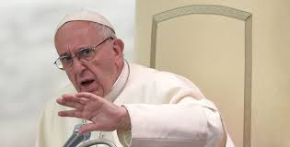
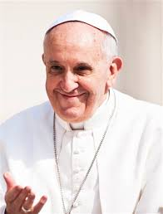
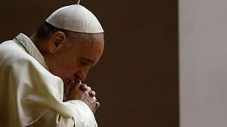
Sharing how we are feeling

Slide 6
Praying the Novena with the Congregation of the Sisters of St Joseph of Peace
We pray for all who suffer the violence of poverty, may the billions wasted on nuclear weapons be redirected to health, education, housing and the environment.
Amen

Slide 7
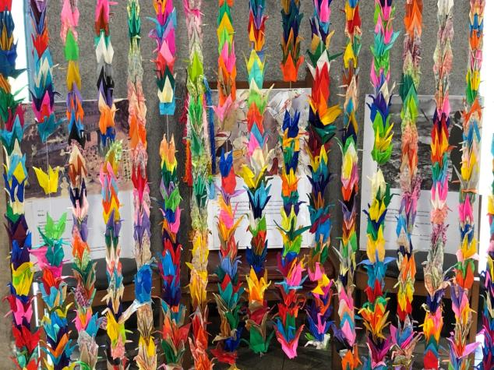
Sharing our prayers

Slide 8
Pax Christi Daily Prayer
Lord,
Strengthen my determination to work for a world of peace and justice;
My conviction that whatever our nationality or race we are all global citizens, one in Christ;
And my courage to challenge the powerful with the values of the Gospel.
Amen

Slide 9
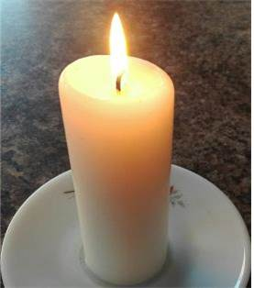
Blessing
Deep peace of the running wave to you
Deep peace of the flowing air to you
Deep peace of the quiet earth to you
Deep peace of the shining stars to you
Deep peace of the Son of peace, to you
Amen
Music credit:
October by Kai Engel

