Slide 1
We Remember Hiroshima
We Remember Nagasaki
75 years of nuclear weapons

Slide 2
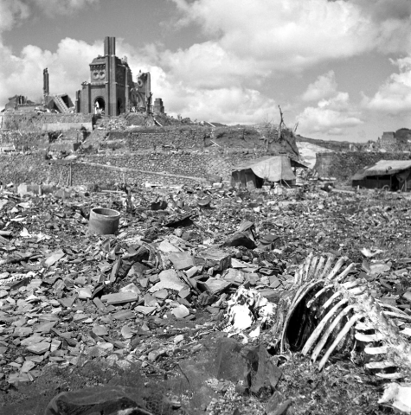
The Light and the Terror
by Kate Holmstorm

Slide 3
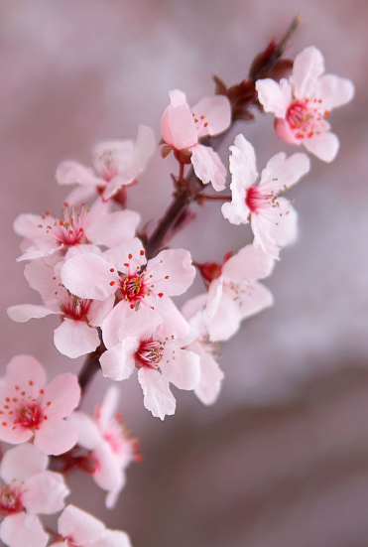
Psalm 62
In God alone
there is rest for my soul,
from him comes my safety;
he alone is my rock,
my safety,
my stronghold,
so that I stand unshaken.

Slide 4
Each member of my family died in various locations here and there. Furthermore, they died in a nearly naked condition with their clothes almost burned. There were no means to identify their ashes.
I collected the dirt of the locations on which my family might have died and I put them with new shirts into the grave of Tokunaga family. It seemed to me they could gather together at last and sleep in peace under this grave.
From the testimony of Nagasaki survivor,
Ayako Okumura (8 years old in 1945)

Slide 5
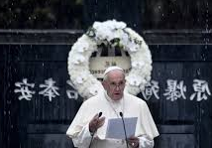
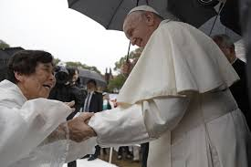
Convinced as I am that a world without nuclear weapons is possible and necessary, I ask political leaders not to forget that these weapons cannot protect us from current threats to national and international security.
We need to ponder the catastrophic impact of their deployment,
especially from a humanitarian and environmental standpoint,
and reject heightening a climate of fear, mistrust and hostility fomented by nuclear doctrines.
Pope Francis, Nagasaki, 2019

Slide 6
Praying the Novena with the Congregation of the Sisters of St Joseph of Peace
We pray for all peacemakers, especially those who risk their own liberty to nonviolently resist the preparations for nuclear war.
Amen

Slide 7
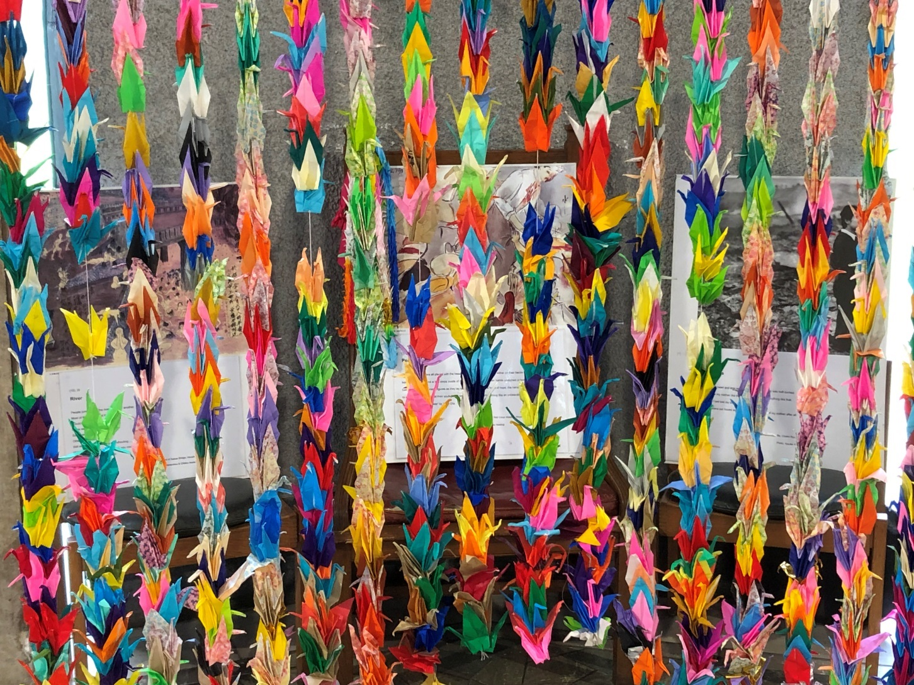
Sharing our prayers

Slide 8
Pax Christi Daily Prayer
Lord,
Strengthen my determination to work for a world of peace and justice;
My conviction that whatever our nationality or race we are all global citizens, one in Christ;
And my courage to challenge the powerful with the values of the Gospel.
Amen

Slide 9
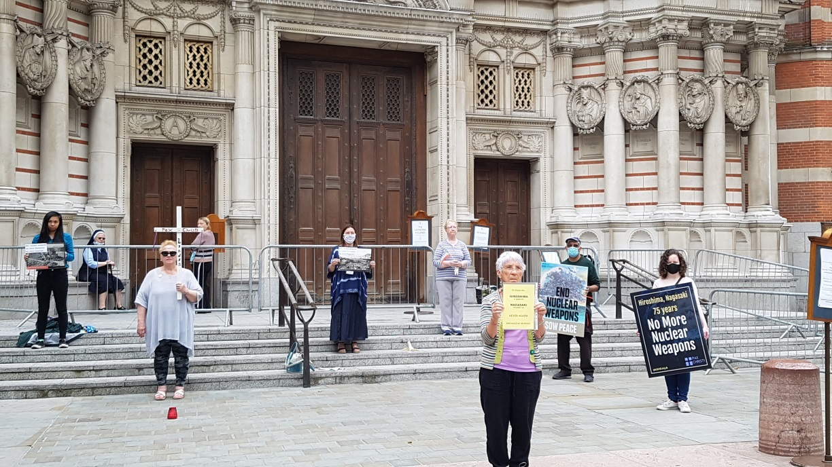
Sharing our Thoughts and What now?

Slide 10
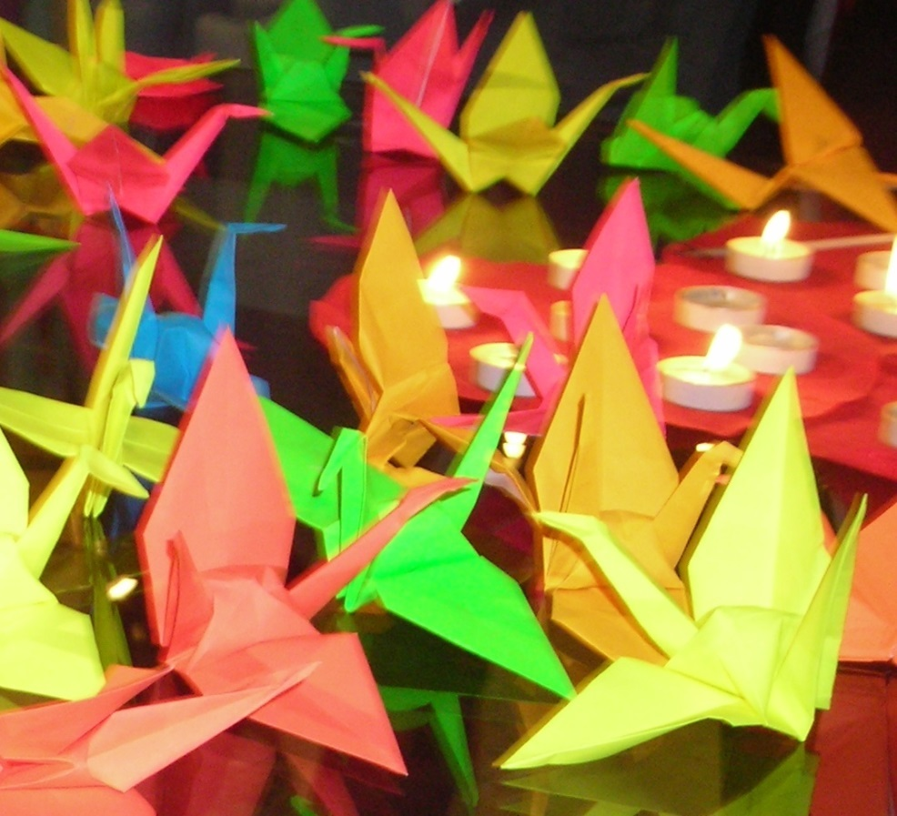
Blessing
May the Lord bless us,
giving health to our bodies
hope to our spirits
and comfort to our hearts.
He will not leave us
at the mercy of the storm.
Amen

