Slide 1
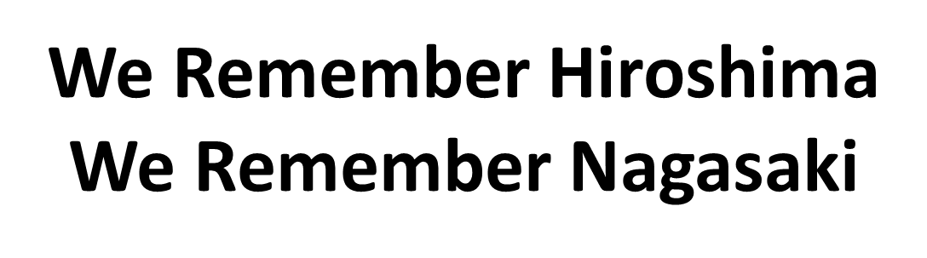
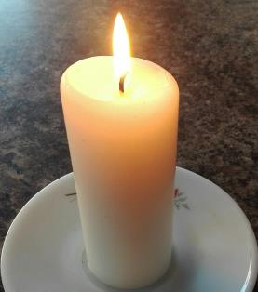

75 years of nuclear weapons

Slide 2
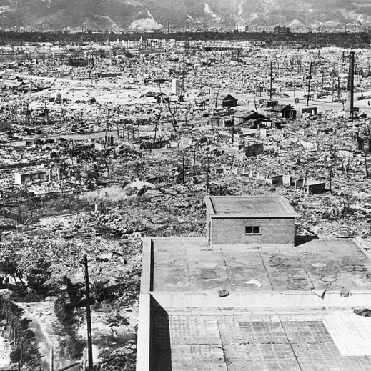
“An incandescent burst of lightning and fire, so many men and women, so many dreams and hopes, disappeared, leaving behind only shadows and silence. In barely an instant everything was devoured by a black hole of destruction and death.”
Pope Francis, Hiroshima 2019

Slide 3

Ephesians 2:13-16
But now in Christ Jesus you who once were far away have been brought near by the blood of Christ.
For he himself is our peace, who has made the two groups one and has destroyed the barrier, the dividing wall of hostility, by setting aside in his flesh the law with its commands and regulations. His purpose was to create in himself one new humanity out of the two, thus making peace, and in one body to reconcile both of them to God through the cross, by which he put to death their hostility.

Slide 4
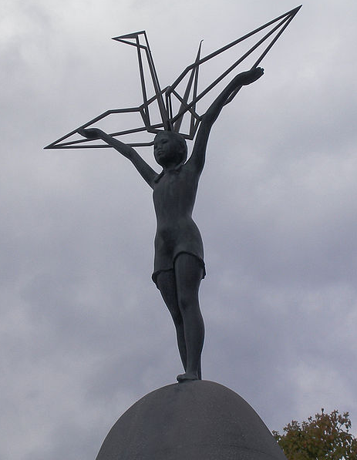
“Every threatening situation feeds mistrust and leads people to withdraw into their own safety zone. Mistrust and fear weaken relationships and increase the risk of violence, creating a vicious circle that can never lead to a relationship of peace. Even nuclear deterrence can only produce the illusion of security.
We cannot claim to maintain stability in the world through the fear of annihilation, in a volatile situation, suspended on the brink of a nuclear abyss and enclosed behind walls of indifference…
How, then, do we undertake a journey of peace and mutual respect? How do we break the unhealthy mentality of threats and fear? How do we break the current dynamic of distrust?”
Pope Francis, Message for World Day of Peace 2020
Tomi Mäkitalo
https://web.archive.org/web/20161009213712/http://www.panoramio.com/photo/6673621

Slide 5
For the times we have chosen fear over openness, Lord Have Mercy
Lord Have Mercy
For the times we have neglected to enter into dialogue , Christ Have Mercy
Christ Have Mercy
For the times we have failed to be reconciled with others,
Lord Have Mercy
Lord Have Mercy

Slide 6

Novena to Commemorate the 75th Anniversary of the Bombing of Hiroshima and Nagasaki with the Congregation of the Sisters of St Joseph of Peace
We pray for all investors and manufactures in the nuclear industry, that they will divest and transfer their money and skills to bringing life not death.

Slide 7
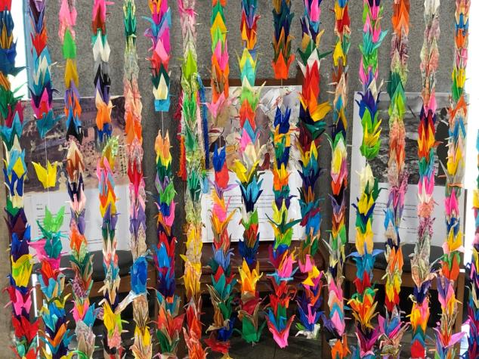
Sharing our prayers

Slide 8
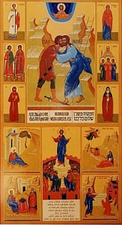
Final prayer
Blessed are you peacemakers
who say no to war as a means to peace.
Blessed are you peacemakers
who offer hope and healing.
Blessed are you peacemakers
who care and comfort.
Blessed are you peacemakers
who help find answers.
Blessed are you peacemakers
who welcome, encourage, and inspire.
Blessed are you peacemakers
who see the good in others.
Blessed are you peacemakers
who never give up.
Fr Paul Milanowski (adapted)

Slide 9
https://commons.wikimedia.org/wiki/File:AtomicEffects-Hiroshima.jpg
Tomi Mäkitalo
https://web.archive.org/web/20161009213712/http://www.panoramio.com/photo/6673621
Music: Better Days from Bensound.com

