Slide 1
We Remember Hiroshima
We Remember Nagasaki
75 years of nuclear weapons

Slide 2
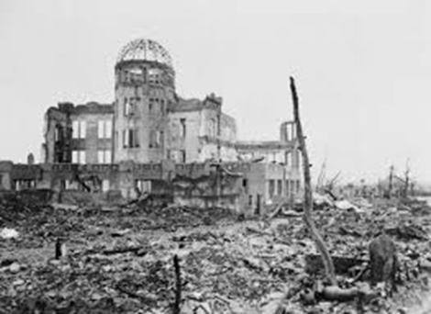
The Light and the Terror
a poem by Pax Christi member, Kate Holmstrom

Slide 3
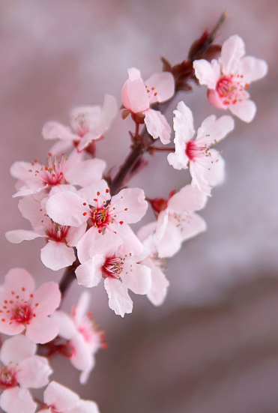
Psalm 62
In God alone
there is rest for my soul,
from him comes my safety;
he alone is my rock,
my safety,
my stronghold,
so that I stand unshaken.

Slide 4
I had my entire body covered with bandages, with only eyes, nose, and mouth uncovered.
Everybody thought I would die over time.
Yet, I survived.
It is a miracle.
I am here at the UN, asking for an abolition of nuclear weapons.
I am convinced that this is a mission I am given as a survivor of the atomic-bomb.
From the testimony of Hiroshima survivor, Fujimori Toshiki, given at the UN in 2017

Slide 5
For the times we have chosen vengeance over justice, Lord Have Mercy
Lord Have Mercy
For the times we have stored up violence in our hearts, Christ Have Mercy
Christ Have Mercy
For the times we have failed to be peacemakers,
Lord Have Mercy
Lord Have Mercy

Slide 6
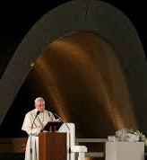
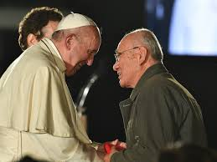
To remember, to journey together, to protect.
These are three moral imperatives that here in Hiroshima assume even more powerful and universal significance, and can open a path to peace.
For this reason, we cannot allow present and future generations to lose the memory of what happened here.
It is a memory that ensures and encourages the building of a more fair and fraternal future;
an expansive memory, capable of awakening the consciences of all men and women, especially those who today play a crucial role in the destiny of the nations;
a living memory that helps us say in every generation: never again!
Pope Francis, Hiroshima, 2019

Slide 7
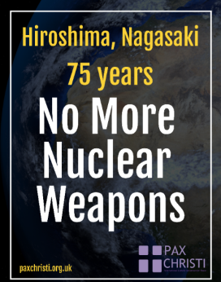
Sharing Our Plans and Actions We Can Take
Continue with prayer and fasting
Speak about the anniversaries with others
Provide prayers for liturgies and Mass over the next few days
Write to your bank or pension provider
Put a poster in your window
Join with others in your area

Slide 8

Come, Lord, for it is late,
and where destruction
has abounded,
may hope also abound today
that we can write and achieve
a different future.
Come, Lord, Prince of Peace!
Make us instruments
and reflections
of your peace!
Pope Francis, Hiroshima 2019

Slide 9
Praying the Novena with the Congregation of the Sisters of St Joseph of Peace
May we listen afresh to the wisdom of the Hibakusha, the surviving victims of Hiroshima and Nagasaki, calling us to a nuclear free world.
Amen

Slide 10
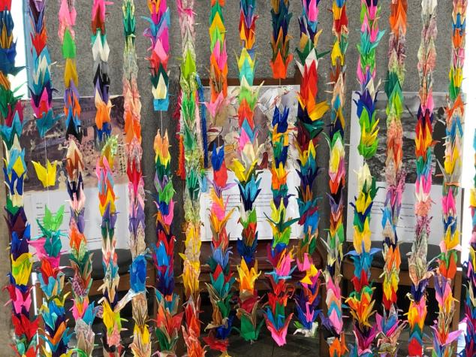
Sharing our prayers

Slide 11
Pax Christi Daily Prayer
Lord,
Strengthen my determination to work for a world of peace and justice;
My conviction that whatever our nationality or race we are all global citizens, one in Christ;
And my courage to challenge the powerful with the values of the Gospel.
Amen

Slide 12
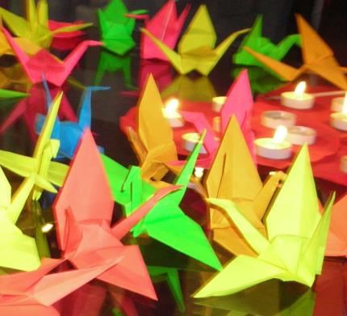
Blessing
May the Lord bless us,
giving health to our bodies
hope to our spirits
and comfort to our hearts.
He will not leave us
at the mercy of the storm.
Amen

