Slide 1
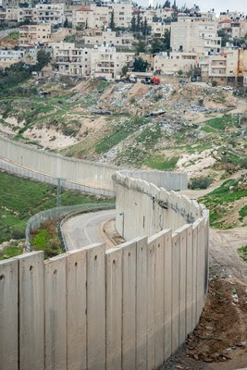

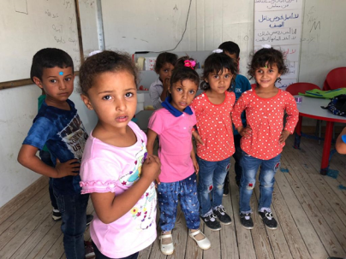
Annexation:
What hope for Palestine?

Slide 2
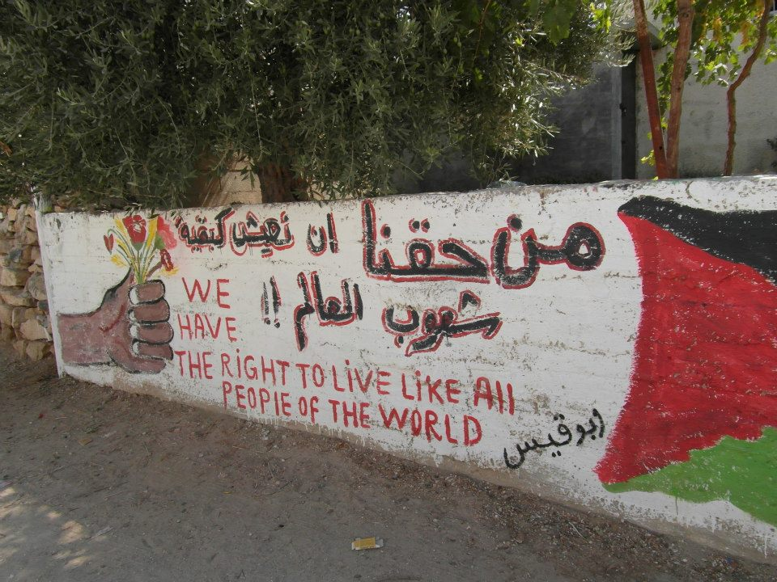

Slide 3
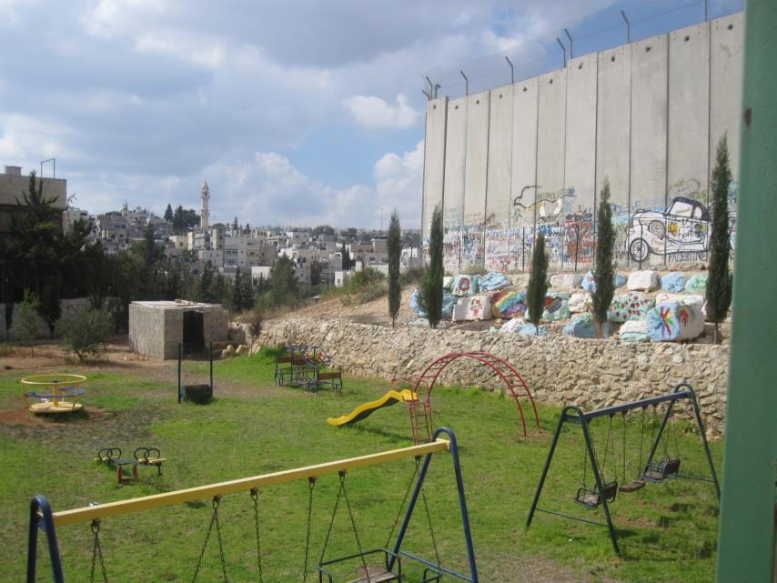
Wi’am Conflict Resolution Centre

Slide 4
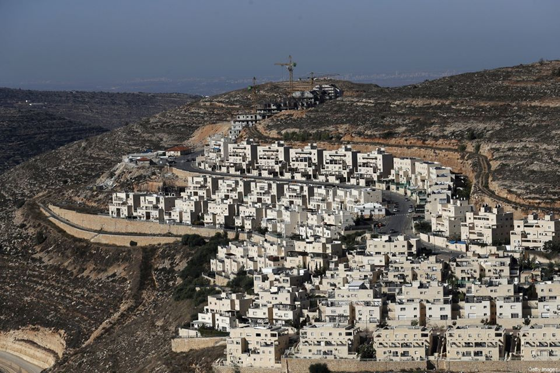
The Occupation = Creeping annexation

Slide 5


"If implemented, annexation would constitute a most serious violation of international law, grievously harm the prospect of a two-state solution and undercut the possibilities of a renewal of negotiations," Guterres told the UN Security Council.
"I call on the Israeli government to abandon its annexation plans.“
Antonio Guterres
Secretary General
of the United Nations

Slide 6
Bishop Declan Lang (RC)and Bishop Christopher Chessun (CE):
"From our dialogue with communities in the Holy Land, we know first-hand that the situation is rapidly deteriorating. Annexation would only bring more conflict, suffering and division.
"The UK Government has a duty to act and to do everything possible to dissuade the Government of Israel from annexing the West Bank in violation of international law.
"This week we have made representations to the government and senior parliamentarians about the situation. Alongside other churches and faith groups we will continue to work on this fundamental question of justice and peace.

Slide 7

Pax Christi International vehemently opposes Israel’s plan to annex any area of the West Bank including the Jordan Valley.
We stand in steadfast solidarity with our Palestinian sisters and brothers whose freedom, dignity and human rights are threatened by this current proposal and Israel’s previous actions.
As the global Catholic movement for peace and nonviolence, Pax Christi International is deeply concerned that actions to annex any portion of the West Bank will extinguish the last glimmers of hope for a just and lasting peace in the land we call holy.

Slide 8
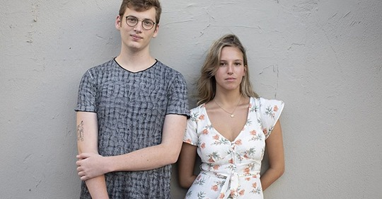
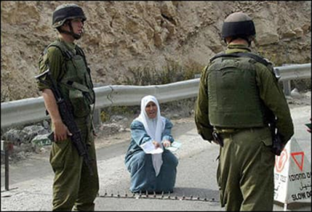
Israeli Teens Against Annexation
“Four hundred Israeli teenagers from around the country have signed a letter demanding Israel halt its plans to annex parts of the occupied West Bank. Titled ‘Teens Against Annexation.’
The letter notes that the signatories who are planning to enlist in the Israeli military will be the same ones forced to carry out the policies of annexation.”

Slide 9
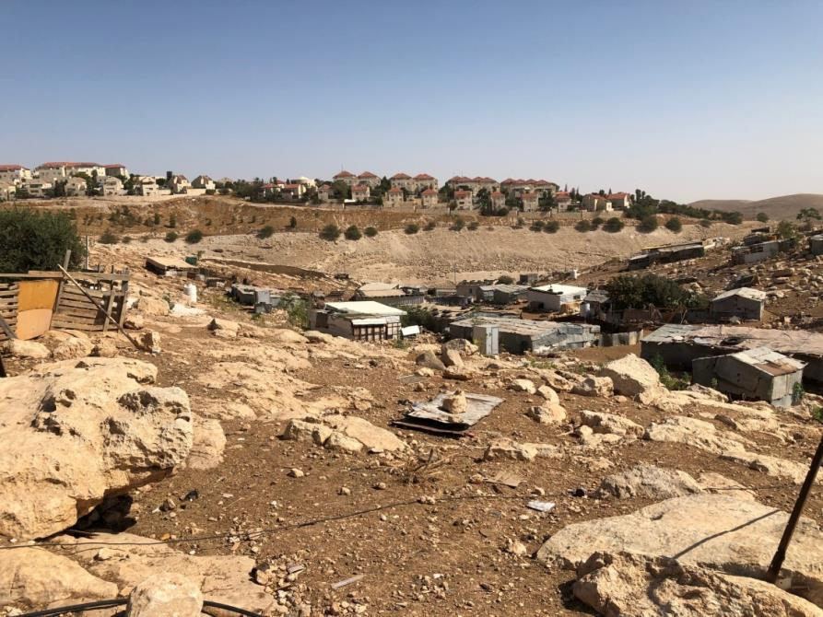
We need action not words: Stop the annexation

Slide 10
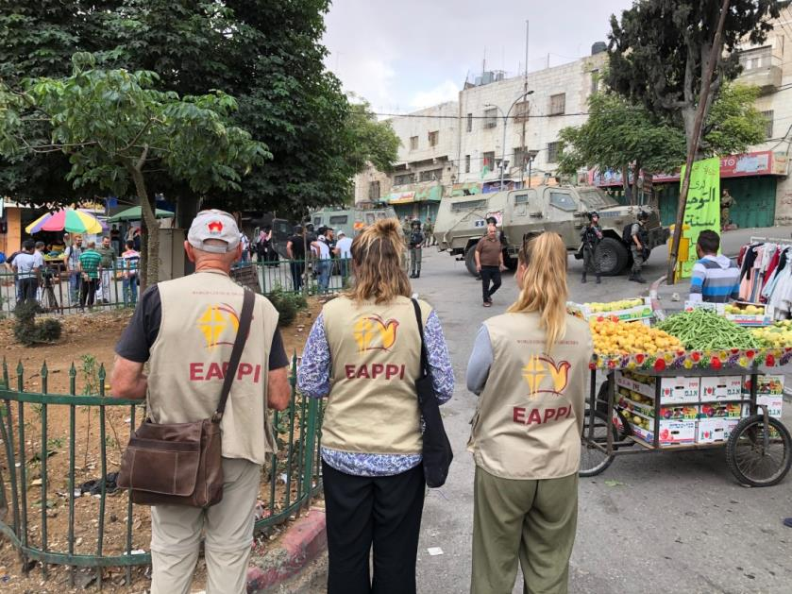
EAPPI in Hebron

Slide 11
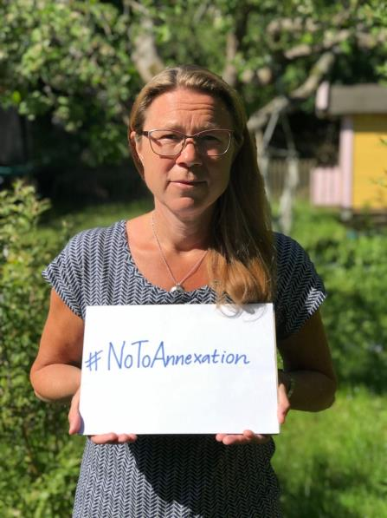

Please join the EAPPI advocacy action by:
posting a photo of yourself holding a poster with #NoToAnnexation
briefly say why you oppose annexation
tag @eappiukireland
If you don’t want to post a photo of yourself - a relevant photo or just a text message please.

Slide 12
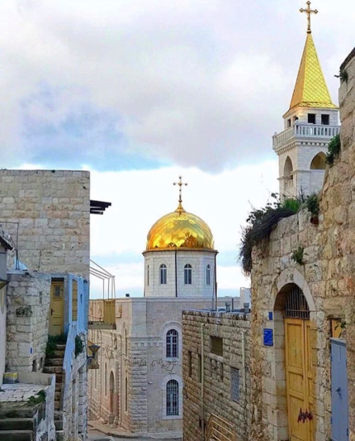
Please join with Church leaders and members of faith communities to:
express our solidarity with Palestinians and Israelis who oppose annexation, occupation and the blockade of Gaza;
speak out in opposition to Israel’s illegal and unilateral plans for annexation at this crucial moment;
urge dioceses to ensure that they do not invest in the occupation of Palestine and that investments are ethical.

Slide 13
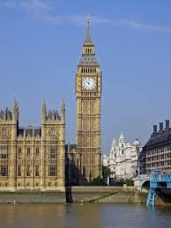
Please write to your MP
or elected representatives
Express your opposition to the annexation;
Ask them to take action to urge the Government to:
Stop the annexation;
take action to call the Israeli Government to account if the annexation takes place;
end the occupation of Palestine
and the siege on Gaza.

Slide 14
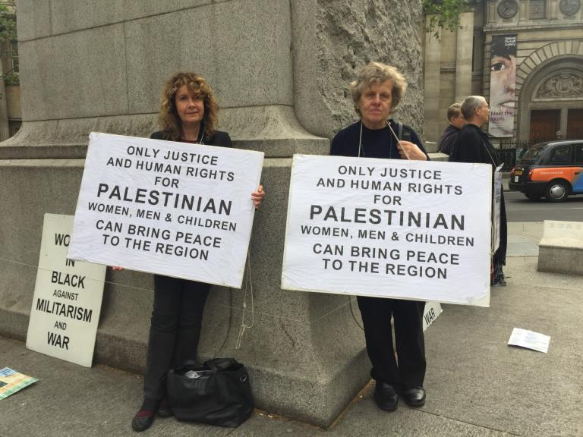
Women in Black - in solidarity
http://london.womeninblack.org/

Slide 15
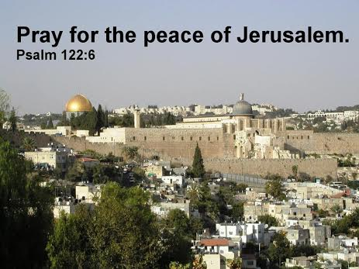
How I rejoiced when they said to me,
'Let us go to the house of Yahweh!
And now our feet are standing in your gateways, Jerusalem.
Jerusalem restored! The city, one united whole!
Pray for peace in Jerusalem.
Since all are my sisters, brothers and friends,
I say, 'Peace be with you!'
Since Yahweh, our God lives here,
I pray for your happiness.

Slide 16
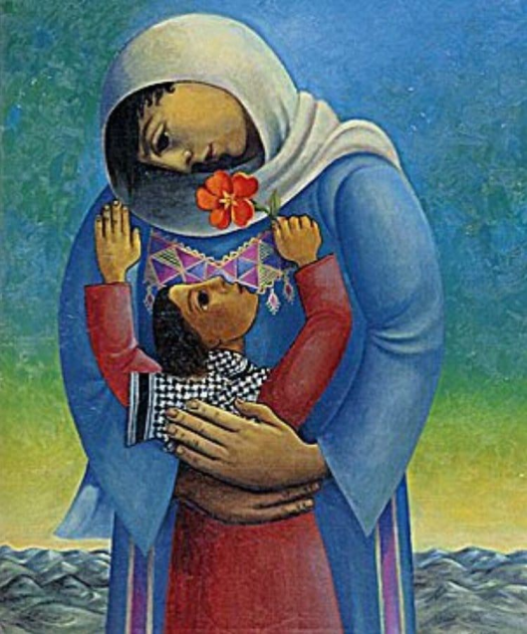

Slide 17
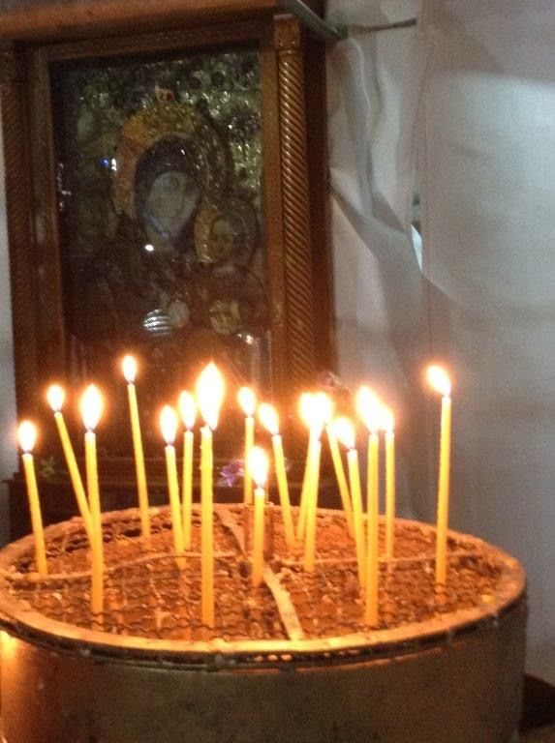
Let us Pray
Thank you, loving God
for the gift of life
for this wonderful world that we all share
for the joy and love
and friendship
for the challenge of helping to build your kingdom.
Please share your
own prayers
Renew our hope for a world free from the cruelty and evil of war,
So that we may all come to share in God’s peace and justice.
Icon and candles in Church of the Nativity

Slide 18
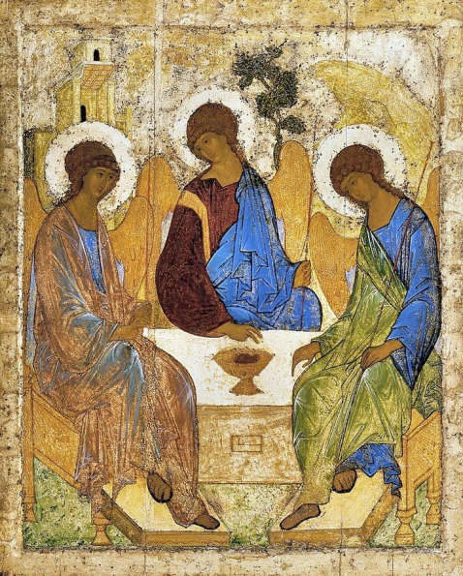
Blessing
The blessing of the God of Sarah
and of Abraham,
The blessing of the Son,
born of the woman Mary,
the blessing of the Holy Spirit, who broods over us
as a mother over her children,
be with us all,
Amen

