Slide 1


Making active nonviolence our way of life
Study session 1 Cultivating nonviolence
A project of
Notes:
Before slide:
Welcome from Theresa. Zoom housekeeping. Pass over to Pat – slide

Slide 2
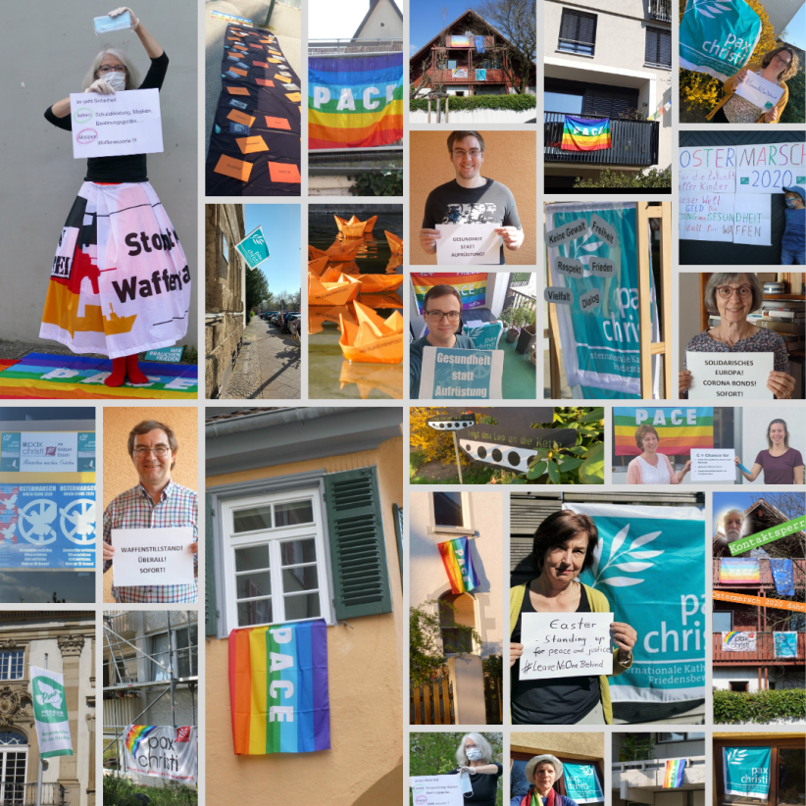
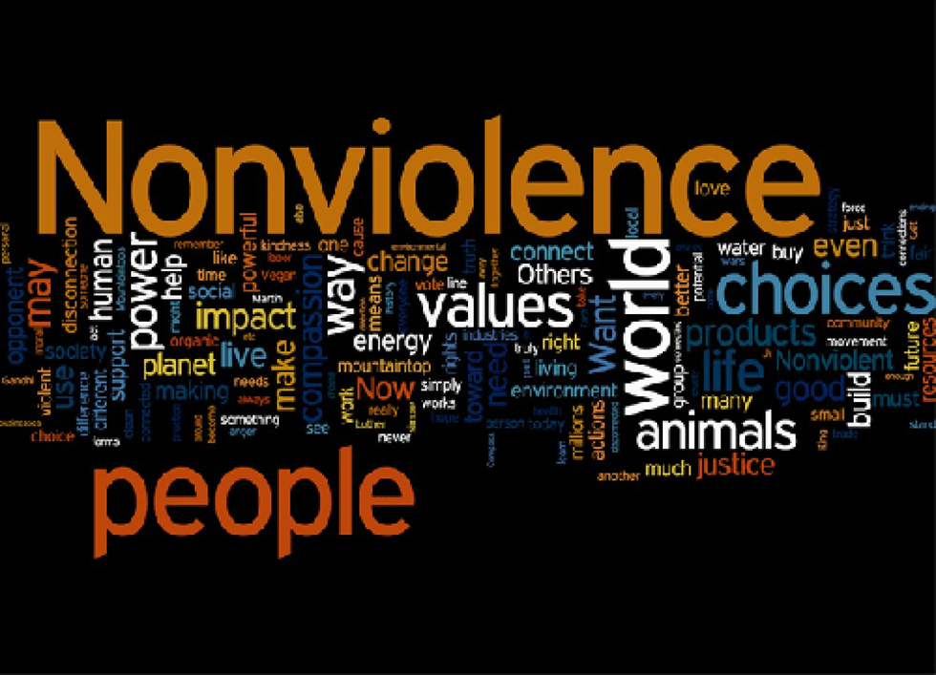
Welcome and introduction
Being the People of God, means being God’s leaven in this our humanity,
Pope Francis
A culture of nonviolence is not an unattainable dream, but a path that has produced decisive results.
Pope Francis, letter to Cardinal Cupich, Archdiocese of Chicago, April 4, 2017

Slide 3
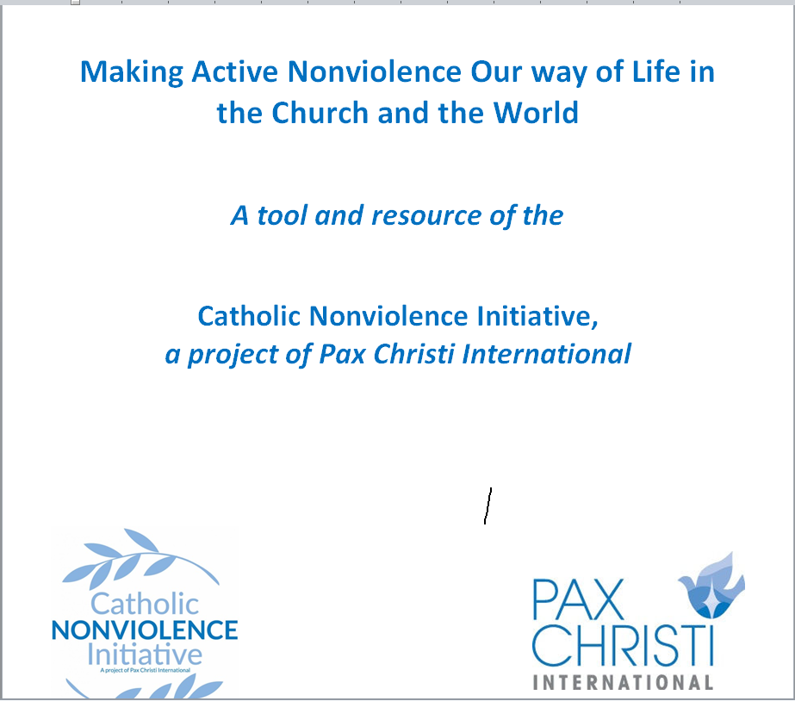
Making active nonviolence our way of life
5 session discussion/reflection resource for groups
Cultivating Nonviolence
Seeing Violence in our World Today
Discerning and Judging based on the Good News of Jesus
Acting with a force more powerful than violence
Invitation to take up “active nonviolence”

Slide 4
Gathering prayer
Spirit of God, we long to mend the broken circle. We long to heal the fractures in the world around us and within our souls.
To learn from one another the ways of living fully alive.
To transform those parts of ourselves and our world that block our making contact with our deepest reality and with the deepest, richest and most sacred dimensions of all other beings.
Silence
Spirit of God, we long to see reality.
To contact our deepest yearning for a world pulsing with justice and truth.
To dream of a society where we all sit down at the Great Feast,
where every person eats until they are full.
Silence
Spirit of God, we long to discover anew the courage deep within us.
To see and to listen. To discover our true selves.
To take steps to stop the cycle of violence in our homes, in our work-places, in our neighbourhoods, in our country and in our entire world.

Slide 5
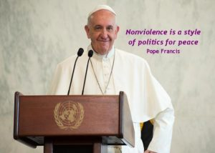
Reading for today – Session 1
“I wish peace to every man, woman and child,
and I pray that the image and likeness of God in each
person will enable us to acknowledge one another as
sacred gifts endowed with immense dignity. Especially
in situations of conflict, let us respect this, our
“deepest dignity” and make active nonviolence
our way of life.” (World Day of Peace, 2017, 1)
“On this occasion, I would like to reflect on nonviolence as a style of politics for peace. I ask God to help all of us to cultivate nonviolence in our most personal thoughts and values. May charity and nonviolence govern how we treat each other as individuals, within society and in international life. When victims of violence are able to resist the temptation to retaliate, they become the most credible promoters of nonviolent peacemaking. In the most local and ordinary situations and in the international order, may nonviolence become the hallmark of our decisions, our relationships and our actions, and indeed of political life in all its forms.” (WDP 2017, 1)

Slide 6
Discussion for today
What do you associate with the word nonviolence?
What are some positive ways in which you have seen nonviolence being used in your family or workplace, in your community, or in your local Church?
Be ready to bring some of your ‘learning’ back
to the large group

Slide 7
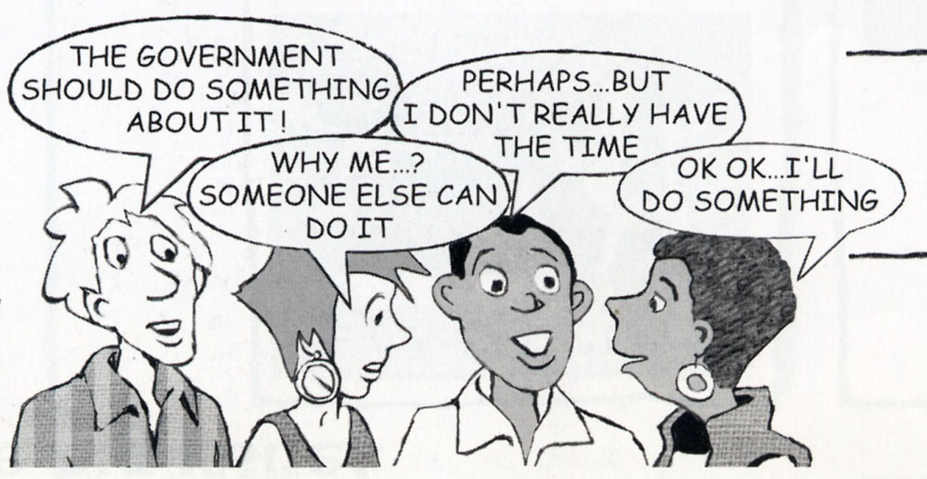
What did we learn?

Slide 8
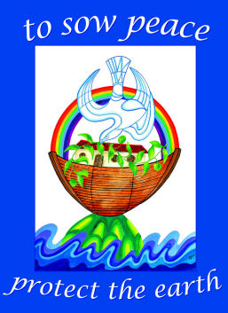
Closing prayer – together
Pour out on us the power of your love,
that we may protect life and beauty.
Fill us with peace, that we may live
As brothers and sisters, harming no one…
Bring healing to our lives
that we may protect the world and
not prey on it,
that we may sow beauty
not pollution and destruction.
Touch the hearts of those who look only for gain
at the expense of the poor and the earth.
Encourage us, we pray, our our struggle for justice, love and peace
(Adapted from Laudato Si, Pope Francis, 2015)

Slide 9
Date and time of next gathering…
Resources
Websites
Catholic Nonviolence Initiative: https://nonviolencejustpeace.net/
Pax Christi International : https://paxchristi.net/
Pax Christi England and Wales : https://paxchristi.org.uk/

