Slide 1


Making active nonviolence our way of life
Session 2 – Seeing Violence in our World
A project of
Notes:
Before slide:
Welcome from Theresa. Zoom housekeeping. Pass over to Pat – slide

Slide 2
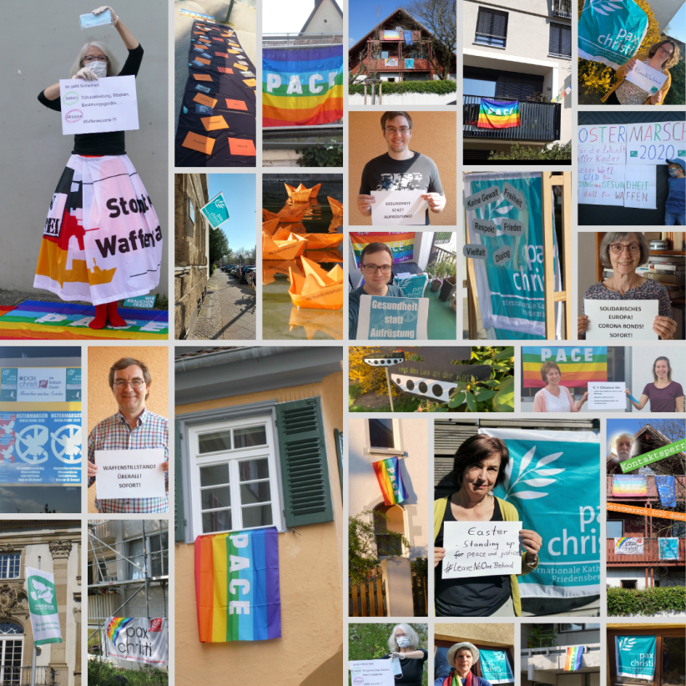
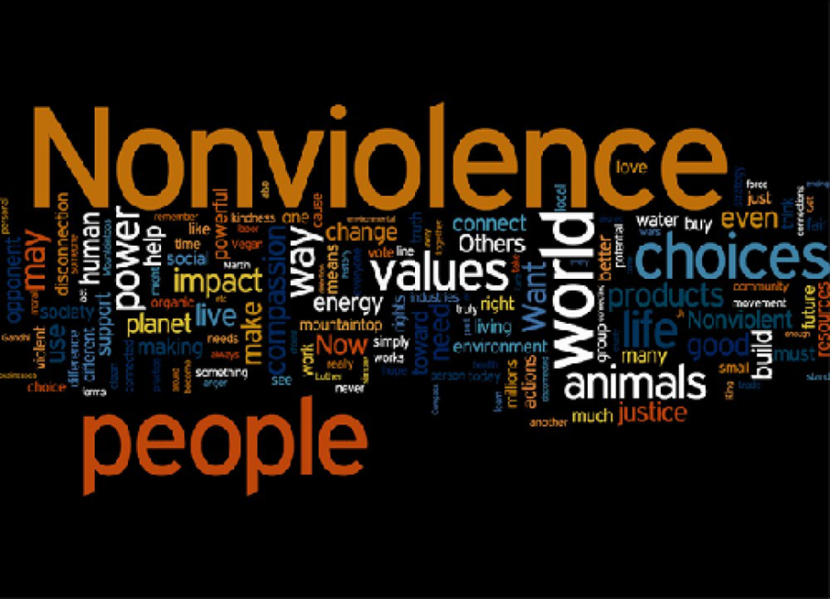
Welcome and introduction
Being the People of God, means being God’s leaven in this our humanity,
Pope Francis
Learning from last week

Slide 3
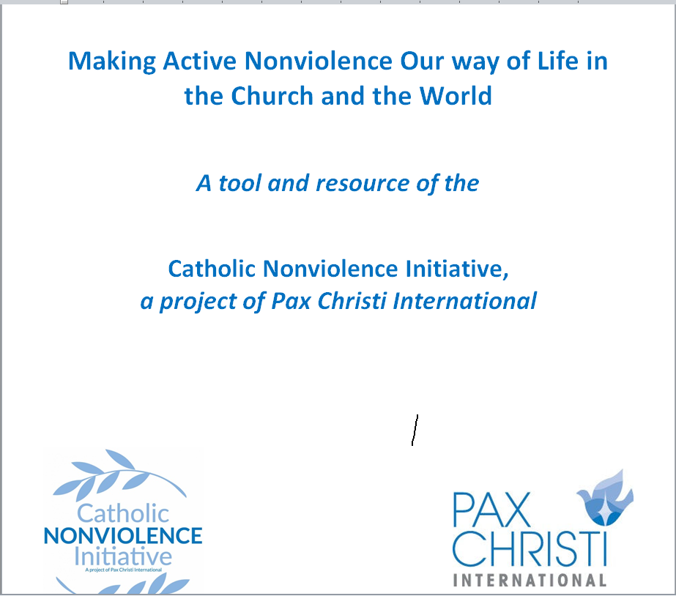
Making active nonviolence our way of life
5 session discussion/reflection resource for groups
Cultivating Nonviolence
Seeing Violence in our World Today
Discerning and Judging based on the Good News of Jesus
Acting with a force more powerful than violence
Invitation to take up “active nonviolence”

Slide 4
Gathering prayer
Spirit of God, we long to mend the broken circle. We long to heal the fractures in the world around us and within our souls.
To learn from one another the ways of living fully alive.
To transform those parts of ourselves and our world that block our making contact with our deepest reality and with the deepest, richest and most sacred dimensions of all other beings.
Silence
Spirit of God, we long to see reality.
To contact our deepest yearning for a world pulsing with justice and truth.
To dream of a society where we all sit down at the Great Feast,
where every person eats until they are full.
Silence
Spirit of God, we long to discover anew the courage deep within us.
To see and to listen. To discover our true selves.
To take steps to stop the cycle of violence in our homes, in our work-places, in our neighbourhoods, in our country and in our entire world.

Slide 5
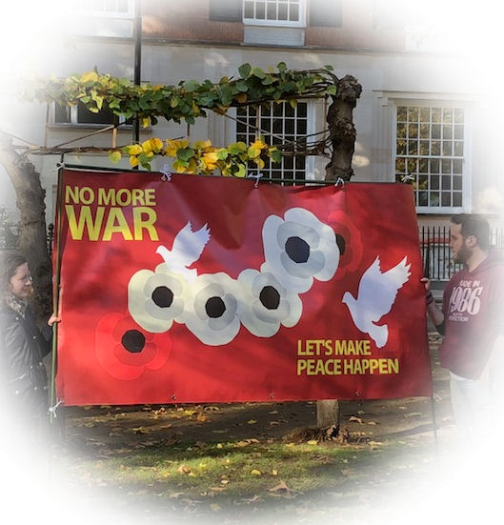
Reading for today – Session 2
“Today, sadly, we find ourselves engaged in a horrifying world war fought piecemeal. It is not easy to know if our world is presently more or less violent than in the past, or to know whether modern means of communications and greater mobility have made us more aware of violence, or, on the other hand, increasingly inured to it.
In any case, we know that this “piecemeal” violence, of different kinds and levels, causes great suffering: wars in different countries and continents; terrorism, organized crime and unforeseen acts of violence; the abuses suffered by migrants and victims of human trafficking; and the devastation of the environment. Where does this lead? Can violence achieve any goal of lasting value? Or does it merely lead to retaliation and a cycle of deadly conflicts that benefit only a few “warlords”?

Slide 6
Violence is not the cure for our broken world. Countering violence with violence leads at best to forced migrations and enormous suffering, because vast amounts of resources are diverted to military ends and away from the everyday needs of young people, families experiencing hardship, the elderly, the infirm and the great majority of people in our world. At worst, it can lead to the death, physical and spiritual, of many people, if not of all.”
(WDP 2017, 2)

Slide 7
Discussion for today
How do you see the violence of hunger and poverty in your community? What form does this take?
What are the impacts of the ecological violence around you?
Be ready to bring some of your ‘learning’ back
to the large group

Slide 8
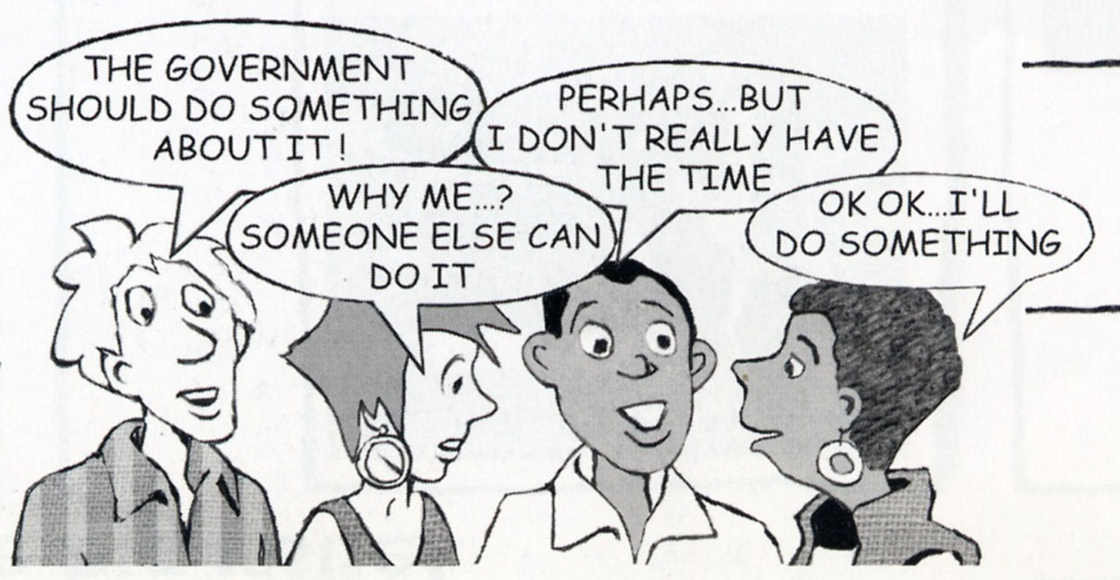
What did we learn?

Slide 9
Looking ahead
Here you can add dates/events local and national that may link to your discussion or that may be of interest to your group.

Slide 10
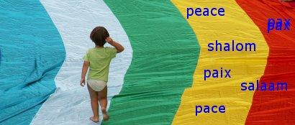
Closing prayer
Give me a heart of poverty,
able to love and open up and give myself to others
Give me a heart of patience,
able to love and live in hope.
Give me a heart of justice,
able to love and measure myself by the standard of justice.
Give me a heart of mercifulness,
able to love and understand and forgive others.
Give me a heart of sensitivity,
able to love and weep without being discouraged
Give me a heart of strength,
able to love and be faithful unto death.
Give me a heart touched by the Gospel,
able to love
(Adapted from WCC prayer –
full prayer on Pax Christi prayer card)

Slide 11
Date and time of next gathering
Resources
Websites
Catholic Nonviolence Initiative: https://nonviolencejustpeace.net/
Pax Christi International : https://paxchristi.net/
Pax Christi England and Wales : https://paxchristi.org.uk/

