Slide 1


Making active nonviolence our way of life
Session 3 – Discerning and Judging based on the Good News of Jesus
A project of
Notes:
Before slide:
Welcome from Theresa. Zoom housekeeping. Pass over to Pat – slide

Slide 2
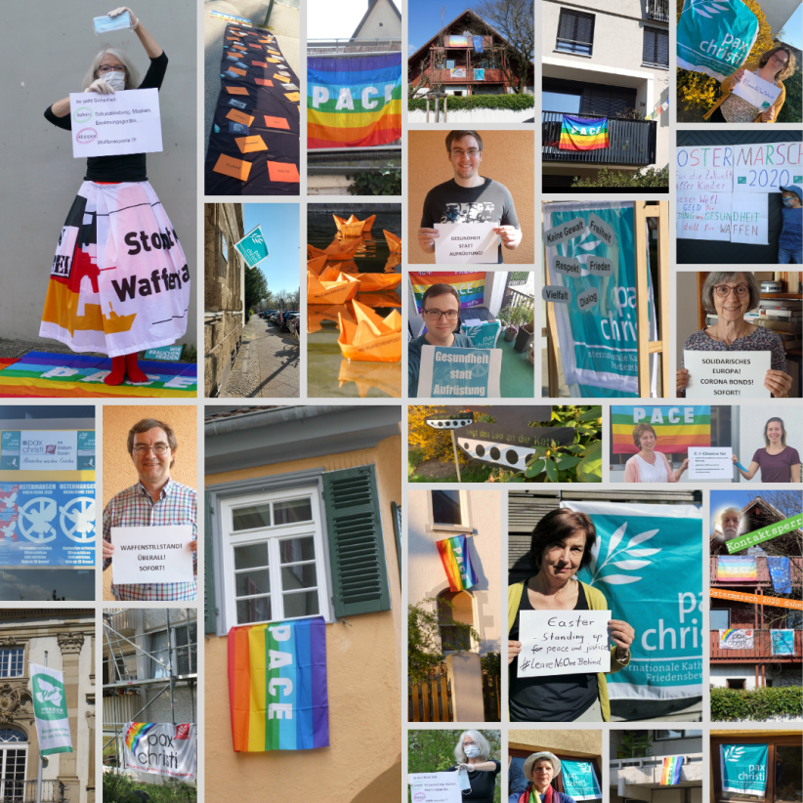
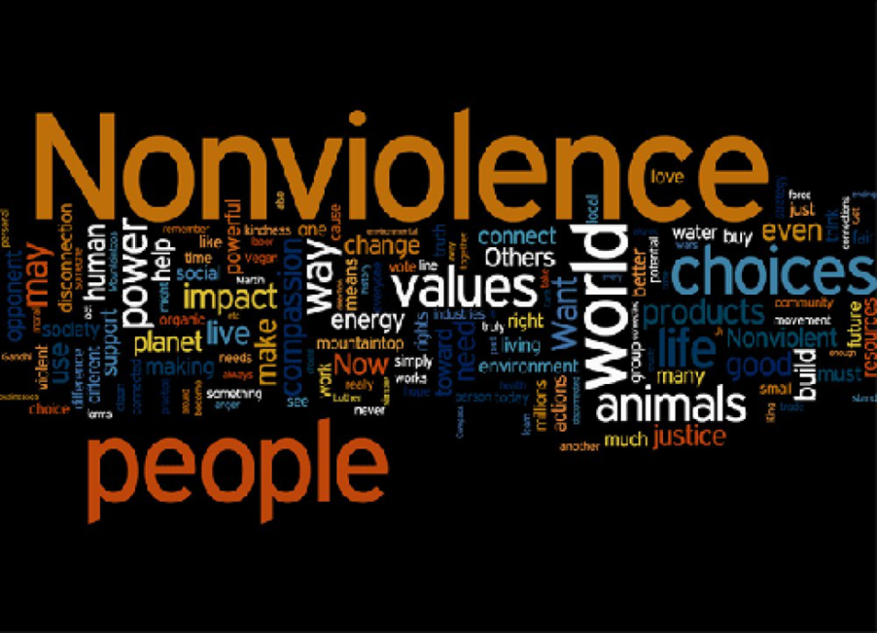
Welcome and introduction
Being the People of God, means being God’s leaven in this our humanity,
Pope Francis
Learning from last week

Slide 3
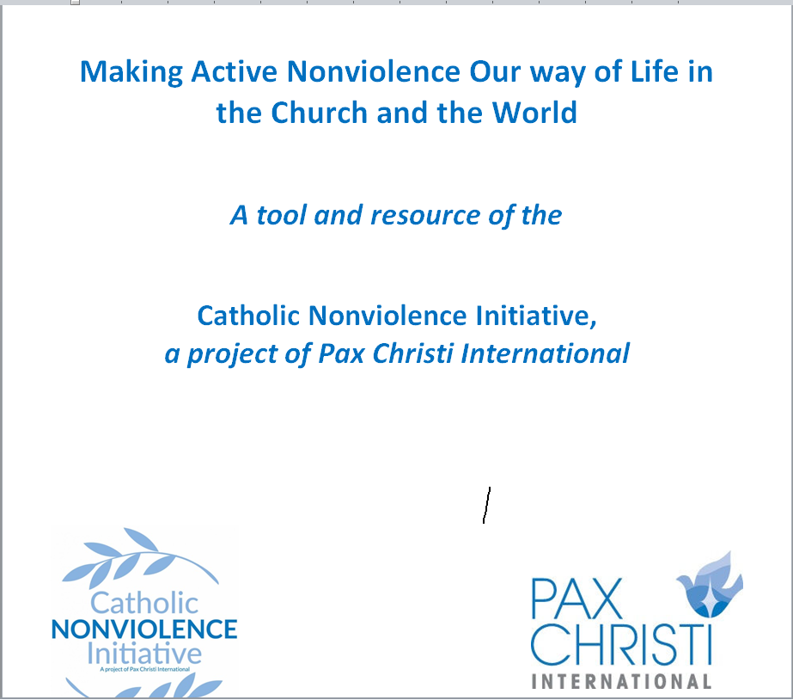
Making active nonviolence our way of life
5 session discussion/reflection resource for groups
Cultivating Nonviolence
Seeing Violence in our World Today
Discerning and Judging based on the Good News of Jesus
Acting with a force more powerful than violence
Invitation to take up “active nonviolence”

Slide 4
Gathering prayer
Spirit of God, we long to mend the broken circle. We long to heal the fractures in the world around us and within our souls.
To learn from one another the ways of living fully alive.
To transform those parts of ourselves and our world that block our making contact with our deepest reality and with the deepest, richest and most sacred dimensions of all other beings.
Silence
Spirit of God, we long to see reality.
To contact our deepest yearning for a world pulsing with justice and truth.
To dream of a society where we all sit down at the Great Feast,
where every person eats until they are full.
Silence
Spirit of God, we long to discover anew the courage deep within us.
To see and to listen. To discover our true selves.
To take steps to stop the cycle of violence in our homes, in our work-places, in our neighbourhoods, in our country and in our entire world.

Slide 5

Reading for today – Session 3
“Jesus himself lived in violent times. Yet he taught that the true battlefield, where violence and peace meet, is the human heart: for “it is from within, from the human heart, that evil intentions come” (Mk 7:21). But Christ’s message in this regard offers a radically positive approach. He unfailingly preached God’s unconditional love, which welcomes and forgives. He taught his disciples to love their enemies (cf. Mt 5:44) and to turn the other cheek (cf. Mt 5:39). When he stopped her accusers from stoning the woman caught in adultery (cf. Jn 8:1-11), and when, on the night before he died, he told Peter to put away his sword (cf. Mt 26:52), Jesus marked out the path of nonviolence. (WDP 2017, 3)
To be true followers of Jesus today also includes embracing
his teaching about nonviolence. As my predecessor Benedict XVI
observed, that teaching “is realistic because it takes into account
that in the world there is too much violence, too much injustice,
and therefore that this situation cannot be overcome except by
countering it with more love, with more goodness. This ‘more’
comes from God”.[4] He went on to stress that: “For Christians,
nonviolence is not merely tactical behaviour but a person’s way of
being, the attitude of one who is so convinced of God’s love and
power that he or she is not afraid to tackle evil with the weapons
of love and truth alone. Love of one’s enemy constitutes the
nucleus of the ‘Christian revolution’”.[5] The Gospel command to
love your enemies (cf. Lk 6:27) “is rightly considered the magna carta of Christian nonviolence. It does not consist in succumbing to evil…, but in responding to evil with good (cf. Rom 12:17-21), and thereby breaking the chain of injustice”.[6] (WDP 2017, 3)

Slide 6
5. If violence has its source in the human heart, then it is fundamental
that nonviolence be practised before all else within families.
This is part of that joy of love which I described ... in my Exhortation
Amoris Laetitia, in the wake of two years of reflection by the Church
on marriage and the family. The family is the indispensable crucible in
which spouses, parents and children, brothers and sisters, learn to
communicate and to show generous concern for one another, and in
which frictions and even conflicts have to be resolved not by force but by dialogue, respect, concern for the good of the other, mercy and forgiveness.[16]
From within families, the joy of love spills out into the world and
radiates to the whole of society. [17] An ethics of fraternity and peaceful coexistence between individuals and among peoples cannot be based on the logic of fear, violence and closed-mindedness, but on responsibility, respect and sincere dialogue. (WDP 2017, 5)
The politics of nonviolence have to begin in the home and then spread to the entire human family. “Saint Therese of Lisieux invites us to practice the little way of love, not to miss out on a kind word, a smile or any small gesture which sows peace and friendship. An integral ecology is also made up of simple daily gestures that break with the logic of violence, exploitation and selfishness”.[19] (WDP 2017, 5)

Slide 7
Discussion for today
Can you recall a Gospel story where Jesus acts with nonviolence?
How can faith in Jesus Christ and what we read about his life and witness, help us to understand and promote gospel nonviolence in the Church and in the society?
Be ready to bring some of your ‘learning’ back
to the large group

Slide 8
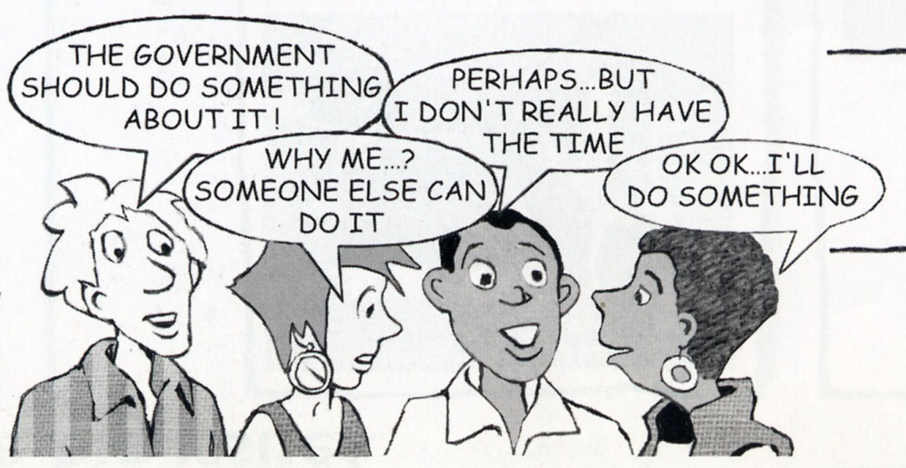
What did we learn?

Slide 9
Looking ahead
Here you can add dates/events local and national that may link to your discussion or that may be of interest to your group.

Slide 10
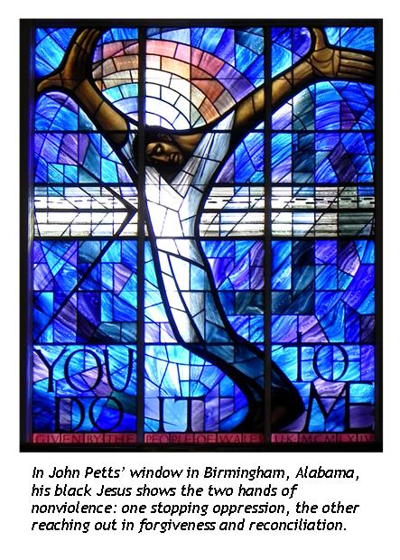
Prayer
How I wish that all men and
women of good will would look at
the Cross if only for a moment!
There, we can see God’s reply:
violence is not answered
with violence,
death is not answered with the
language of death
In the silence of the cross,
The uproars of weapons ceases
And the language of reconciliation,
Forgiveness, dialogue and peace is spoken
Pope Francis

Slide 11
Date and time of next gathering…
Resources
Websites
Catholic Nonviolence Initiative: https://nonviolencejustpeace.net/
Pax Christi International : https://paxchristi.net/
Pax Christi England and Wales : https://paxchristi.org.uk/

