Slide 1
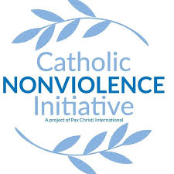

Making active nonviolence our way of life
Session 4 – Acting with a force more powerful than violence
A project of
Notes:
Before slide:
Welcome from Theresa. Zoom housekeeping. Pass over to Pat – slide

Slide 2
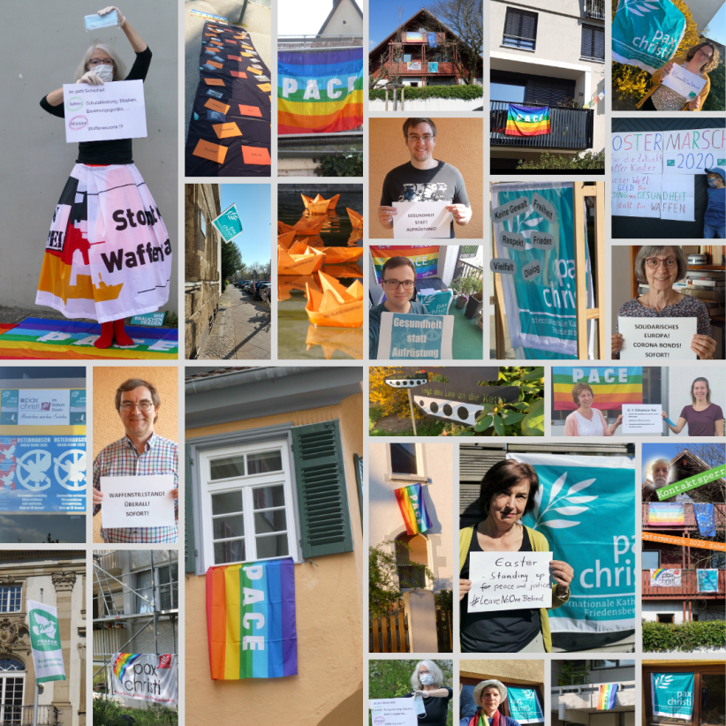
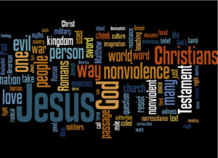
Welcome and introduction
Being the People of God, means being God’s leaven in this our humanity,
Pope Francis
Learning from last week

Slide 3
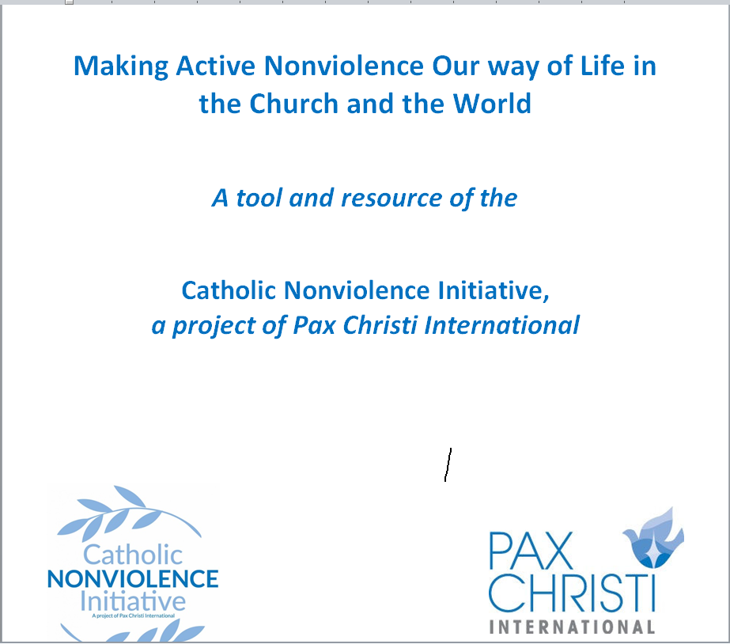
Making active nonviolence our way of life
5 session discussion/reflection resource for groups
Cultivating Nonviolence
Seeing Violence in our World Today
Discerning and Judging based on the Good News of Jesus
Acting with a force more powerful than violence
Invitation to take up “active nonviolence”

Slide 4
Gathering prayer
Spirit of God, we long to mend the broken circle. We long to heal the fractures in the world around us and within our souls.
To learn from one another the ways of living fully alive.
To transform those parts of ourselves and our world that block our making contact with our deepest reality and with the deepest, richest and most sacred dimensions of all other beings.
Silence
Spirit of God, we long to see reality.
To contact our deepest yearning for a world pulsing with justice and truth.
To dream of a society where we all sit down at the Great Feast,
where every person eats until they are full.
Silence
Spirit of God, we long to discover anew the courage deep within us.
To see and to listen. To discover our true selves.
To take steps to stop the cycle of violence in our homes, in our work-places, in our neighbourhoods, in our country and in our entire world.

Slide 5
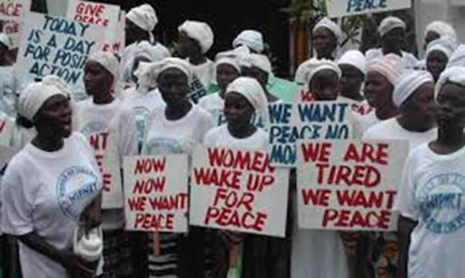
Reading for today – Session 4
4. Nonviolence is sometimes taken to mean surrender, lack of involvement and passivity, but this is not the case. When Mother Teresa received the Nobel Peace Prize in 1979, she clearly stated her own message of active nonviolence: “We in our family don’t need bombs and guns, to destroy to bring peace – just get together, love one another… And we will be able to overcome all the evil that is in the world”.[7] For the force of arms is deceptive. “While weapons traffickers do their work, there are poor peacemakers who give their lives to help one person, then another and another and another”; for such peacemakers, Mother Teresa is “a symbol, an icon of our times”.[8] (WDP 2017, 4)
The decisive and consistent practice of nonviolence has produced impressive results. The achievements of Mahatma Gandhi and Khan Abdul Ghaffar Khan
in the liberation of India, and of Dr Martin Luther King Jr in combating racial discrimination will never be forgotten.
Women in particular are often leaders of
nonviolence, as for example, was
Leymah Gbowee and the thousands of Liberian
women, who organized pray-ins and nonviolent
protest that resulted in high-level peace talks to
end the second civil war in Liberia.

Slide 6
Nor can we forget the eventful decade that ended with the fall of Communist regimes in Europe. The Christian communities made their own contribution by their insistent prayer and courageous action. Particularly influential were the ministry and teaching of Saint John Paul II. Reflecting on the events of 1989 in his 1991 Encyclical Centesimus Annus, my predecessor highlighted the fact that momentous change in the lives of people, nations and states had come about “by means of peaceful protest, using only the weapons of truth and justice”.[10] This peaceful political transition was made possible in part “by the non-violent commitment of people who, while always refusing to yield to the force of power, succeeded time after time in finding effective ways of bearing witness to the truth”. Pope John Paul went on to say: “May people learn to fight for justice without violence, renouncing class struggle in their internal disputes and war in international ones”.[11]
The Church has been involved in nonviolent peacebuilding strategies in many countries, engaging even the most violent parties in efforts to build a just and lasting peace.
Such efforts on behalf of the victims of injustice and violence are not the legacy of the Catholic Church alone, but are typical of many religious traditions, for which “compassion and nonviolence are essential elements pointing to the way of life”.[12] I emphatically reaffirm that “no religion is terrorist”.[13] Violence profanes the name of God.[14] Let us never tire of repeating: “The name of God cannot be used to justify violence. Peace alone is holy. Peace alone is holy, not war!”[15] (WDP 2017, 4)

Slide 7
Discussion for today
Can you think of a person or group you know/have read about who has used nonviolence in the face of conflict or injustice? What approach did they take?
What opportunities might we have to share good news stories of nonviolence in schools, our churches, communities?
Be ready to bring some of your ‘learning’ back
to the large group

Slide 8
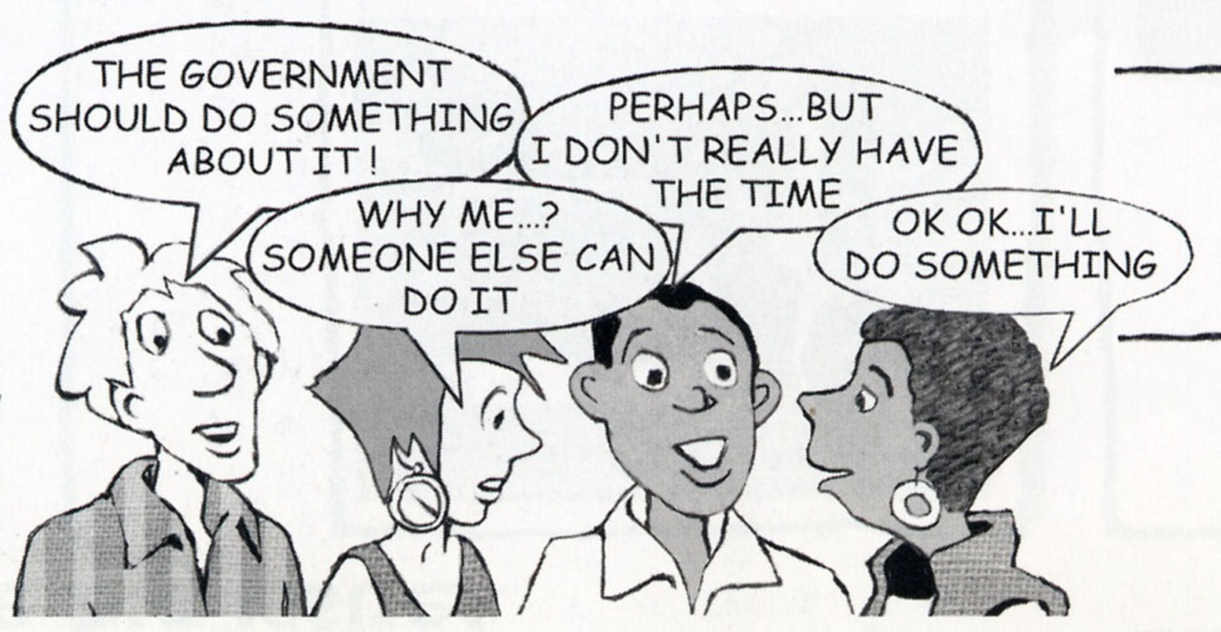
What did we learn?

Slide 9
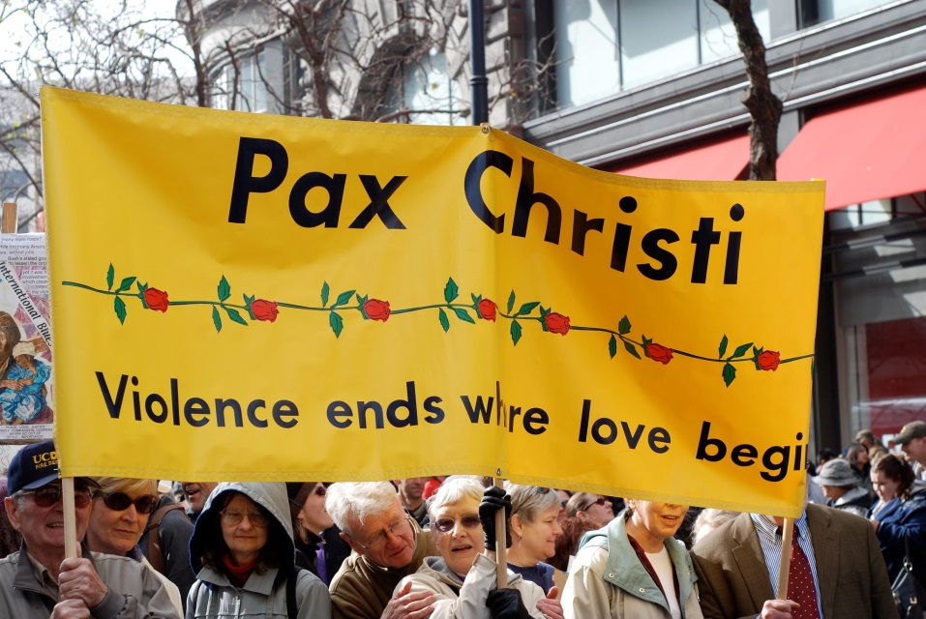
Prayer
O God of Mercy and Compassion, open our hearts to your grace.
We ask you to:
Bless us with courage to embrace nonviolence in our everyday lives;
Bless us with vision to seek alternatives when violence appears as the only solution;
Encourage us to look deeply at our own complicity that allows violence to continue in our own hearts and in our world;
Bless us with insight to see the roots of
violence inherent in our community/
society;
Bless us with the tenacity to stay
committed to the struggle to shape
a more peaceful, nonviolent world
for all your people.
Sisters of Mercy, USA

Slide 10
Date and time of next gathering…
Resources
Websites
Latest Justpeace newsletter
https://paxchristi.org.uk/wp/wp-content/uploads/2020/09/JustpeaceNonviolence-Sept2020pdf.pdf
Catholic Nonviolence Initiative: https://nonviolencejustpeace.net/
Pax Christi International : https://paxchristi.net/
Pax Christi England and Wales : https://paxchristi.org.uk/

