Slide 1


Making active nonviolence our way of life
Session 5– Invitation to take up “active nonviolence”
A project of
Notes:
Before slide:
Welcome from Theresa. Zoom housekeeping. Pass over to Pat – slide

Slide 2
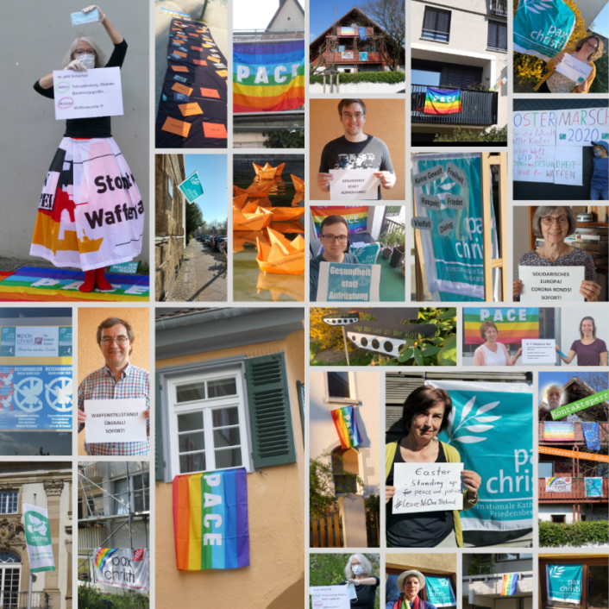
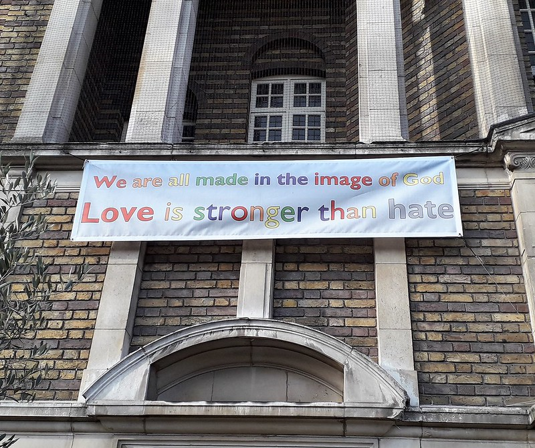
Welcome and introduction
Being the People of God, means being God’s leaven in this our humanity,
Pope Francis
Learning from last week

Slide 3
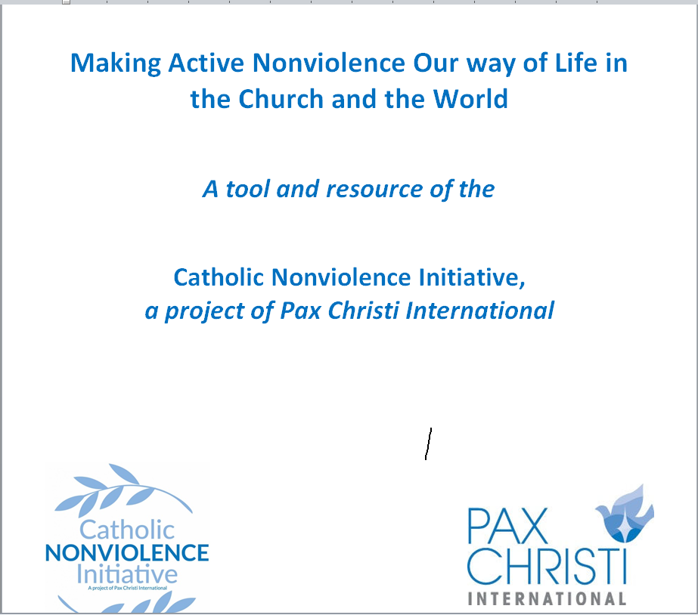
Making active nonviolence our way of life
5 session discussion/reflection resource for groups
Cultivating Nonviolence
Seeing Violence in our World Today
Discerning and Judging based on the Good News of Jesus
Acting with a force more powerful than violence
Invitation to take up “active nonviolence”

Slide 4
Gathering prayer
Spirit of God, we long to mend the broken circle. We long to heal the fractures in the world around us and within our souls.
To learn from one another the ways of living fully alive.
To transform those parts of ourselves and our world that block our making contact with our deepest reality and with the deepest, richest and most sacred dimensions of all other beings.
Silence
Spirit of God, we long to see reality.
To contact our deepest yearning for a world pulsing with justice and truth.
To dream of a society where we all sit down at the Great Feast,
where every person eats until they are full.
Silence
Spirit of God, we long to discover anew the courage deep within us.
To see and to listen. To discover our true selves.
To take steps to stop the cycle of violence in our homes, in our work-places, in our neighbourhoods, in our country and in our entire world.

Slide 5
Reading for today – Session
6. Peacebuilding through active nonviolence is the natural and necessary complement to the Church’s continuing efforts to limit the use of force by the application of moral norms; she does so by her participation in the work of international institutions and through the competent contribution made by so many Christians to the drafting of legislation at all levels. Jesus himself offers a “manual” for this strategy of peacemaking in the Sermon on the Mount. The eight Beatitudes (cf. Mt 5:3-10) provide a portrait of the person we could describe as blessed, good and authentic. Blessed are the meek, Jesus tells us, the merciful and the peacemakers, those who are pure in heart, and those who hunger and thirst for justice.
This is also a programme and a challenge for political and religious leaders, the heads of international institutions, and business and media executives: to apply the Beatitudes in the exercise of their respective responsibilities. It is a challenge to build up society, communities and businesses by acting as peacemakers. It is to show mercy by refusing to discard people, harm the environment, or seek to win at any cost. To do so requires “the willingness to face conflict head on, to resolve it and to make it a link in the chain of a new process”.[20] To act in this way means to choose solidarity as a way of making history and building friendship in society. Active nonviolence is a way of showing that unity is truly more powerful and more fruitful than conflict. /over

Slide 6
Everything in the world is inter-connected.[21] Certainly differences can cause frictions. But let us face them constructively and nonviolently, so that “tensions and oppositions can achieve a diversified and life-giving unity,” preserving “what is valid and useful on both sides”.[22]
I pledge the assistance of the Church in every effort to build peace through active and creative nonviolence. (WDP 2017, 6)

Slide 7
Discussion for today
Can you think of any examples of the Church using its role/voice creatively and effectively in situations of conflict? How can we make these better known?
What hopeful or practical ideas will you take away from this course? How might you share these?
Be ready to bring some of your ‘learning’ back
to the large group

Slide 8
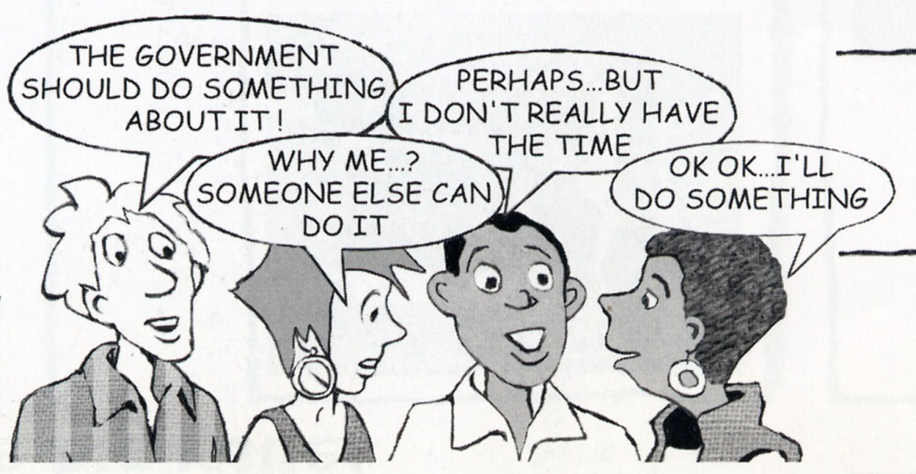
What did we learn?

Slide 9
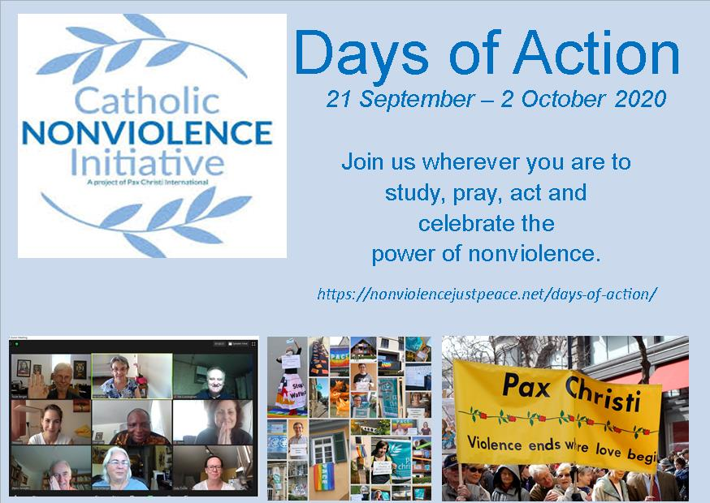
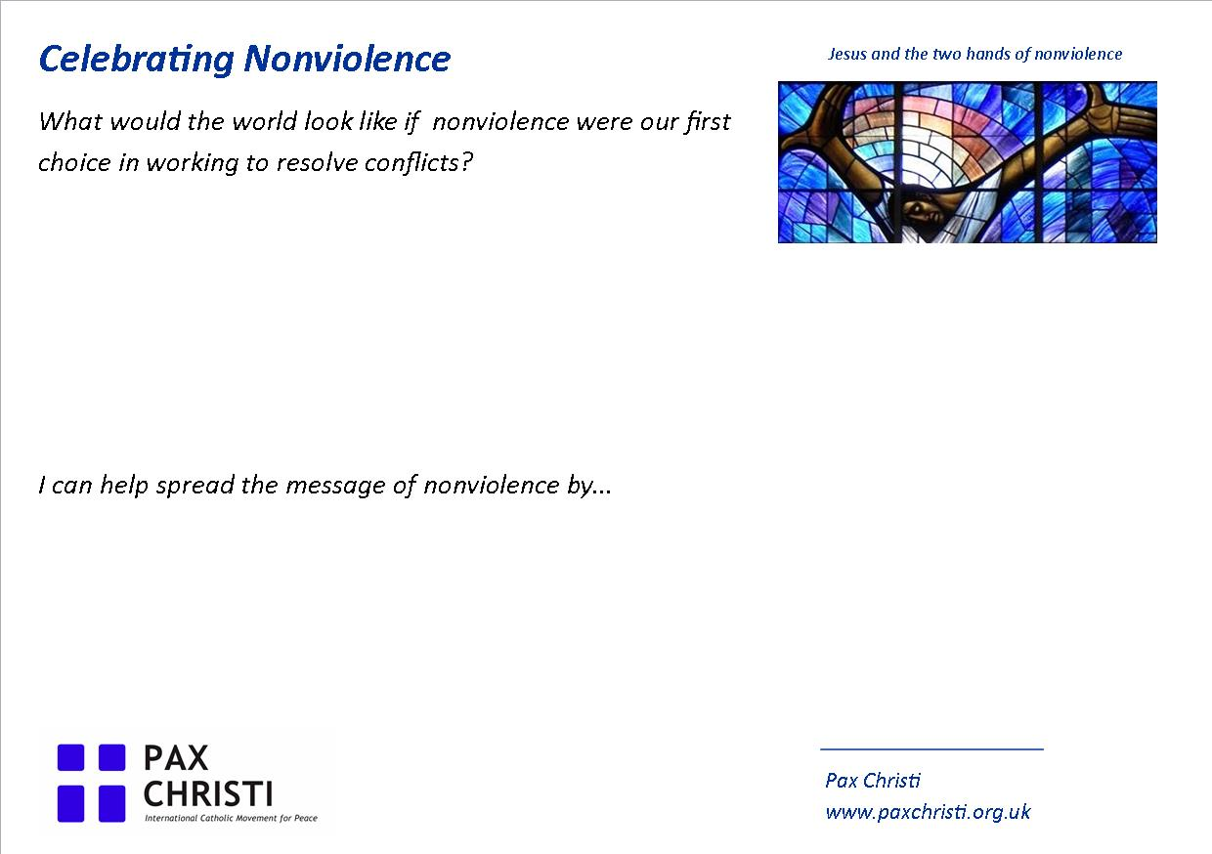
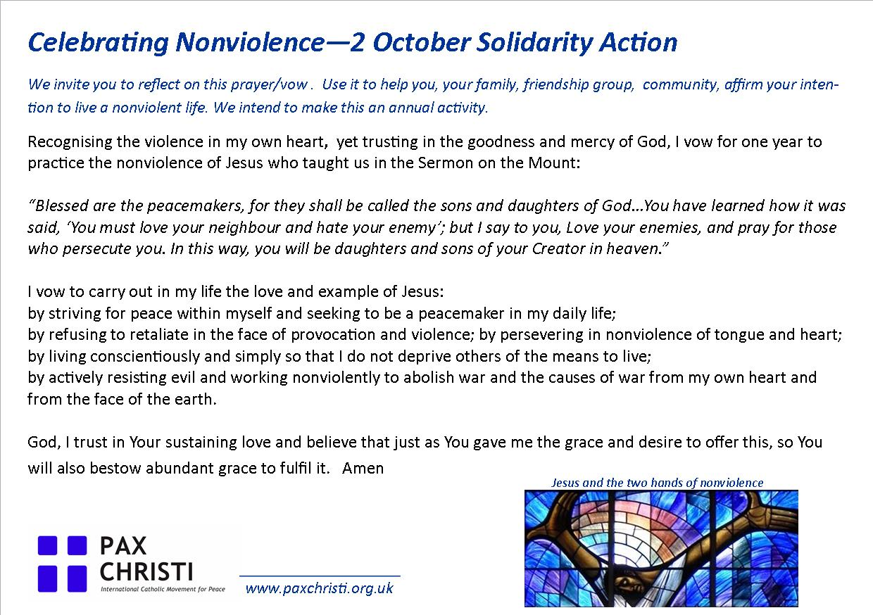

Slide 11
Resources
Websites
Latest Justpeace newsletter
https://paxchristi.org.uk/wp/wp-content/uploads/2020/09/JustpeaceNonviolence-Sept2020pdf.pdf
Catholic Nonviolence Initiative: https://nonviolencejustpeace.net/
Pax Christi International : https://paxchristi.net/
Pax Christi England and Wales : https://paxchristi.org.uk/

