Slide 1
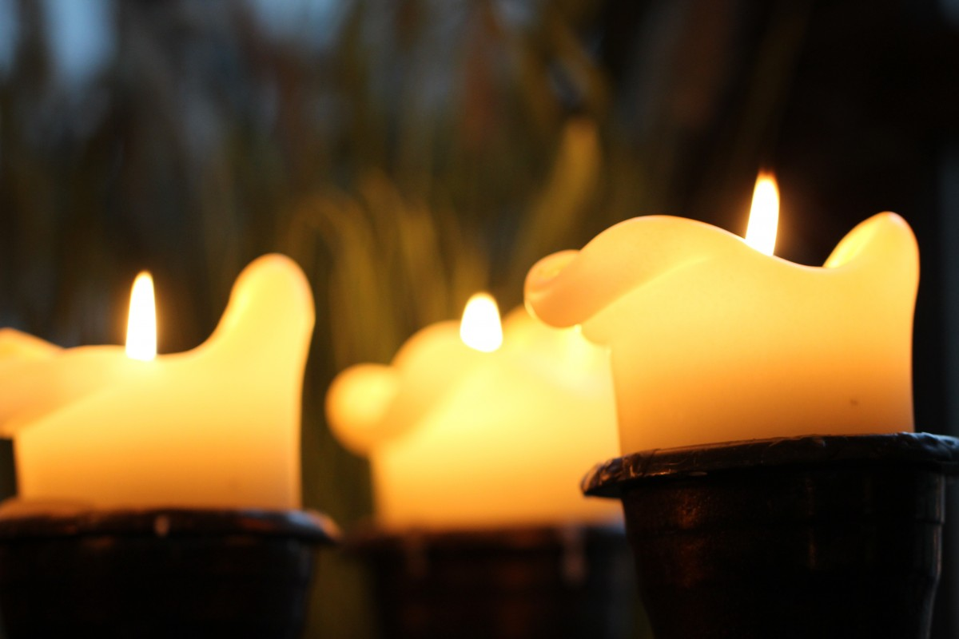
Advent Activities and Reflections

Slide 2

Advent is a time when we look forward to the coming of Jesus at Christmas. It’s a time to prepare ourselves spiritually and to reflect. But often we find ourselves drawn into the busyness of Christmas, with all the preparations and pre-celebrations.
Take a minute just to think about what it is we are preparing for. For some of us, it’s the celebration of the Nativity, for others it’s a time to be with family and friends, or maybe it’s a time for rest.
Take some time to have a moment of stillness for yourself in the middle of all the busyness.
Notes:
You may want to play some quiet music and get some feedback.

Slide 3
Peace is a feeling
Agree
Disagree
Notes:
Opinion spectrum: Students should consider whether they agree or disagree with the statement and decide where they would be along the line.

Slide 4

In Advent, we hear a lot about peace.
What do you think peace is?
You might have many different answers. If so, do you see any patterns? Can you group your answers into categories or themes?
What might this tell us about peace?
Notes:
This could be done as a written or spoken activity. Patterns, themes or categories might include: inner peace, interpersonal peace, global peace, ideas around a lack of violence, feelings or actions.

Slide 5

What would our lives be like if we all lived in peace?
Notes:
You may want to prompt students using answers from previous slides or talking about how it might affect us personally versus how if might look on a global level.

Slide 6
In the Church’s Advent readings, we hear this from Isaiah, proclaiming:
“The spirit of the Lord God is upon me,
because the Lord has anointed me;
he has sent me to bring good news to the oppressed,
to bind up the broken-hearted,
to proclaim liberty to the captives,
and release to the prisoners”
Isaiah 61:1 (NRSV)
What do you think this verse is saying?
Who might these people be in our world today?
What might this verse mean for us?

Slide 7
“The spirit of the Lord God is upon me,
because the Lord has anointed me;
he has sent me to bring good news to the oppressed,
to bind up the broken-hearted,
to proclaim liberty to the captives,
and release to the prisoners”
Isaiah 61:1 (NRSV)
For many people this verse is about justice, and we even see Jesus reading from this piece of scripture in Luke chapter 4.
How might you work for justice and peace in your school community? For example, how could you challenge racism
or challenge bullying?

Slide 8






Activity
Create an acrostic poem using the letters of the word ‘peace’ and decorate your poem with images of peace.
P
E
A
C
E

Slide 9




Activity
Think of as many words as you can to do with peace and write them down.
Pick 7 of the words from your list and use them to create a poem, song or piece of creative writing about peace.

Slide 10
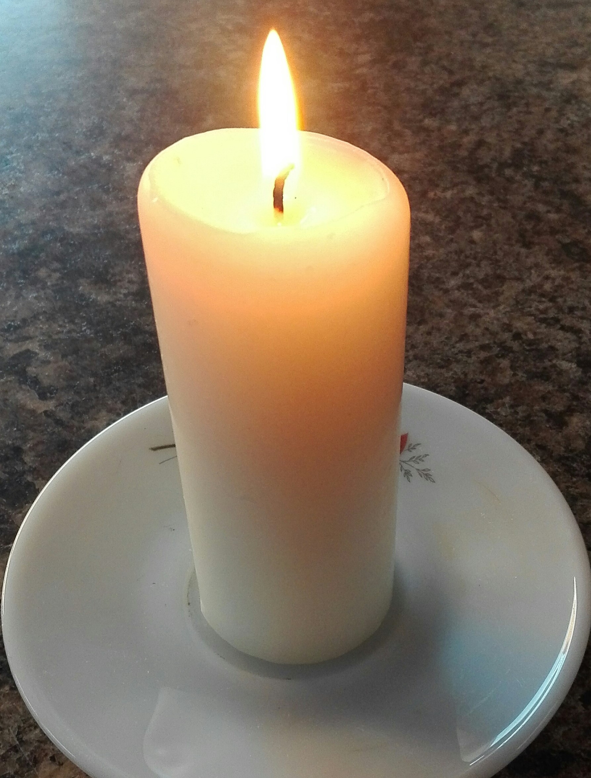
Prayer
Dear Lord,
We pray for peace in our world at this time.
We pray for a world of justice, of compassion, of kindness and of mercy.
We ask that you grant us the grace to work for this more just and peaceful world.
Amen

Slide 11

Copyright
The Scripture quotations contained herein are from the New Revised Standard Version Bible © 1989, Division of Christian Education of the National Council of Churches of Christ in the United States of America. Used by permission. All rights reserved.
www.paxchristi.org.uk
https://twitter.com/PaxChristiYouth

