Slide 1
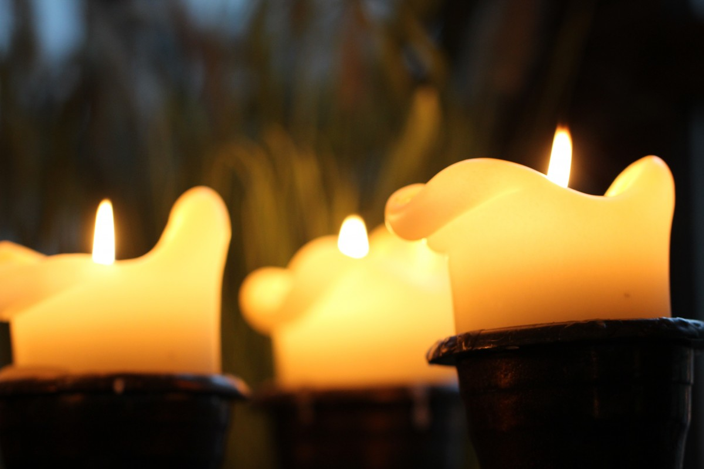
Pax Christi Advent Service
2020- Readings and Prayers

Slide 2
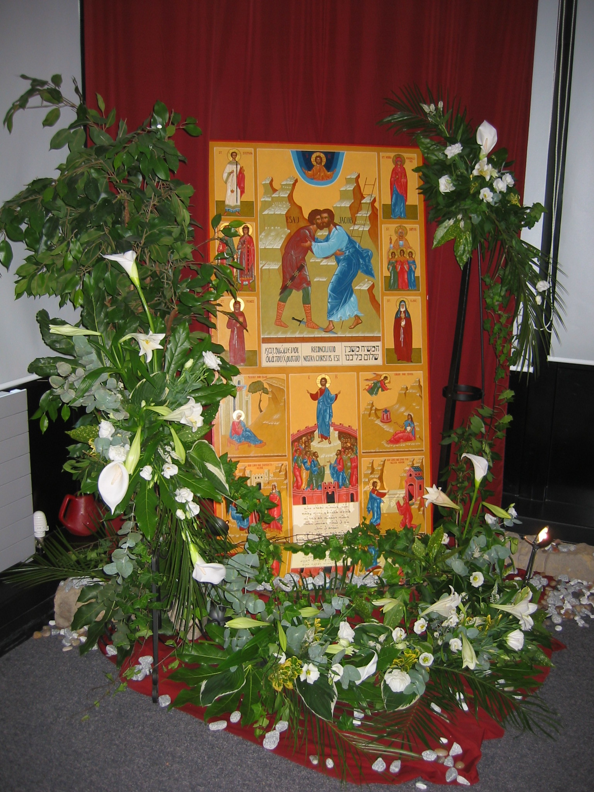
The wilderness and the dry land shall be glad,
the desert shall rejoice and blossom;
like the crocus it shall blossom abundantly,
and rejoice with joy and singing.
Isaiah 35:1-2
New Revised Standard Version Bible, copyright © 1989, Division of Christian Education of the National Council of Churches of Christ in the United States of America. Used by permission. All rights reserved.
Notes:
Check translation to check copyright

Slide 3
Loving God,
Creator of Heaven and Earth.
Open our minds and touch our hearts, so that we can be part of Creation, your gift.
Response: Guide us into your ways of peace
Help us to show creative solidarity as we confront the consequences of the global pandemic.
Response: Guide us into your ways of peace
Make us courageous in embracing the changes required to seek the common good.
Response: Guide us into your ways of peace
Now more than ever, may we all feel interconnected and interdependent.
Response: Guide us into your ways of peace
Enable us to succeed in listening and responding to the cry of the Earth.
Response: Guide us into your ways of peace
We pray through Christ our Lord,
Amen.
Adapted, Prayer for the Fifth Anniversary of the Encyclical Laudato si’: “Common Prayer for Earth and for Humanity”. Pope Francis, the Vatican
Notes:
Figure out here

Slide 4
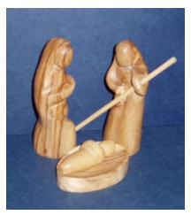
I heard a loud voice call from the throne, 'Look, here God lives among human beings. He will make his home among them; they will be his people, and he will be their God, God-with-them. He will wipe away all tears from their eyes; there will be no more death, and no more mourning or sadness or pain. The world of the past has gone.'
Then the One sitting on the throne spoke, 'Look, I am making the whole of creation new’.
Revelation 21: 3-5a
From The Jerusalem Bible © 1966 by Darton Longman & Todd Ltd and Doubleday and Company Ltd

Slide 5
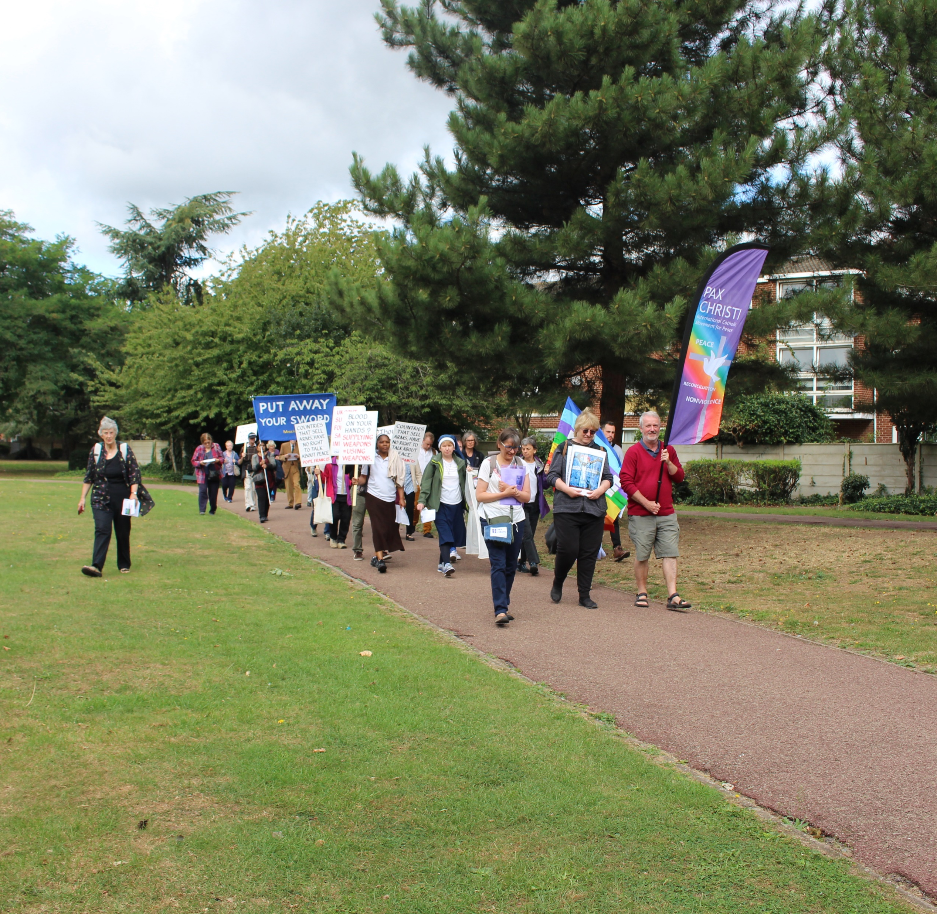
“No one can face life in isolation... We need a community that supports and helps us, in which we can help one another to keep looking ahead. How important it is to dream together... By ourselves, we risk seeing mirages, things that are not there. Dreams, on the other hand, are built together".
Pope Francis, Fratelli Tutti #8

Slide 6

Lord, Father of our human family,
you created all human beings equal in dignity:
pour forth into our hearts a sisterly and brotherly spirit and inspire in us a dream of renewed encounter, dialogue, justice and peace.
Move us to create healthier societies and a more dignified world,
a world without hunger, poverty, violence and war.
May our hearts be open to all the peoples and nations of the earth.
May we recognize the goodness and beauty that you have sown in each of us,
and thus forge bonds of unity, common projects, and shared dreams.
Amen
Adapted from Pope Francis, Fratelli Tutti, “A Prayer to the Creator”

Slide 7
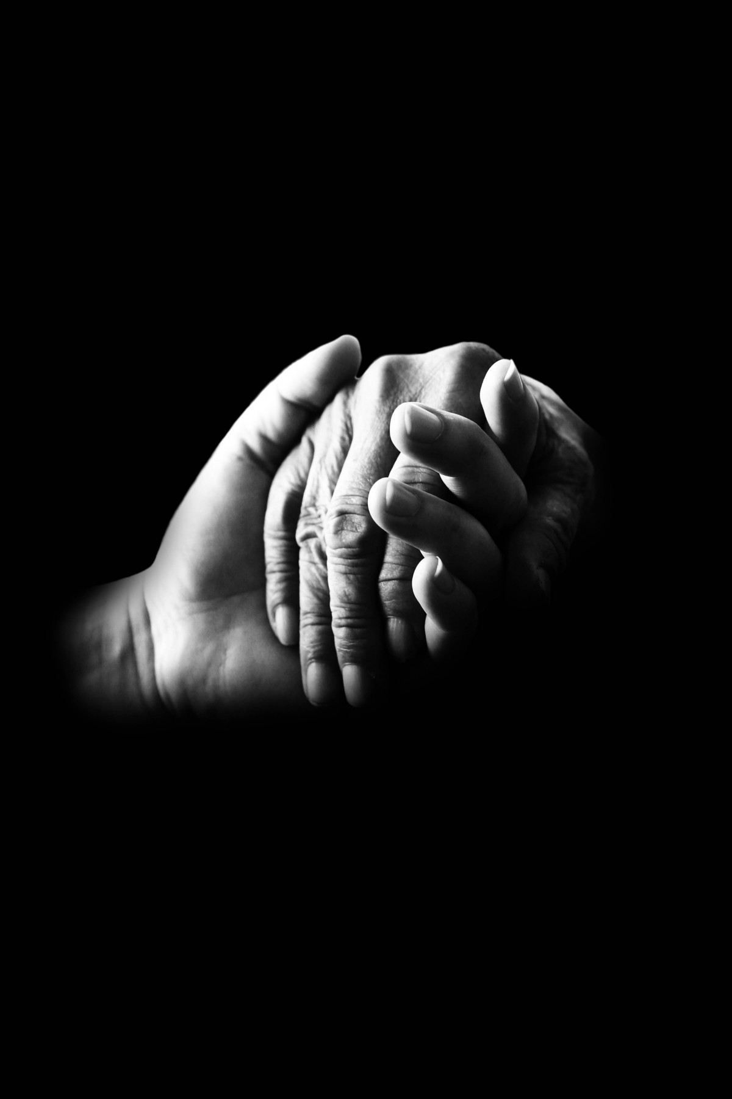
As God’s chosen ones, holy and beloved, clothe yourselves with compassion, kindness, humility, meekness, and patience. Bear with one another and, if anyone has a complaint against another, forgive each other; just as the Lord has forgiven you, so you also must forgive. Above all, clothe yourselves with love, which binds everything together in perfect harmony. And let the peace of Christ rule in your hearts, to which indeed you were called in the one body. And be thankful.
Colossians 3:12-15
New Revised Standard Version Bible, copyright © 1989, Division of Christian Education of the National Council of Churches of Christ in the United States of America. Used by permission. All rights reserved.

Slide 8
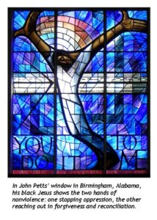
Story of nonviolence
Notes:
Some guidance for stories of nonviolence can be found on slide 20

Slide 9

I believe in God, who is love and who has given the earth to all people.
I believe in Jesus Christ, who came to heal us and to free us from all forms of oppression.
I believe in the spirit of God, who works in and through all who are turned toward the truth.
I believe in the community of faith, which is called to be at the service of all people.
I do not believe in the right of the strongest, nor the force of arms, nor the power of oppression.
I believe in human rights, the solidarity of all people, in the power of nonviolence.
I do not believe in accepting racism, in the power that comes from wealth and privilege, or in any established order that enslaves.

Slide 10
I believe that all women and men are equally human and that God intends for the world an order based on justice and love.
I do not believe that war and hunger are inevitable and peace unattainable.
I believe in the beauty of simplicity, in love with open hands, in peace on earth.
I dare to believe,
always and in spite of everything,
in God’s power to transform and transfigure,
fulfilling the promise of a new heaven and a new earth
where justice and peace will flourish.
Amen
Adapted creed from Indonesia from Carmel Little, CSJP (also found in Dare to Dream: A Prayer & Worship Anthology from around the world. Ed. Geoffrey Duncan)

Slide 11
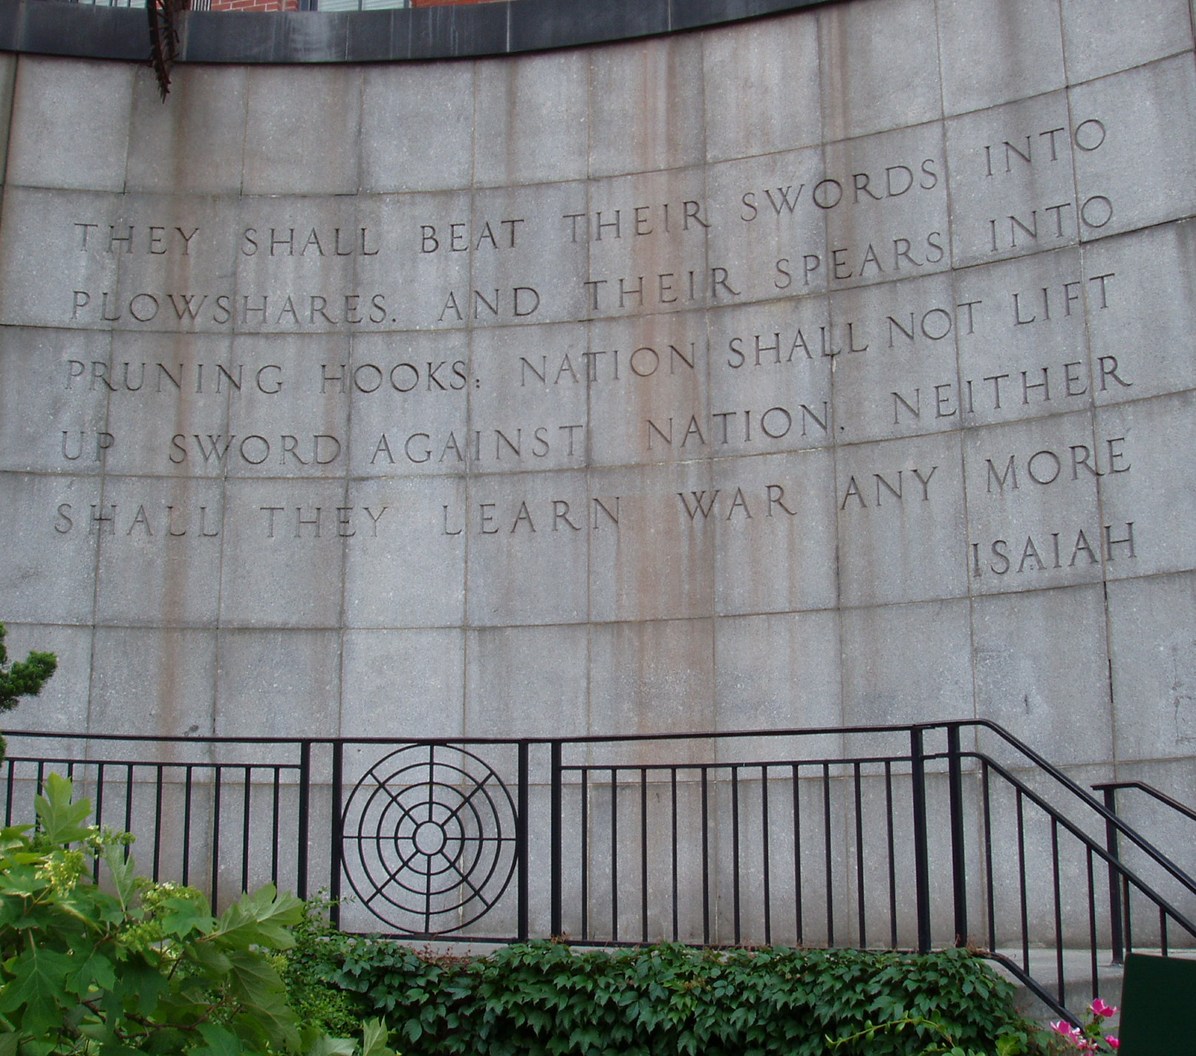
In days to come
the mountain of the Lord’s house
shall be established as the highest of the mountains,
and shall be raised above the hills;
all the nations shall stream to it.
Many peoples shall come and say,
‘Come, let us go up to the mountain of the Lord,
to the house of the God of Jacob;
that he may teach us his ways
and that we may walk in his paths.’
For out of Zion shall go forth instruction,
and the word of the Lord from Jerusalem.
He shall judge between the nations,
and shall arbitrate for many peoples;

Slide 12
they shall beat their swords into ploughshares,
and their spears into pruning hooks;
nation shall not lift up sword against nation,
neither shall they learn war any more.
Isaiah 2:2-4
New Revised Standard Version Bible, copyright © 1989, Division of Christian Education of the National Council of Churches of Christ in the United States of America. Used by permission. All rights reserved.

Slide 13
I have a dream that one day this land will live out the true meaning of its creed “that all are created equal."
I have a dream, that one day on the green hills of Carmel, the refugees who fled Haifa, and the grandchildren of the Jews who took refuge there will be able to sit together at the same table.
I have a dream that one day Jerusalem, a city now filled with injustice and oppression will be transformed into an oasis of peace and justice.
I have a dream that my sisters and brothers will one day live in a country where they will not be judged by their family names but by the content of their characters.
Notes:
Ok to use

Slide 14
I have a dream that one day in the Jordan Valley and on the shores of Gaza,
Palestinian and Israeli children will feel safe and joyful by the sea.
This is our hope, yes this is the faith I go home with. With this faith we will be able to hew out of the mountain of despair a stone of hope. With this faith, we will be able to transform hatred into a symphony of love.
This will be the day when all of God’s children will be able to sing, with new meaning, their songs of liberty.
When this happens, and when freedom rings from every village, town, city, and Bedouin tent, we will be able to speed up that day when all God’s children, Jews, Muslims, Christians, and all others, will be able to join hands and sing, ‘We are free at last’.
Yusef Daher, adapted
Notes:
Ok to use

Slide 15
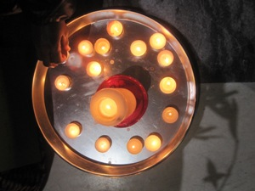
God, loving parent of all humankind,
you are our Peace.
In Jesus Christ you embodied peace with
justice – and you still do – peace at its most
down to earth, peace, which can still prevail in
the face of all the walls we build.
R: God, loving parent of all humankind,
you are our Peace.
We confess our helpless anger, confronted
by concrete cutting across the daily lives of
your children: limits imposed on travel, study,
healthcare, work, worship, family connections,
celebrations.
R: God, loving parent of all humankind,
you are our Peace.
Notes:
Ok to use

Slide 16
We confess our complicity in maintaining
barriers of ignorance, fear, privilege,
prejudice, ‘us’ and ‘them’.
R: God, loving parent of all humankind,
you are our Peace.
Our world is crossed by razor wire
that tears at flesh and draws blood.
But you are our peace, with power
to cut this wire for good,
to break down all our walls.
R: God, loving parent of all humankind,
you are our Peace.
Help us to share in this work.
R: God, loving parent of all humankind,
you are our Peace. Jan Sutch Pickard, 2016, adapted
Notes:
Ok to use

Slide 17
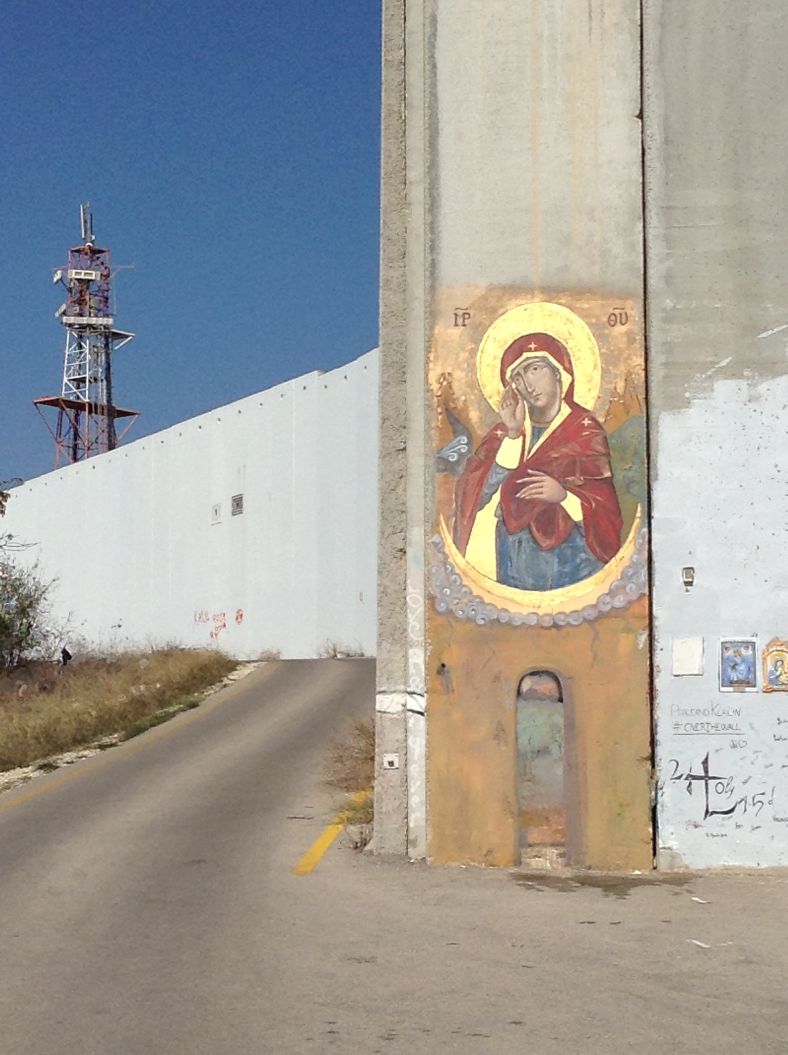
Here we have a time of quiet reflection.

Slide 18
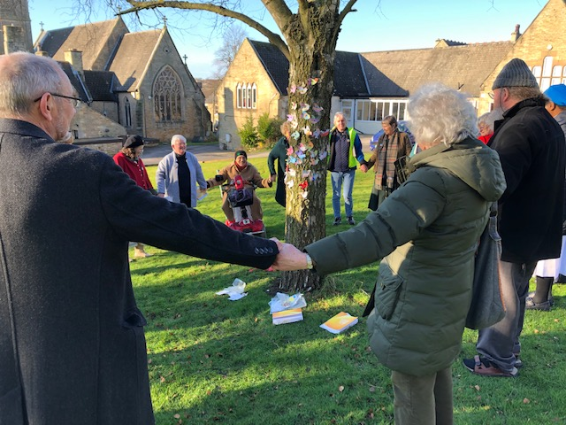
God of all,
as we walk together,
Open our hearts,
To your tenderness.
Open our minds,
To your understanding.
Open our lives,
To your challenge.
We are one people, many nations,
Building hope through steps for peace.
One world with many barriers,
Breaking chains so we dance free.
One voice that shouts for justice,
Shatters hatred, calls for change.
One God, one world, one people,
Turning tables, share the feast.
Amen
Linda Jones/ CAFOD

Slide 19
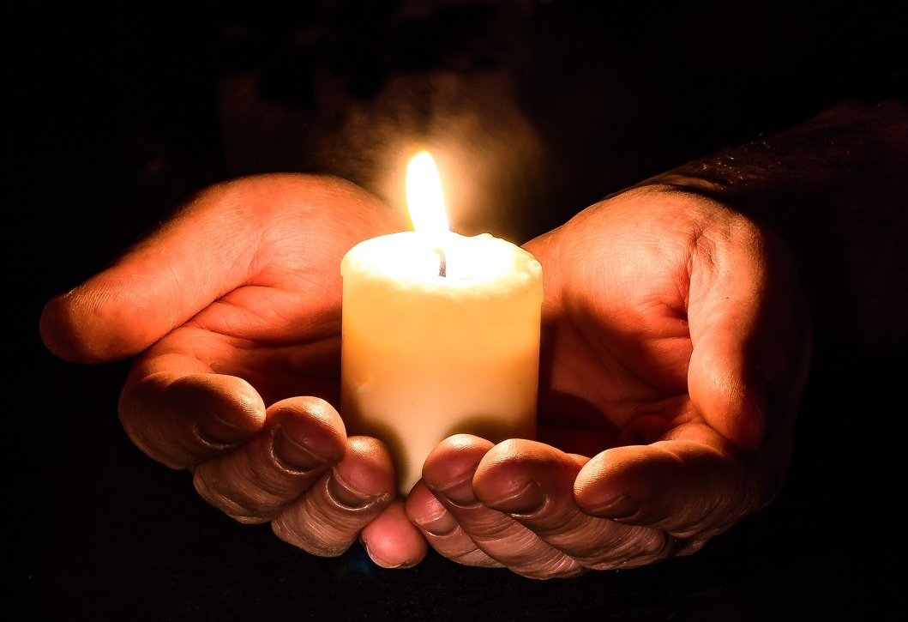
Sign
of
peace

Slide 20
Suggested songs used on the evening were:
Litany of the Word, Bernadette Farrell © OCP Publications
When Out of Poverty is Born, Kathy Galloway © WGRG c/o Iona Community. Tune: Kingsfold.
Come to us, O Emmanuel, Marty Haugen ©2000 GIA Publications Inc
My Soul Rejoices, From Luke 1:46-55 Text and Music: Owen Alstott ©1984, 1991, OCP.
Soon and Very Soon © 1976, Crouch Music/Bud John Songs, admin at EMICMGPublishing.com
Thanks to the Afghan Peace Volunteers for the use of their video, In Afghanistan, we have three dreams
In Afghanistan, We Have Three Dreams | (ourjourneytosmile.com)
Some examples of stories of nonviolence can be found on our website at: Educational Resources on Nonviolence – Pax Christi England and Wales

Slide 21
Scripture
The Scripture quotations contained herein are from the New Revised Standard Version Bible, copyright © 1989, Division of Christian Education of the National Council of Churches of Christ in the United States of America. Used by permission. All rights reserved.
From The Jerusalem Bible © 1966 by Darton Longman & Todd Ltd and Doubleday and Company Ltd
Readings and prayers
Adapted, Prayer for the Fifth Anniversary of the Encyclical Laudato si’: “Common Prayer for Earth and for Humanity”. Pope Francis, the Vatican
Pope Francis, Fratelli Tutti #8
Adapted from Pope Francis, Fratelli Tutti, “A Prayer to the Creator”
Adapted creed from Indonesia from Carmel Little, CSJP (also found in Dare to Dream: A Prayer & Worship Anthology from around the world. Ed. Geoffrey Duncan)
Yusef Daher, I have a dream. I have a dream — WCC Pilgrimage Blog (oikoumene.org)
Jan Sutch Pickard, 2016
Linda Jones/ CAFOD

