Slide 1

“A Culture of Care as a Path to Peace”
Peace Sunday
January 17th 2021

Slide 2
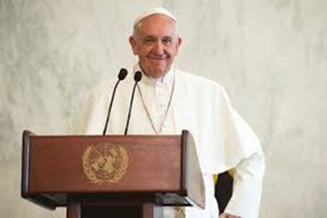
Pope Francis’ World Peace Day Message 2021
Each year the Pope releases a message for the World Day of Peace on 1st January. This year the message was titled “A Culture of Care as a Path to Peace”.
On the Second Sunday of Ordinary time, this year 17th January 2021, Pax Christi England and Wales promotes the peace message as part of its work for peace.
What do you think Pope Francis means by “A Culture of Care?”

Slide 3

Pope Francis’ World Peace Day Message 2021
The message this year focuses on the need for us to care for each other if we want to build a peaceful world and “combat the culture of indifference, waste and confrontation”.
This idea of justice, love and care is found in the Bible, in the life of Jesus and in Church teaching. The Pope calls on us to live out these values and to be “peacemakers …prepared to work boldly and creatively”.

Slide 4
What does Pope Francis say?
“Peace, justice and care for creation are three inherently connected questions, which cannot be separated”
What do you think “peace, justice and care for creation” are?
Why can they not be separated?
“become a prophetic witness of the culture of care, working to overcome the many existing social inequalities”
What inequalities do you see in our world today?
How can you be a witness to a culture of care?

Slide 5
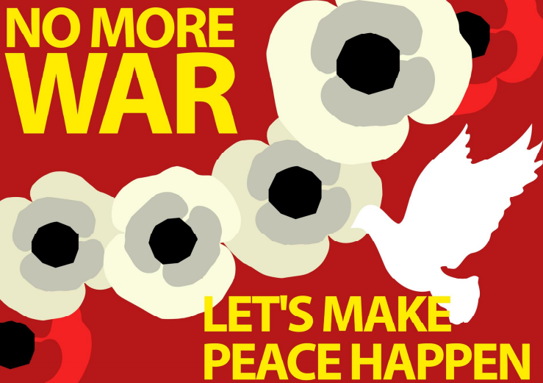
What does Pope Francis say?
“How many resources are spent on weaponry, especially nuclear weapons, that could be used for more significant priorities such as …the safety of individuals, the promotion of peace… the fight against poverty, and the provision of health care.”
What would your priorities be to make the world more peaceful?
How can we show on a global level that we care?
What could you do in your school community?

Slide 6
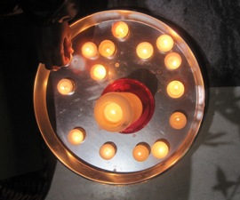
Prayer
Dear Lord,
May we all work together and play our part in creating a world of compassion, peace and justice.
May we always remember that everyone we meet is our brother or sister. May we learn how to care for them and show that we accept them for who they are.
Grant us the courage to challenge injustice and become peacemakers.
Amen

Slide 7

Each year Pax Christi promotes Peace Sunday with a range of resources. Our resources can be found on our website at:
https://paxchristi.org.uk/peace-sunday-2021/
The quotations in this resource come from Pope Francis’ Message for the 54th World Day of Peace, “A Culture of Care as a Path to Peace”, the Vatican, 8th December 2020. Available at: http://www.vatican.va/content/francesco/en/messages/peace/documents/papa-francesco_20201208_messaggio-54giornatamondiale-pace2021.html

