Slide 1

A culture of care as a path to peace… grows through active nonviolence

Slide 2
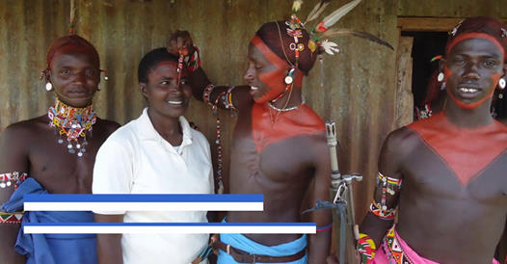
Opening prayer
Lord, Creator of our human family,
you created all human beings
equal in dignity:
pour forth into our hearts
a spirit of solidarity
and inspire in us a dream of
renewed encounter,
dialogue, justice and peace.
Move us to create healthier societies
and a more dignified world,
a world without hunger, poverty,
violence and war.
Kanini, a partner working with groups of young men in Kenya to overcome tribal conflicts

Slide 3

May our hearts be open
to all the peoples and
nations of the earth.
May we recognize the goodness
and beauty
that you have sown in each of us,
and thus forge bonds of unity,
common projects, and shared dreams.
Amen.
Adapted, Pope Francis, Fratelli Tutti

Slide 4
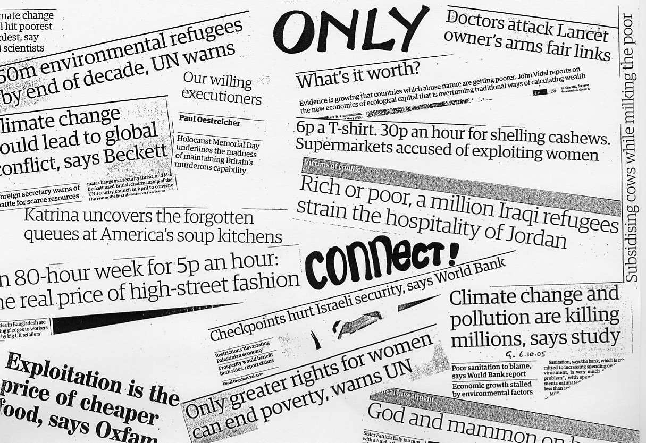
Reflect: Only connect!
As we listen to words from Pope Francis
India migrant workers paid heaviest price for Covid crisis…
Syrians refugees flee Lebanon camp after tents set on fire…
Félix Vásquez: Honduran environmental
activist killed…
South Sudan faces 'catastrophic' famine unless conflict ended

Slide 5
Only connect!
The year 2020 was marked by the massive Covid-19 health crisis, which became a global phenomenon cutting across boundaries, aggravating deeply interrelated crises like those of the climate, food, the economy and migration, and causing great suffering and hardship…
we have also seen a surge in various forms of nationalism, racism and xenophobia, and wars and conflicts that bring only death and destruction in their wake. These and other events that marked humanity’s path this past year have taught us how important it is to care for one another and for creation in our efforts to build a more fraternal society
A culture of care as a path to peace, Pope Francis, WPD 2021

Slide 6
Penitential prayer
In a world crying out for care and love but still filled with too much
hatred and violence
Response: help us to grow as peacemakers
In a country that speaks of justice and equality but fails to live up to its promise /R
In our communities where some people are considered to be worth less than others /R
In our cities city where too many young people, victims and perpetrators, have their lives ruined and are caught in the vicious cycles of violence
/R
In our faith communities, were we often neglect the teachings of peace, justice and care of creation.
/R
In our families and among our friends, when by word or deeds we hurt each other /R
Together: In ourselves, when we are tempted by the world to desire more, to be dominated by all sorts of ‘isms’ and to neglect what really matters.
/R

Slide 7
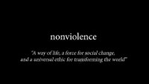
Responses from peacemakers
Notes:
https://www.youtube.com/watch?v=7b4XS6k6LDo&feature=youtu.be%28opens+in+a+new+tab%29

Slide 8

In many parts of the world there is a need for paths of peace to heal open wounds… (Pope Francis, WPD 2021)
Group work
Where do you see such paths being created in your community / the wider world?

Slide 9
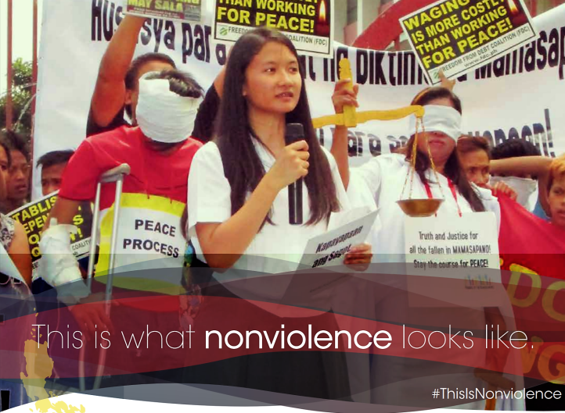
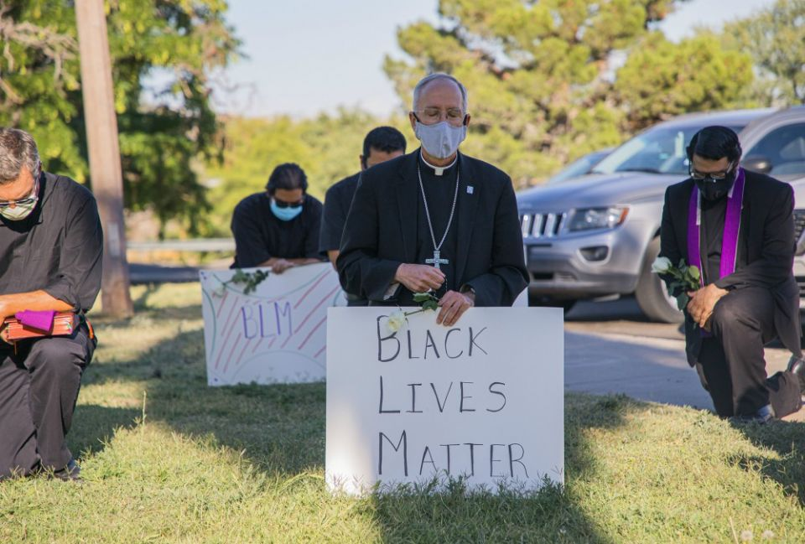
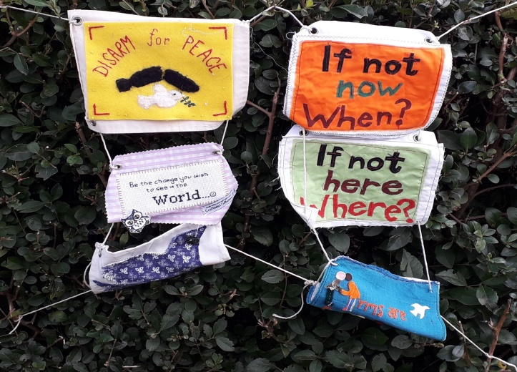
Reflect - so, what is nonviolence?
Voice 1: It is a strategy for social change that rejects violence.
Voice 2: It is a philosophy of active peacemaking.
Voice 1: It is a spiritual discipline.
Voice 2: It is a pragmatic choice based on what works.
Voice 1: It is an active response to violence.
Voice 2: It is a force more powerful than violence.
How do Christians walk the talk in everyday life?
Voice 1: By working for justice.
Voice 2: By trusting in God rather than trusting in weapons.
Voice 1: By practising creative and disarming ways of
responding to a crisis.
Voice 2: By actively and publicly resisting war.
Voice 1: By building relationships with those who
are supposed to be enemies.
Voice 2: By showing more love.

Slide 10
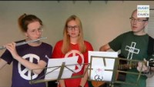
Song: Let us raise our voice
Notes:
https://www.youtube.com/watch?v=4yjQ7cS1jeA&feature=emb_logo

Slide 11
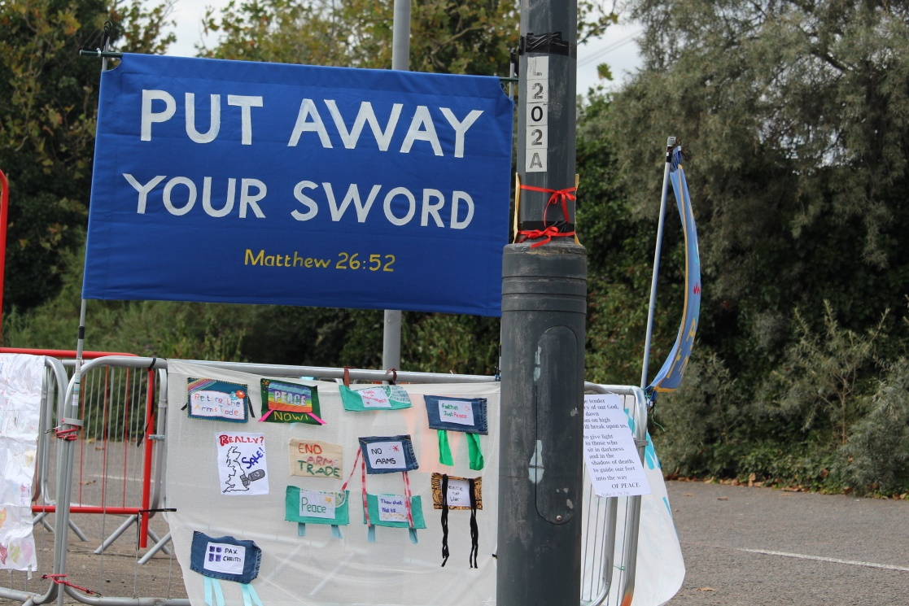
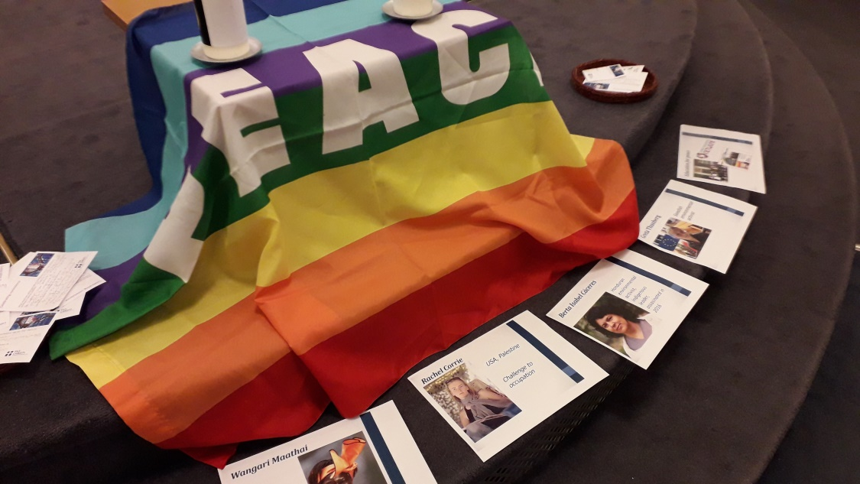
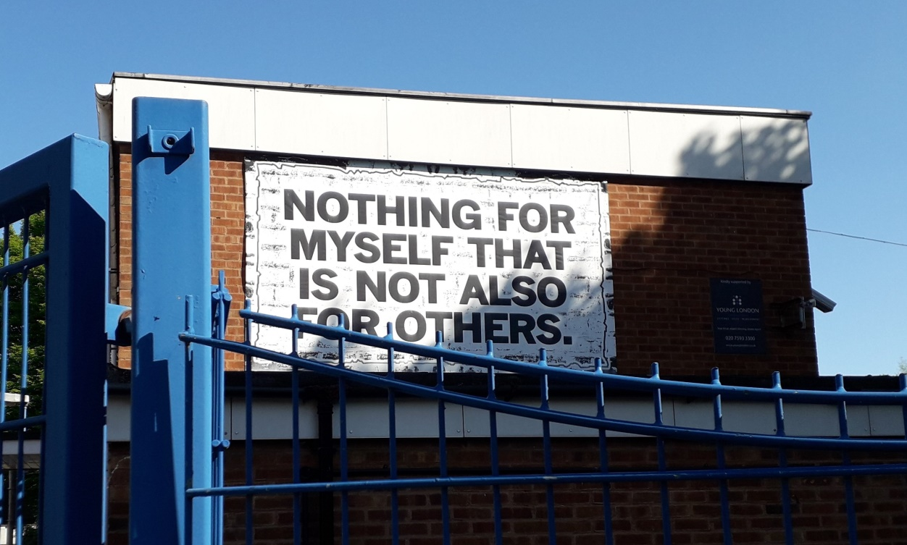
Reading : a compass to guide our work
As we listen to words from Pope Francis

Slide 12
A compass to guide our work
Promoting a culture of care calls for a process of education. The “compass” of social principles can prove useful and reliable in a variety of interrelated contexts…
The culture of care thus calls for a common, supportive and inclusive commitment to protecting and promoting the dignity and good of all, a willingness to show care and compassion, to work for reconciliation and healing, and to advance mutual respect and acceptance. As such, it represents a privileged path to peace. “In many parts of the world, there is a need for paths of peace to heal open wounds. There is also a need for peacemakers, men and women prepared to work boldly and creatively to initiate processes of healing and renewed encounter”
A culture of care as a path to peace, Pope Francis, WPD 2021

Slide 13


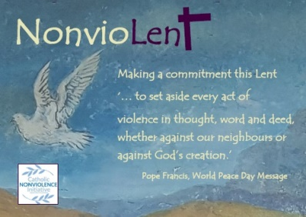
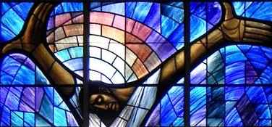
An all year round opportunity
8 March: Tell stories, celebrate women
Int Women’s Day
Sept – Oct
celebrate
Days of nonviolence
Advent, season of peace
22 Jan, celebrate Nuclear Weapon Ban
17 January E&W
World Peace Message celebrated
17 February
Lent NonvioLent
15 May,
Tell stories, celebrate COs
Int CO Day
2 October committing to nonviolence with the Vow/ Prayer of Nonviolence

Slide 14
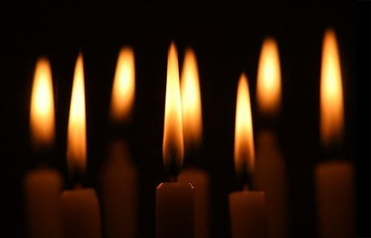
Prayer
Let us pray for all who work to promote a culture of care in our midst: for those who nurse the sick, for those who support the marginalised, for those who feed the hungry, for those who oppose oppression and reject the way of violence. We ask God’s blessing on the work of the international Catholic peace movement, Pax Christi.
Lord in your mercy:
R/ HEAR OUR PRAYER.
For peace between the nations, beginning with our own place in the world following Brexit. May we build bridges, not walls. May we build relationships of trust, rather than rivalries, working together to bring healing where there is hurt, peace where there is conflict.
Lord in your mercy:
R/ HEAR OUR PRAYER.
Think of a particular situation in the
news at the moment where there is
an absence of care and a path of peace
needs to be found ....
Lord in your mercy:
R/ HEAR OUR PRAYER.
In silence, let us place before the Lord
all that is in our hearts …

Slide 15
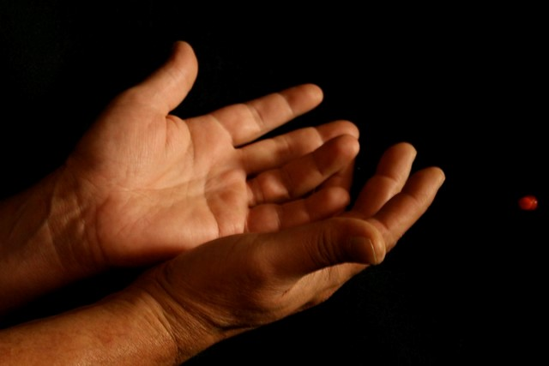
Blessing
The blessing of the God of life be ours,
The blessing of the loving Christ be ours,
The blessing of the Holy Spirit be ours
To cherish us, to help us, to make us holy.

Slide 16
Resources & support
We offer YOU materials for all year around
Peace Sunday family, parish and group resources https://paxchristi.org.uk/peace-sunday-2021/
Email follow-up from this gathering
Pax Christi England and Wales : https://paxchristi.org.uk/
Catholic Nonviolence Initiative: https://nonviolencejustpeace.net/
We ask YOUR support and donation
Send us YOUR news, reports and up-dates
Send us a donation https://paxchristi.org.uk/about-us/support-us/donation/
Become a member: https://paxchristi.org.uk/about-us/support-us/become-a-pax-christi-member/

