Slide 1
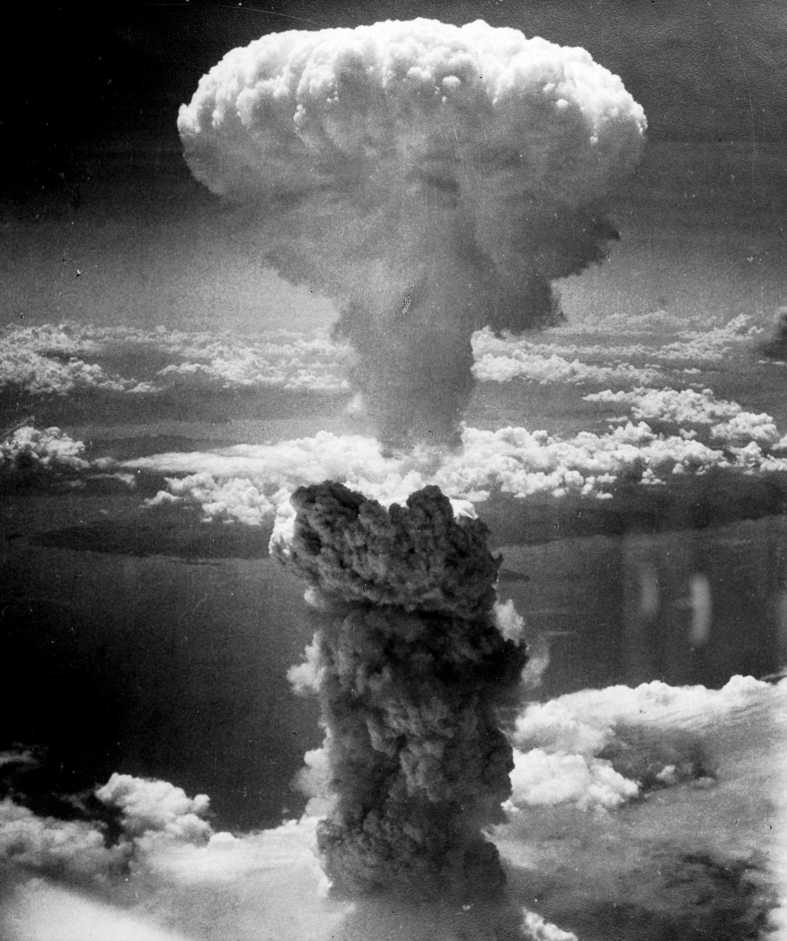

Nuclear Weapons and the UN Treaty on the Prohibition of Nuclear Weapons
On 22 January 2021 the UN Treaty on the Prohibition of Nuclear Weapons came into force. This workshop introduces some key facts about nuclear weapons, some of the arguments surrounding nuclear weapons, the role of the treaty and the voice of the Catholic Church.

Slide 2

What are nuclear weapons?
Have a go at answering these questions about nuclear weapons. Don’t worry if you don’t know the answers. The questions are to help us see what we know so far. We will see the answers afterwards.
What is a nuclear bomb?
Why are nuclear weapons different from most other weapons?
How many nuclear weapons are there in the world?
How many countries have nuclear weapons?
How many nuclear weapons does the UK have?
Have any nuclear bombs been dropped in war?
How many people were killed as a result?
How many times more powerful are the weapons the UK has today compared to the one dropped on Hiroshima?

Slide 3
What are nuclear weapons?Answers
1) What is a nuclear bomb?
A nuclear bomb is a weapon that uses the energy from atoms (either by splitting them or joining the particles within them) to cause an explosion.
2) Why are nuclear weapons different from most other weapons?
They are weapons of mass destruction. Just one bomb is enough to destroy a very wide area, killing thousands of people, whether they are fighting or not, and damaging the environment so that food and water supplies are poisoned. Nuclear radiation goes on killing people by causing illnesses for the rest of their lives, and causes future generations to be born with serious health problems.
3) How many nuclear weapons are there in the world?
Currently there are approximately 13,865 nuclear weapons in the world.
4) How many countries have nuclear weapons?
Nine. The UK, the USA, Russia, China, France, India, Pakistan, North Korea and Israel
Do any of the answers surprise you? Why?
What other questions do you have?

Slide 4
What are nuclear weapons?Answers continued
4) How many nuclear weapons does the UK have?
215
5) Have any nuclear bombs been dropped in war?
Yes, two. One on Hiroshima and the other on Nagasaki, Japan, in 1945.
6) How many people were killed as a result?
140,000 people were killed in Hiroshima and 74,000 in Nagasaki by the end of 1945, due to the impact and effects of the bombs.
7) How many times more powerful are the weapons the UK has today compared to the one dropped on Hiroshima?
The nuclear warheads Britain has today are eight times more powerful than that dropped on Hiroshima.
Do any of the answers surprise you? Why?
What other questions do you have?

Slide 5
“Nuclear weapons make us safer. People won’t attack us, because we’d attack them back.”
“I’m worried that if they’re used we’ll be stuck in a nuclear war that would destroy life as we know it.”
We should get rid of nuclear weapons
We need nuclear weapons
"An accident with even one nuclear weapon would have terrifying results."
“Nuclear weapons are morally wrong. Many innocent people would be killed if we used them.”
“I don’t like nuclear weapons, but I would rather we have them if other countries do as well.”
“Nuclear weapons make the world more dangerous.”

Slide 6
We should get rid of nuclear weapons
We need nuclear weapons
What are your thoughts and opinions? Where would you be on this line?

Slide 7
The Treaty
Do you think the treaty is a good idea?
What do you think are the benefits?
What do you think are the difficulties?
How do you think it will make a difference?
Do you agree the treaty is important? Why/ why not?
On 22 January 2021 the UN Treaty on the Prohibition of Nuclear Weapons came into force.
This means over 50 countries have agreed that they won’t possess, develop, test, use or encourage other countries to use nuclear weapons. They also agree to help victims of nuclear weapon usage and testing and to clean up the environmental impacts of nuclear weapons.
However, not all countries have signed the treaty, including the nine countries with nuclear weapons.
Campaigners say that the law will put pressure on the countries which haven’t banned them, meaning they are less and less likely to produce and use them. Companies will also be less likely to want to be involved in producing and financing the weapons. For campaigners, it is an important step in creating a world free from nuclear weapons.

Slide 8
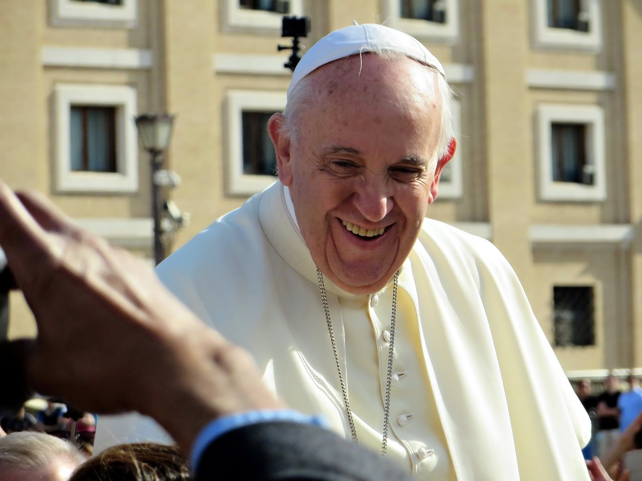
The Catholic Church
The Vatican was one of the first countries to sign and ratify the treaty.
In his letter to the Church, Fratelli Tutti, Pope Francis says:
“if we take into consideration the principal threats to peace and security … in …. the twenty-first century… for example, terrorism, … conflicts, cybersecurity, environmental problems, poverty…doubts arise regarding the inadequacy of nuclear deterrence as an effective response to such challenges.
These concerns are even greater when we consider the catastrophic humanitarian and environmental consequences that would follow from any use of nuclear weapons... We need also to ask ourselves how sustainable is a stability based on fear, when it actually increases fear and undermines relationships of trust between peoples.”
Fratelli Tutti, #262
-What do you understand from the text?
-Does Pope think nuclear weapons are a good response to the challenges of the world today?
-What reasons does he give?
- Do you agree or disagree? Why?
Ratify: to formally approve/ make official

Slide 9
The Catholic Church
Why has Pope Francis spoken out about nuclear weapons? Let’s explore some Bible verses to see if they can help us. Some definitions are also given.
“He shall judge between the nations,
and shall arbitrate for many peoples;
they shall beat their swords into ploughshares,
and their spears into pruning hooks;
nation shall not lift up sword against nation,
neither shall they learn war any more.”
Isaiah 2:4
“Blessed are the peacemakers,
for they will be called children of God.”
Matthew 5:9
Arbitrate: resolve a disagreement
Ploughshare/ pruning hook: these are tools used in farming and for growing things
What do you think these verses are saying? Why might they have influenced the Vatican to join the treaty?
Do you think they’re important for our faith? What are they calling us to do?

Slide 10
Over to you…
What have you learnt this session?
Jot down all you have learnt about nuclear weapons, the treaty and Catholic teaching during this session.
What surprised you?
What do you think about nuclear weapons and the Treaty on the Prohibition of Nuclear Weapons?
How can you share what you’ve learnt this session?
How can you tell your friends, community or church about nuclear weapons?
How can you take this further?
What ways can you think of to take what you have learnt and do something about it?
Who might be able to help? Where could you find more information about what people are already doing?

Slide 11
Sources
Questions and answers- slide 3
1) Nuclear weapons: Which countries have them and how many are there? - BBC News, https://www.bbc.co.uk/news/newsbeat-51091897
2) Modernization of world nuclear forces continues despite overall decrease in number of warheads: New SIPRI Yearbook out now, SIPRI, https://www.sipri.org/media/press-release/2019/modernization-world-nuclear-forces-continues-despite-overall-decrease-number-warheads-new-sipri
3) Modernization of world nuclear forces continues despite overall decrease in number of warheads: New SIPRI Yearbook out now, SIPRI, https://www.sipri.org/media/press-release/2019/modernization-world-nuclear-forces-continues-despite-overall-decrease-number-warheads-new-sipri
4) United Kingdom - ICAN (icanw.org), https://www.icanw.org/united_kingdom
5) Nuclear weapons: Which countries have them and how many are there? - BBC News, https://www.bbc.co.uk/news/newsbeat-51091897
6) Hiroshima and Nagasaki bombings - ICAN (icanw.org), https://www.icanw.org/hiroshima_and_nagasaki_bombings
7) ICAN | International Campaign to Abolish Nuclear Weapons (icanw.org), http://uk.icanw.org/the-facts/britains-nuclear-weapons/

Slide 12
Sources
The Treaty- slide 6
The Treaty - ICAN (icanw.org), https://www.icanw.org/the_treaty
How the TPNW works - ICAN (icanw.org), https://www.icanw.org/how_the_tpnw_works
Why a ban? - ICAN (icanw.org), https://www.icanw.org/why_a_ban
The Church- slide 7
Pope Francis, Fratelli Tutti, #262
The Church- slide 8
The Scripture quotations contained herein are from the New Revised Standard Version Bible, copyright © 1989, Division of Christian Education of the National Council of Churches of Christ in the United States of America. Used by permission. All rights reserved.

Slide 13

Pax Christi England and Wales
www.paxchristi.org.uk

