Slide 1


Slide 2
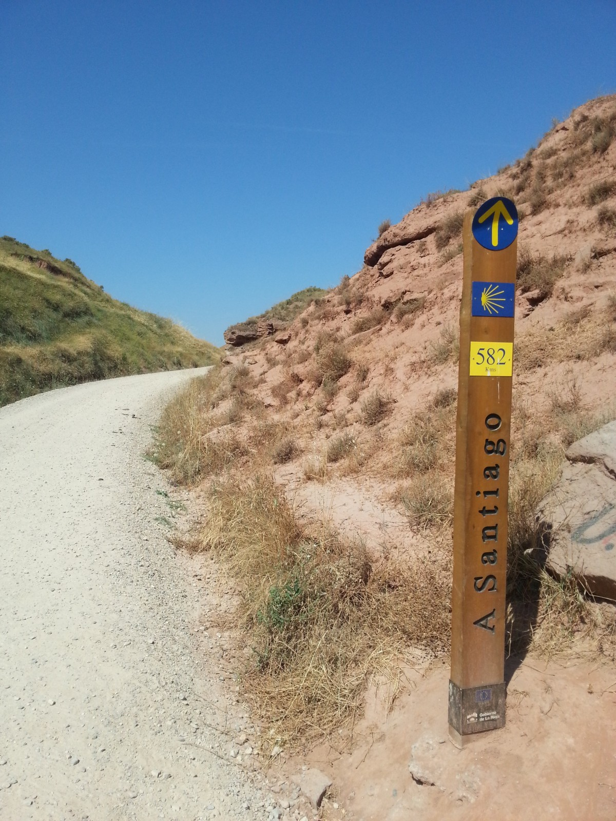
What is a pilgrimage?
A pilgrimage is a kind of journey which traditionally has a spiritual element to it.
People have been going on pilgrimage for hundreds of years. Some pilgrimage places or routes are very well know, such as the Camino de Santiago in Spain or Lourdes in France.
In the past people would walk to places of pilgrimage over a long period of time and use this as a time to pray and reflect, so pilgrimages could often be very challenging.
Notes:
Picture from pxhere.com

Slide 3

Who are Pax Christi?
Pax Christi England and Wales is a Catholic peace movement and are part of the worldwide peace organisation, Pax Christi International.
They promote peace, reconciliation and nonviolence through education, campaigning, prayer and solidarity.

Slide 4
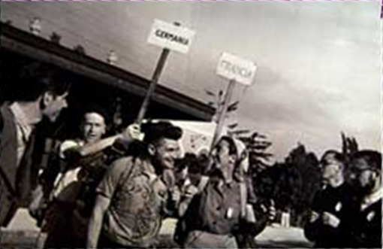
Pax Christi was started as a way to bring reconciliation to France and Germany after the second world war.
In the early days of Pax Christi, peace walks were organised by different groups to bring people from different communities together and to pray for peace.

Slide 5

What is the Pax Christi Pilgrimage for Peace?
To support Pax Christi in their work for peace, we are challenging our friends, supporters and members to do a pilgrimage in any way that they can. Whether it’s walking, cycling, knitting, gardening…..
Everyone has a part to play in working for peace, and everyone brings their own unique ideas, gifts and talents!

Slide 6
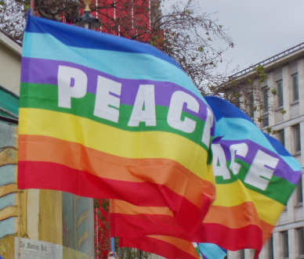
What is peace?
What words or images come to mind when you think of peace?
Can you put the words or images into groups? What could this tell you?
Notes:
You may want to do this activity in pairs or small groups and then feedback. You may find that groups of images or ideas could be around places, feelings, actions, nature, people…. Peace can mean something different for everyone, but discussions may focus on inner peace, interpersonal peace or global peace.

Slide 7
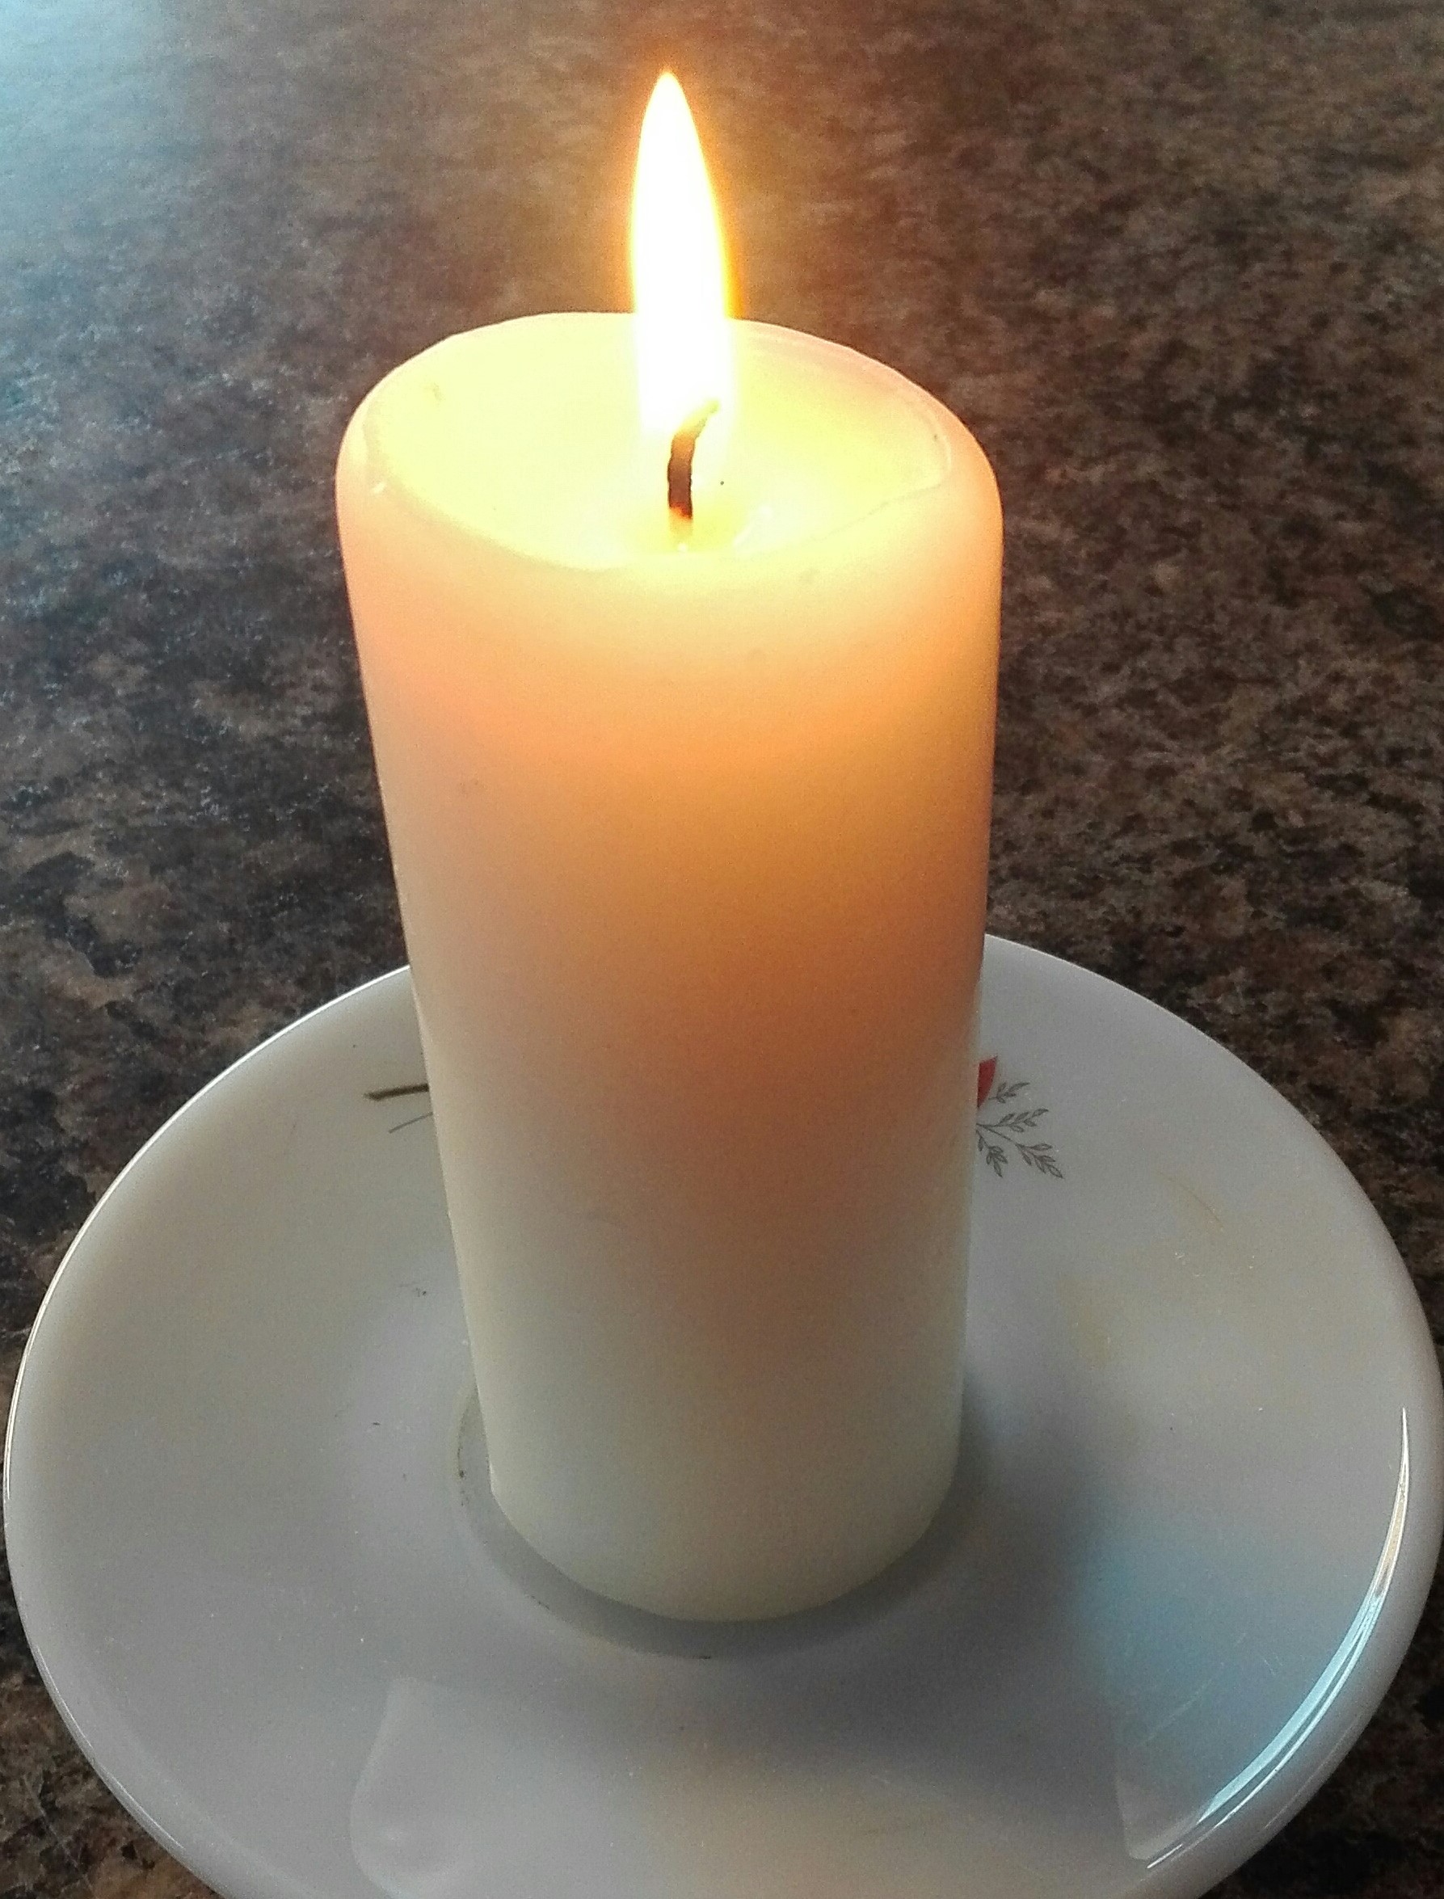
Reflection
This is a quote from St Óscar Romero about peace. What do you understand from it? What does it say about peace?
Peace is not the product of terror or fear.
Peace is not the silence of cemeteries.
Peace is not the silent result of violent repression.
Peace is the generous,
tranquil contribution of all
to the good of all.
Peace is dynamism.
Peace is generosity.
It is right and it is duty.
Óscar Romero

Slide 8

How do we work for peace?
Jesus said ‘Blessed are the peacemakers’ (Matthew 5:9)
What ways can you work for peace in your school?
What could you do today, over the next term and over the next year?
Notes:
There are so many ways to work for peace- caring for our neighbours, caring for the environment, challenging discrimination, challenging injustice, campaigning against militarism and weapons….. Ideas could focus on issues, relationships or awareness raising.

Slide 9

Pax Christi Daily Prayer
Thank you loving God
For the gift of life
For this wonderful world which we all share
For the joy of love and friendship
For the challenge of helping to build your kingdom.
Strengthen
My determination to work for a world of peace and justice
My conviction that, whatever our
nationality or race,
we are all global citizens, one in Christ
My courage to challenge the powerful with the values of the Gospel
My commitment to find nonviolent ways of resolving conflict—personal, local, national and international
My efforts to forgive injuries and to love
those I find it hard to love.
Teach me
To share the gifts you have given me
To speak out for the victims of injustice
who have no voice
To reject the violence which runs
through much of our world today.
Holy Spirit of God
Renew my hope for a world free from the cruelty and evil of war,
so that we may all come to share in God’s peace and justice.

Slide 10


