Slide 1

Peace Sunday 2022
‘Education, work and dialogue between generations: tools for building lasting peace’

Slide 2
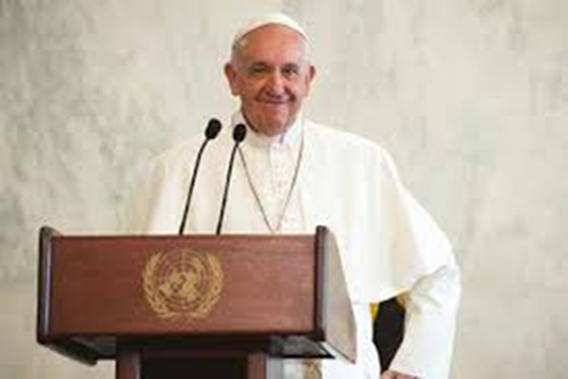
What is Peace Sunday?
Each year the Pope writes a message for the World Day of Peace, 1st January. Pax Christi promotes this message each year on Peace Sunday or the second Sunday of Ordinary time.
This year the theme of the Pope’s message is “Education, work and dialogue between generations: tools for building lasting peace”.
What do you think might be the key ideas in the message?

Slide 3

Working for peace
This year the message talks about having the tools to work for peace.
What do you think creates peace?

Slide 4

Working for peace
We often talk about there being different levels of peace, such as inner peace (peace inside yourself), interpersonal peace (peaceful relationships between people) and global peace (no war or conflict).
How could you encourage inner peace and interpersonal peace in your school?

Slide 5
Working for peace
Could you…?
Create a peace garden
Raise awareness of peacemakers
Create an anti-bullying campaign
How could you encourage inner peace and interpersonal peace in your school?

Slide 6
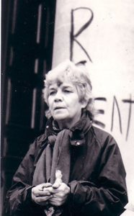
Being a peacemaker
Sarah Hipperson
Sarah was born in 1927 in Glasgow and as a young child was put into care with the Sisters of Charity in Glasgow. From a young age her faith was important to her, and influenced her life in the years that followed. She qualified as a nurse midwife and a district nurse, working in some of the poorest parts of Glasgow. She emigrated to Canada, where she got married and had five children. She returned to London in 1969.
In the 1980s, she became active in the Justice and Peace group in her parish in Wanstead, London. After seeing a film on the dangers of nuclear war, she organised for other churches to see it too, so that people might act. She noticed that although people were often horrified, they often didn’t feel they could do anything. In 1982 she saw an invitation to try and develop a Catholic response to the preparations for nuclear war. This was the beginning of Catholic Peace Action, and her introduction to nonviolent anti-nuclear protest.

Slide 7
Being a peacemaker
At the time, activism against nuclear weapons could mean going to court and sometimes jail. Groups were set up to support each other, and Catholic Peace Action was one of these. Sarah took part in her first arrestable nonviolent action at a protest at the Ministry in Defence in London with the group.
A place called Greenham Common in Berkshire was chosen to hold 96 nuclear cruise missiles, which would be many times more powerful than those that had been used on Hiroshima. Many women went there to protest and set up a camp. In 1983 Sarah joined the camp and went to live at Greenham Common as a form of protest. The conditions were very tough and she was arrested many times, once she even fasted in prison for 32 days.
In 1987 the cruise missiles were removed from the base. However, Sarah stayed there for 17 years altogether, until 2000, as a protest against nuclear war. The site is now a public common again with a commemorative peace garden.

Slide 8

Being a peacemaker
What can we learn from Sarah’s story?
Why is it important to learn about people who are peacemakers?
Sarah is from a different generation, she was born many years before us. What do you think she could teach you that you wouldn’t know? What could she learn from you?
Why is it important to talk and listen to people who are different from us?

Slide 9
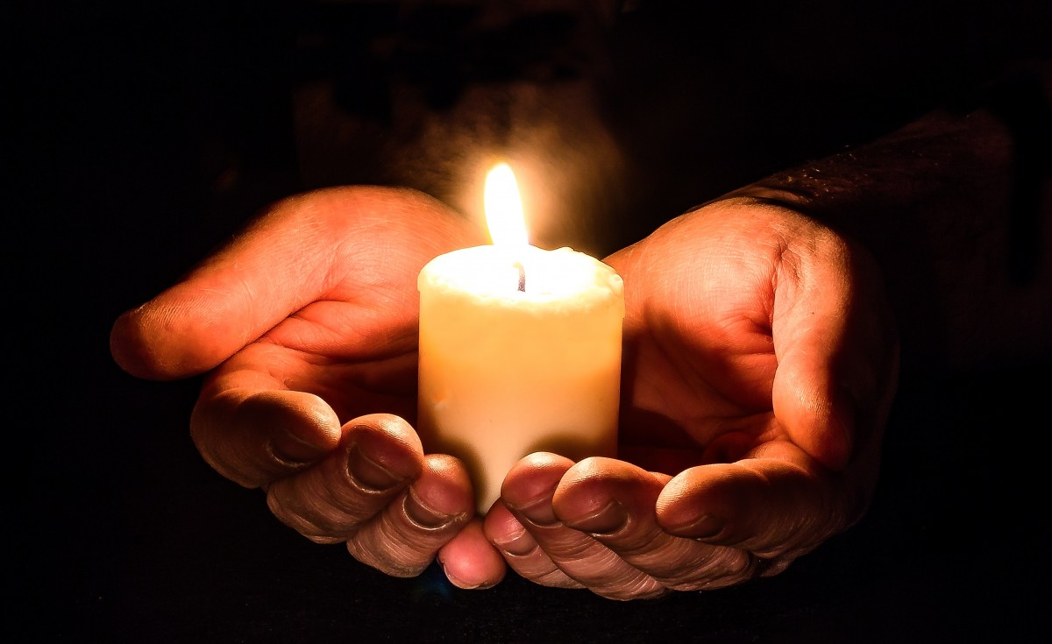
Prayer
Loving God,
We pray for your peace in our homes, in our school, and in our hearts.
We pray that by learning and working together we may become peacemakers, spreading your peace throughout the world.
Amen

Slide 10


www.paxchristi.org.uk
Twitter: @paxchristiuk
@PaxChristiYouth
Each year Pax Christi promotes Peace Sunday with a range of resources. Our resources can be found on our website at:
https://paxchristi.org.uk/peace-sunday-2022
The information on Sarah Hipperson is from https://paxchristi.org.uk/resources/peace-people-2/sarah-hipperson/

Slide 11
Activity ideas for teachers
Discuss the list of questions about peace on slide 12.
Research different peacemakers and create posters about them to share the stories in school.
Use our reflection activities on women peacemakers and Franz and Franziska Jägerstätter available here: https://tinyurl.com/24apchnx
Create and send a card to someone who is a peacemaker to thank them for what they do.
Within school, have a dialogue amongst different year groups about peace and working for peace.
Have a look at these resources on intergenerational conversations (https://millionminutes.org/generations). You could try and organise one at school.

Slide 12
1. What is peace? | 2. Is conflict ever a good thing?
3. Who is a peacemaker? | 4. What is conflict?
5. Is peace possible? | 6. Can violence lead to true peace?
7. What do you agree with more “If you want peace, prepare for war” or “If you want peace, work for justice”? | 8. What creates peace?

