Slide 1
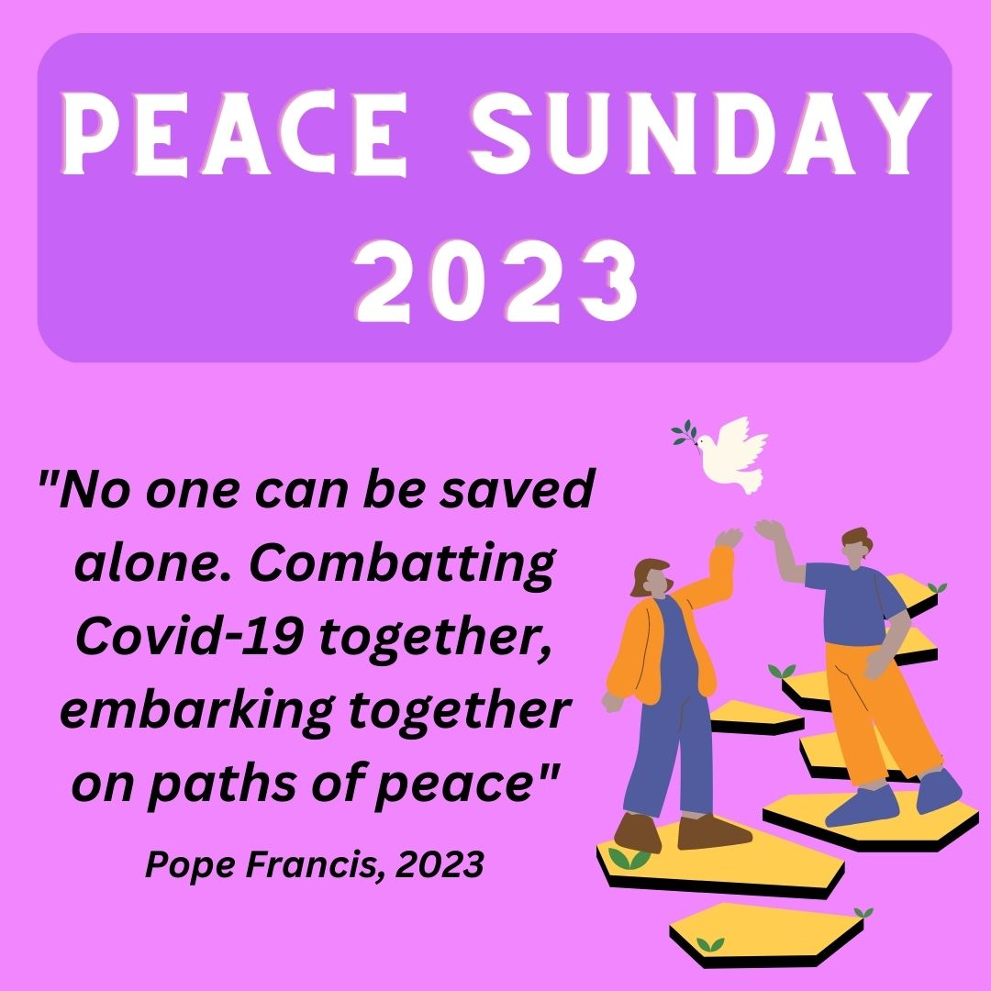
Peace Sunday 2023

Slide 2
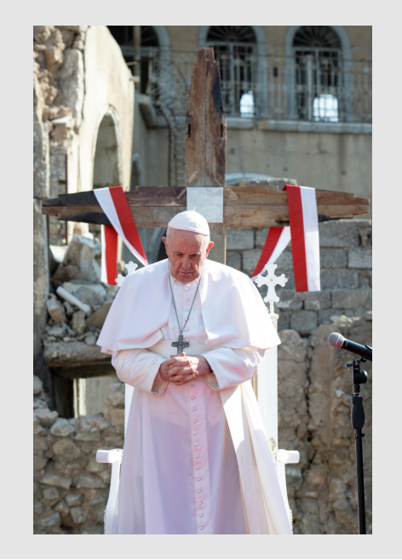
Peace Sunday 2023
Each year the Pope writes a message for the World Day of Peace on 1st January. In England and Wales, the Catholic church celebrates this on the second Sunday of Ordinary Time. This year it is the 15th January. Pax Christi, a Catholic peace movement, promotes the peace message on this day.
The title of the message is, “No one can be saved alone. Combatting Covid-19 together, embarking together on paths of peace”.

Slide 3
Looking at the title, “No one can be saved alone. Combatting Covid-19 together, embarking together on paths of peace” what do you think this message might be about?
What do you think it means to embark on paths of peace?

Slide 4
Peace Sunday 2023
In this message, Pope Francis talks about how Covid-19 affected all of us, but particularly those who are most vulnerable. He asks us what we can learn from it:
‘I have already observed on a number of occasions that we never emerge the same from times of crisis: we emerge either better or worse. Today we are being asked: What did we learn from the pandemic? What new paths should we follow to cast off the shackles of our old habits, to be better prepared, to dare new things? What signs of life and hope can we see, to help us move forward and try to make our world a better place?‘’

Slide 5
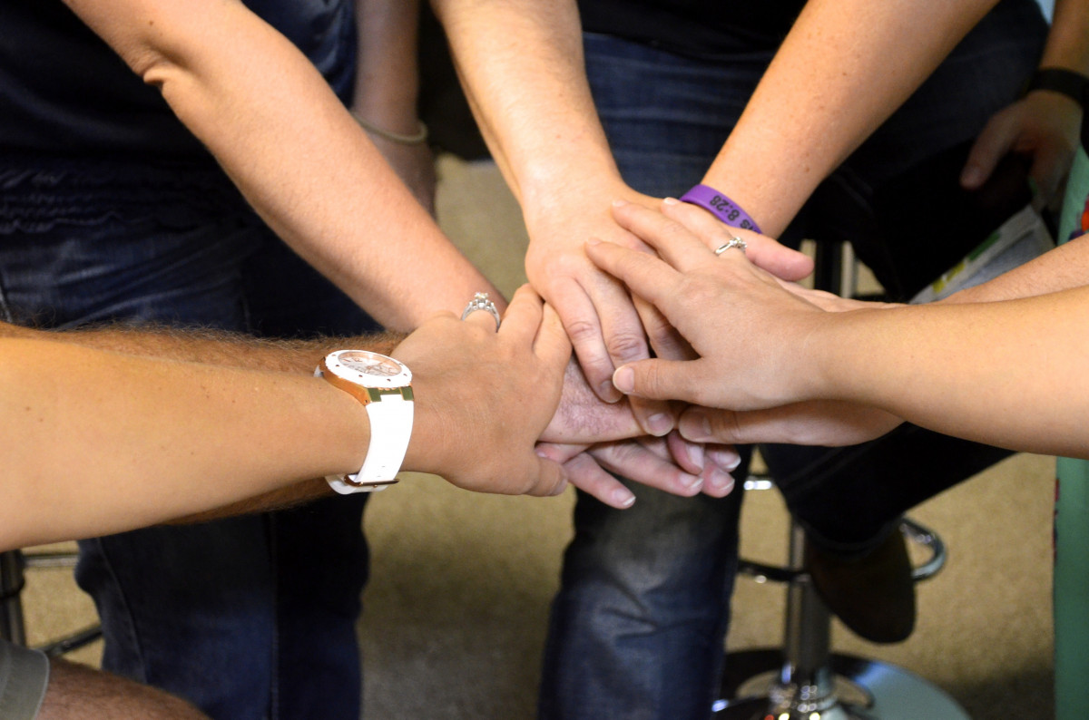
One thing he says we have learnt is that we all need one another, particularly to build peace.
‘…we can say that the greatest lesson we learned from Covid-19 was the realization that we all need one another. That our greatest and yet most fragile treasure is our shared humanity as brothers and sisters, children of God.’
‘For it is together, in fraternity and solidarity, that we build peace, ensure justice and emerge from the greatest disasters.’
Who can help you when you need a hand?
What skills and talents can you share with others?

Slide 6

Pope Francis talks about what causes war and conflict, especially in Ukraine, but points out that everything is interconnected.
‘In our fast-paced world, the widespread problems of inequality, injustice, poverty and marginalization continue to fuel unrest and conflict, and generate violence and even wars.'
‘… we cannot ignore … that the many moral, social, political and economic crises we are experiencing are all interconnected, and what we see as isolated problems are actually causes and effects of one another. Consequently, we are called to confront the challenges of our world in a spirit of responsibility and compassion.’
Where do you see conflict in your community?
What are some of the issues that you think cause conflict?

Slide 7

The Pope mentions lots of different ways to create a fairer and more peaceful world. He mentions access to healthcare, caring for the environment, people having enough food, people being able to have good jobs, supporting the less well-off, welcoming migrants and welcoming those who are left out.
How could you do some of these things?
What do you think would make the world fairer and more peaceful?
‘...the time has come for all of us to endeavour to heal our society and our planet, to lay the foundations for a more just and peaceful world, and to commit ourselves seriously to pursuing a good that is truly common.'

Slide 8
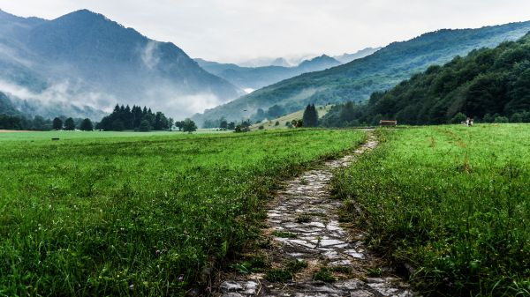
Thinking about what you have heard, how could you build a path to peace in your school?
What would be the first steps?
What would a peaceful school look like?

Slide 9
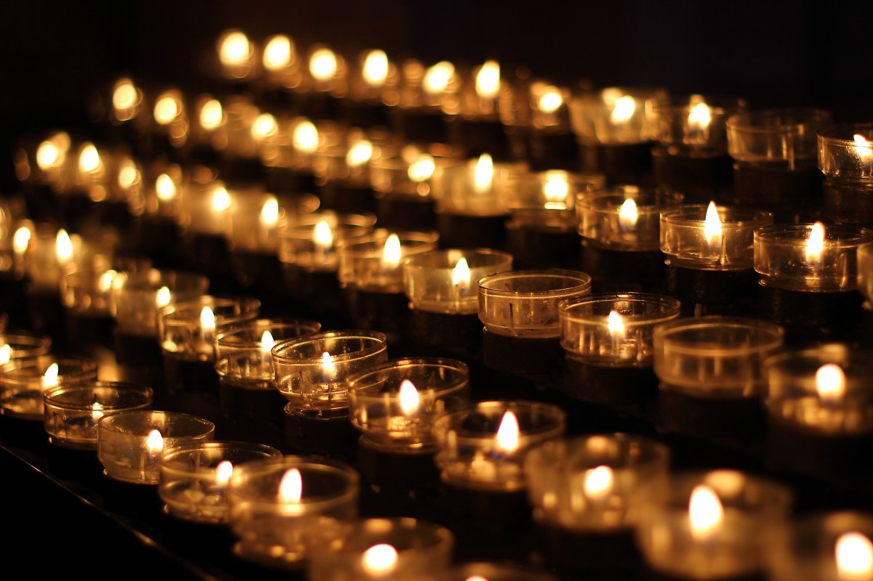
Prayer
God of Peace,
We pray for those who experience conflict and injustice.
We pray for those who work for peace and for those who help us.
We pray for each other, that we may be able to work for peace together.
Grant us the grace to continue working for a world of peace, where all are valued and able to live in safety.
Amen

Slide 10
Further Activities
Using the answers to the questions throughout the PowerPoint, create a poster about the Pope’s message. You could draw a path and decorate it with ways that we could work for peace.
Using the answers from slide 8, create a plan for how you could implement some of the ideas to create a more peaceful school.
Design and send a card to someone who is a peacemaker.
Have a look at our Elements of Peace cards for more activities to explore a range of peace topics: https://paxchristi.org.uk/peace-education/secondary/lessons-workshops/elements-of-peace/

Slide 11


www.paxchristi.org.uk
Twitter: @paxchristiEW
@PaxChristiYouth
Each year Pax Christi promotes Peace Sunday with a range of resources. Our resources can be found on our website at:
https://paxchristi.org.uk/peace-sunday-2023/
Quotes are from Pope Francis’ World Day of Peace Message 2023 available at: https://www.vatican.va/content/francesco/en/messages/peace/documents/20221208-messaggio-56giornatamondiale-pace2023.html

