Slide 1
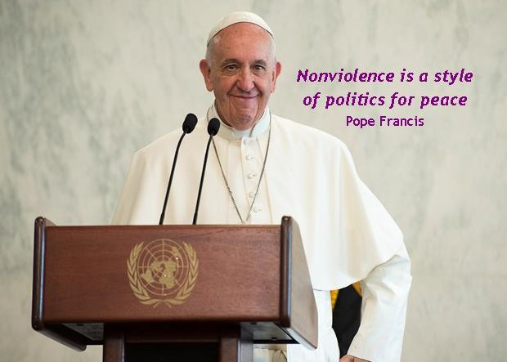
Pope’s Prayer Intention
April 2023
For a non-violent culture

Slide 2
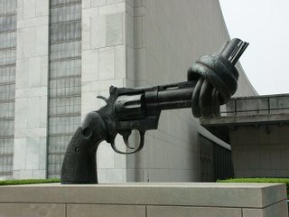
Each month the Pope releases a prayer intention through the Worldwide Prayer Network. This month the intention is for ‘a non-violent culture’.
The Pope asks:
“Let us pray for a more widespread culture of non-violence, that will progress when countries and citizens alike resort less and less to the use of arms”
Have a look at the video about this intention.
What stands out in the video for you?
Credit: Pope’s Worldwide Prayer Network, https://www.popesprayer.va/the-challenges-facing-humanity-and-assists-the-mission-of-the-church/

Slide 3
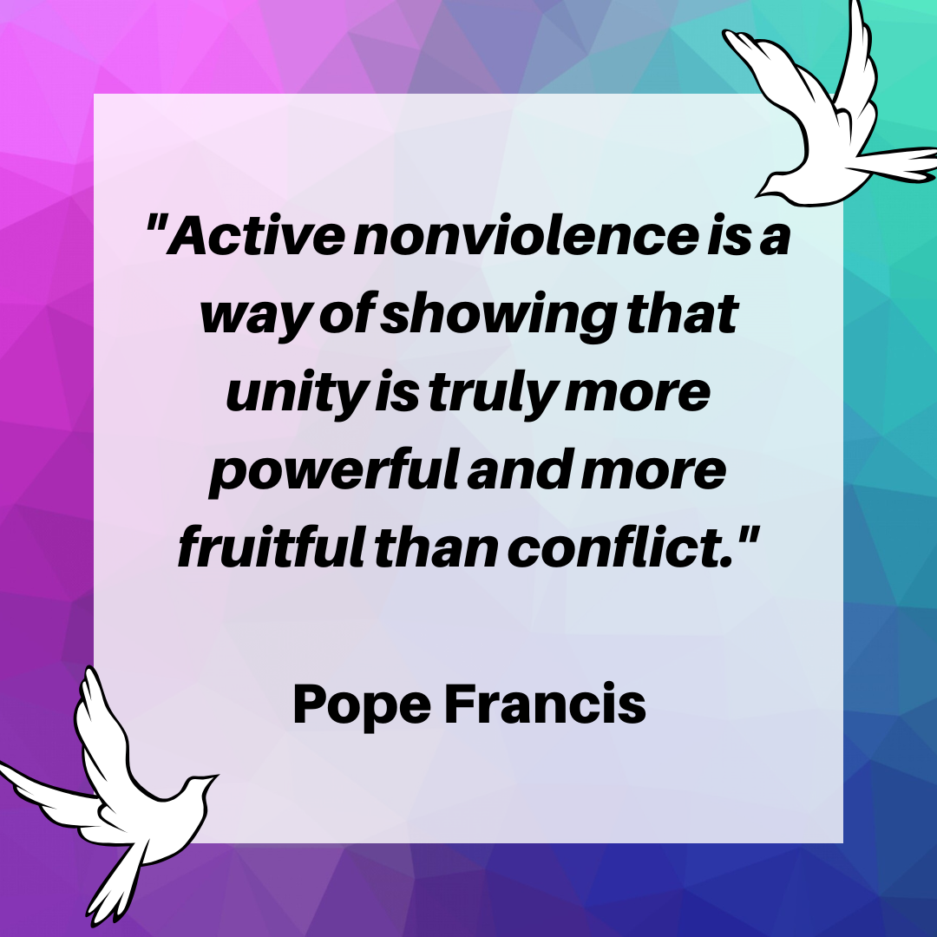
What is nonviolence?
Pax Christi England and Wales is part of an international Catholic movement for peace. Their work includes promoting nonviolence, helping people build peaceful communities and challenging the arms trade.
For Pax Christi England and Wales, nonviolence is a way of living and making choices that respects others, challenges what is not fair or just, and offers alternatives to violence and war.
Why do you think nonviolence is important for peace?
What do you think nonviolence would look like in your daily life?

Slide 4
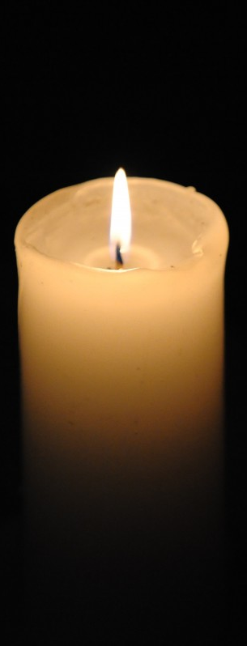
Pax Christi Daily Prayer
Thank you loving God
for the gift of life,
for this wonderful world which
we all share,
for the joy of love and friendship,
for the challenge of helping to build
your kingdom.
ways of resolving conflict—personal, local,
national and international,
my efforts to forgive injuries and to love
those I find it hard to love.
Teach me
to share the gifts you have given me,
to speak out for the victims of injustice
who have no voice,
to reject the violence which runs
through much of our world today.
Holy Spirit of God,
renew my hope for a world free from the
cruelty and evil of war, so that we may
all come to share in God’s peace and
justice.
Strengthen
my determination to work for a world
of peace and justice,
my conviction that, whatever our
nationality or race,
we are all global citizens,
one in Christ;
my courage to challenge the
powerful with the values of the Gospel,
my commitment to find nonviolent

Slide 5
Ideas to continue exploring nonviolence
Have a look at our resources on nonviolence:
Educational resources on nonviolence including a PowerPoint on
‘A Christian Response to Conflict’, stories of nonviolence in action and video resources
Our Elements of Peace card on nonviolence
Our school resources for the Catholic Nonviolence Days of Action and other nonviolence resources for workshops and lessons
You might like to consider celebrating the Catholic Nonviolence Days of Action in your school or community: https://paxchristi.org.uk/resources/nonviolence-in-action/

Slide 6

www.paxchristi.org.uk
Twitter: @paxchristiEW
@PaxChristiYouth
Facebook: www.facebook.com/PaxChristiEW/
www.facebook.com/PaxChristiYouth/
Instagram: @paxchristi_
@paxchristiyouth

