Slide 1

Catholic Nonviolence Days of Action 2023

Slide 2

What are the Catholic Nonviolence Days of Action?
The Catholic Nonviolence Days of Action take place from 21st September (International Day of Peace) to the 2nd October (International Day of Nonviolence and Mahatma Gandhi's birthday).
They are organised by the Catholic Nonviolence Initiative and Pax Christi International, the international Catholic movement for peace. The days raise awareness and understanding of nonviolence.

Slide 3



UN International Day of Peace
Each year the United Nations marks 21st September as the International Day of Peace.
This year the theme is Actions for peace: Our Ambition for the #GlobalGoals
The theme is inspired by the Sustainable Development Goals. They are a collection of 17 goals agreed by countries around the world to create a more equal, fair, sustainable and peaceful world by 2030. The goals include no poverty, education for all and a healthy environment.
What do you think countries around the world should do to work for peace?
What could we do here?

Slide 4
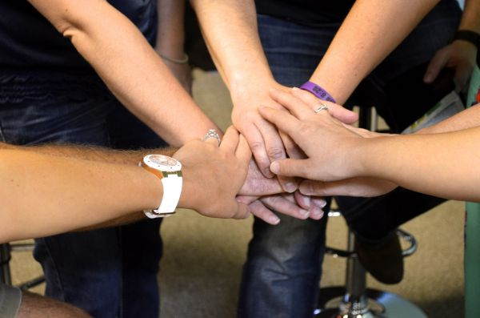
What is nonviolence?
Nonviolence is a way of a way of living and making choices that respects others. It challenges things that aren’t fair and offers alternatives to violence and war.
Can you think of examples of people being nonviolent? Where have you seen people showing respect for others, challenging something that isn’t fair or being a peacemaker?
What could you do in school to encourage people to act nonviolently?

Slide 5
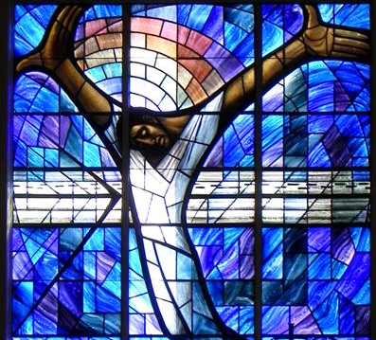
The theme of the Catholic Nonviolence Days of Action this year is ‘Blessed are the feet of those who bring nonviolence’.
Jesus is an example of someone that brought nonviolence. He taught people to love each other, including their enemies, to stand up for what was fair and to be peaceful.

Slide 6
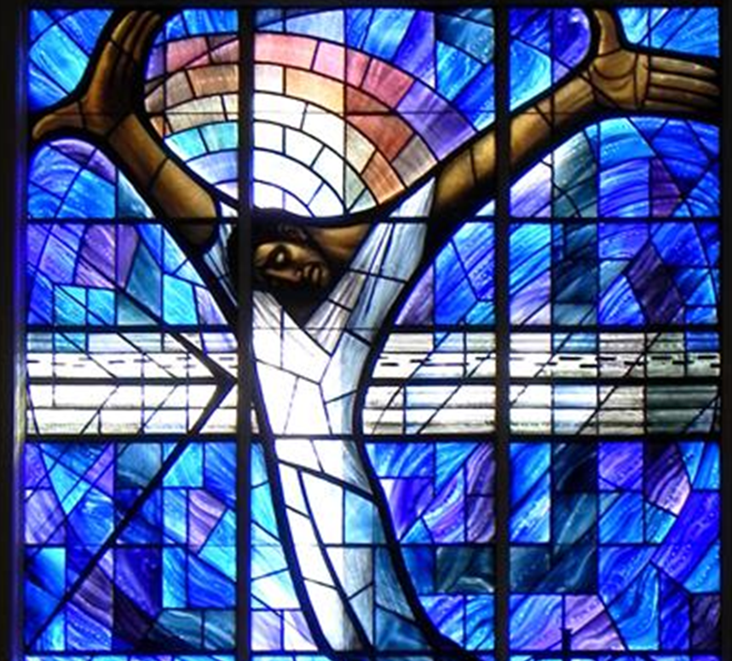
Can you think of examples where Jesus taught about peace and nonviolence?
Can you think of other people who worked for nonviolence?
What could you do to bring nonviolence?

Slide 7
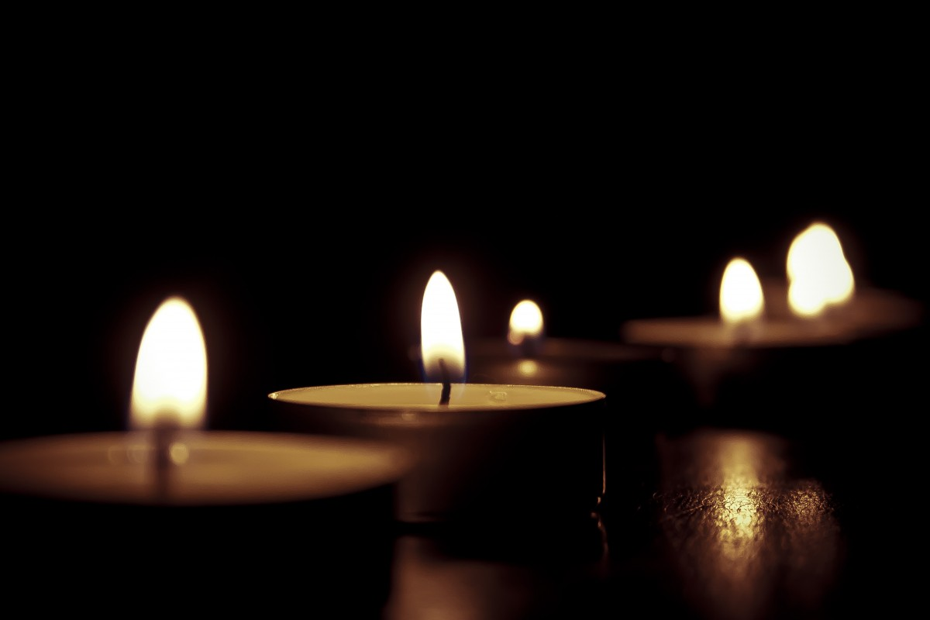
Prayer
Dear God,
Jesus taught us “Blessed are the peacemakers, for they shall be called the sons and daughters of God…”.
Help us to live our lives following the example and teachings of Jesus, to work for peace, to love others, to forgive and to care for the environment.
May we always remember that you love and care for us. Help us to trust in your goodness and know that you will be there guiding us as we work for peace.
Amen
Prayer based on the Vow of Nonviolence

Slide 8
Further ideas
Learn more about the theme of this year’s International Day of Peace and how you could get involved here.
Learn more about the Catholic Nonviolence Days of Action here. On that page you can find websites with stories of nonviolence and a list of organisations that you could write letters to in order to show solidarity and support for their work. The Catholic Nonviolence Initiative is inviting people to join them in the Vow of Nonviolence on 2nd October and more information can also be found on that page.
For an example of Jesus’ teachings on nonviolence, have a look here for our PowerPoint on the Nonviolence of Jesus or our A Christian Response to Conflict resource for schools.
Ask students to create posters on the people they think bring nonviolence.
Ask students to draw around one of their feet and on it write how they could be a person who brings nonviolence.

Slide 9

www.paxchristi.org.uk
Image on pages 1 and 2 from https://nonviolencejustpeace.net/days-of-action/

