Slide 1

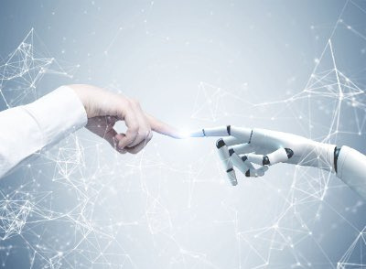
Peace Sunday 2024
‘Artificial Intelligence and Peace’

Slide 2
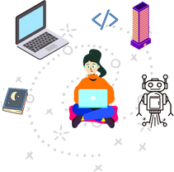
What technology do you use in your everyday life?
Would you trust it to make important decisions?

Slide 3
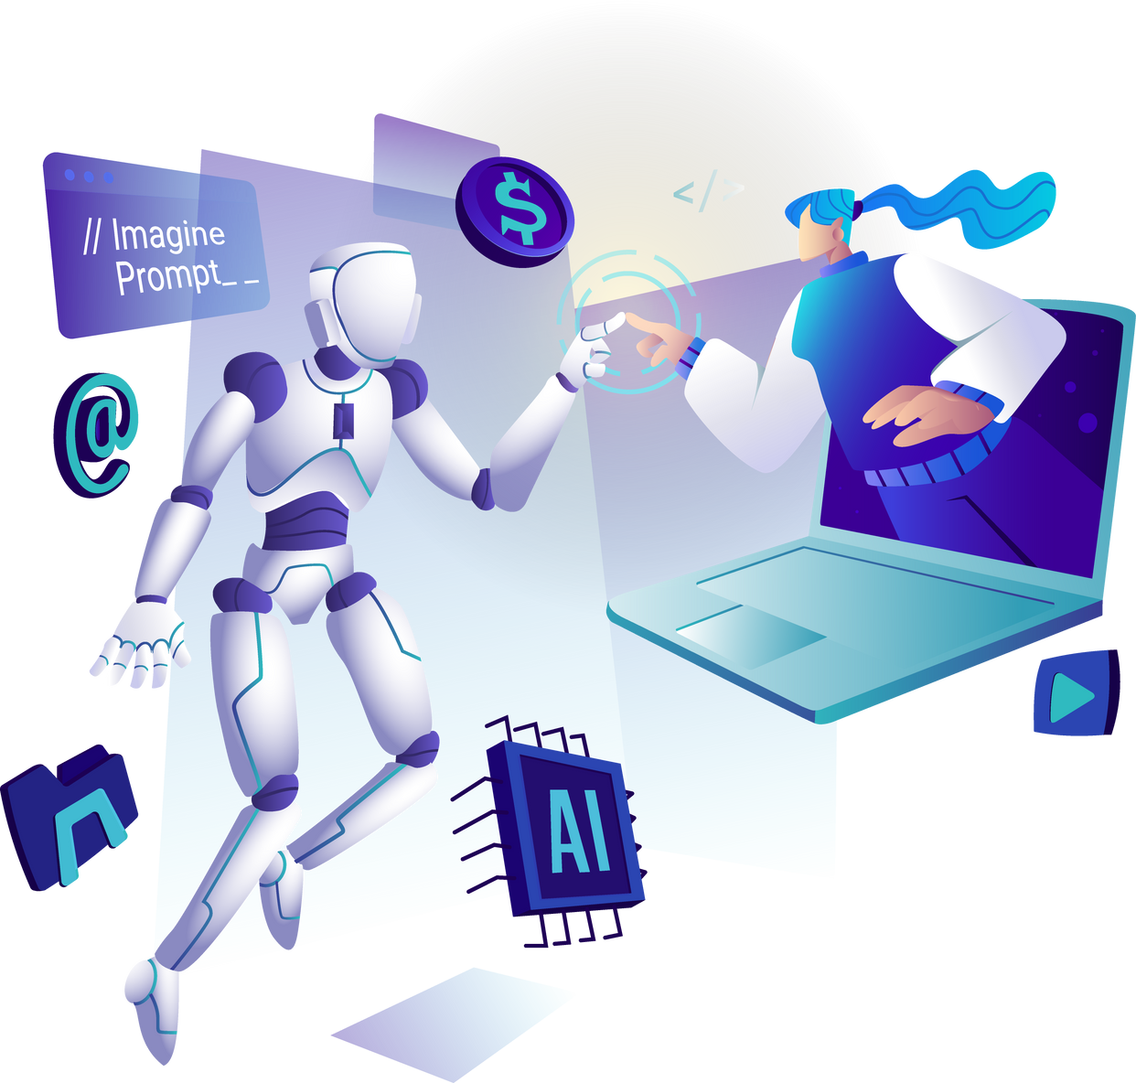
What is Peace Sunday ?
Each year the Pope releases a message for the World Day of Peace on 1st January. Pax Christi England and Wales is a Catholic peace movement and encourages parishes, schools and communities to share the message on the third Sunday in January.
This year the Pope’s message was about artificial intelligence (or AI) and peace. He talks about how we need to ensure AI is used as a tool for good to make the world a better place.

Slide 4
Artificial Intelligence and Peace
Pope Francis says in the message that science and technology show how creative human beings can be. They have helped us in many ways, transforming our societies, but can also be dangerous.
One example he gives is the use of data and information about people. We need to understand how our data is used, and how the results that we get using technology might be affected by biases or how they might even influence our choices without us having all the information. He also says that we might not always be able to trust the result of AI, which could have serious consequences.
What can you do to make sure you’re using technology safely and sensibly?

Slide 5
Artificial Intelligence and Peace
AI can mean a lot of things, but essentially it’s about creating technology that reacts like a human.
Pope Francis suggests setting up organisations and agreements on ethics to make sure that it’s used for good to protect our human rights and dignity, not for selfish reasons. AI won’t be successful if it’s not working to make the world better for everyone, especially if it causes more inequality. We also need to remember that we have limits and that we will never be able to completely predict the future.
Do you agree their should be rules about how we use AI?
Why/ why not?

Slide 6
Pope Francis highlights that we need to ensure we have respect for people as humans beings, not just seeing them as data.
He talks about how AI has helped us to develop more powerful weapons but that instead of using AI for war, we should use it to create peace and an improved quality of life for everyone.
He also talks about how it changes education, our relationships and how we interact with each other. We need to learn how this new technology works and how to use it, as well as making sure we build positive relationships with others.
Artificial Intelligence and Peace
How do you think AI could change your school?

Slide 7
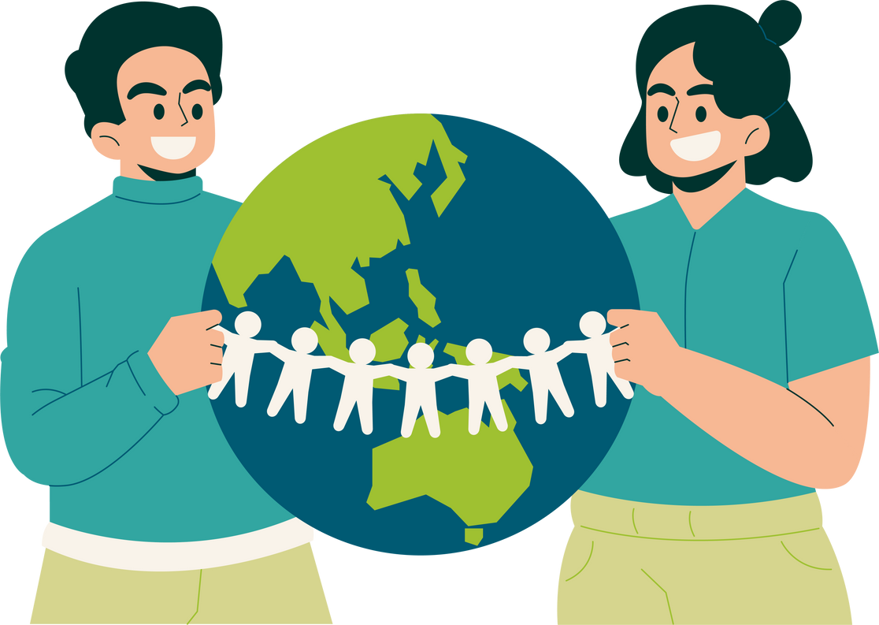
How do you think technology should be used to create a fairer and more peaceful world?

Slide 8

Creator God,
Thank you for the gift of creativity
which gives us the tools to make
the world a better place.
Help us to learn how to use this wisely,
to work to protect the planet
and make the world fairer and more peaceful.
May we always remember that we are are
all worthy of dignity and respect
and that we are called to look after one another
as brothers and sisters.
Amen

Slide 9
Activities
  Have a look on our website at our Activities and Prayers for Children resource on our Peace Sunday webpage: https://paxchristi.org.uk/peace-sunday/. You might also want to use our Children’s liturgy worksheet.
  Create posters about the message to put up in your classroom. You might also want to include tips on how to use technology safely.
  Write a letter to Pope Francis thanking him for the message and ask the students to give their opinions on AI and peace.
  Ask students to come up with as many ways as they can that they could work to create peace in school and ask how they might be able to put this into practice.

Slide 10

For more information and resources, visit our website at www.paxchristi.org.uk
You can access the Pope’s message for the World Day of Peace at: https://www.vatican.va/content/francesco/en/messages/peace.html

