Slide 1
UN International Day of Peace and the Catholic Nonviolence Days of Action 2024

Slide 2
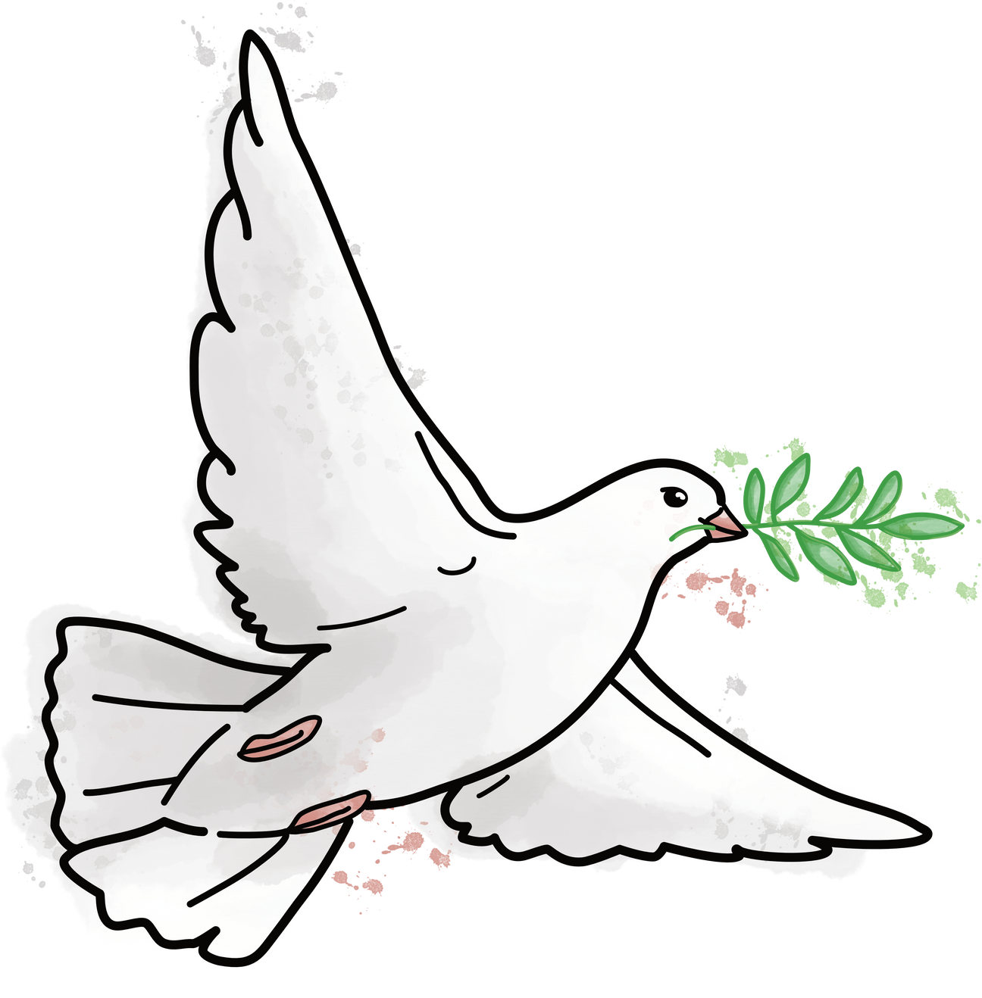
UN International Day of Peace
Each year, 21st September is the United Nations’ International Day of Peace. This year, the theme for the day is ‘Cultivating a Culture of Peace’.
The theme celebrates 25 years since the UN released a document that set out how to build a culture of peace in the world. It included respecting human rights, promoting nonviolence and peacefully resolving conflict.

Slide 3
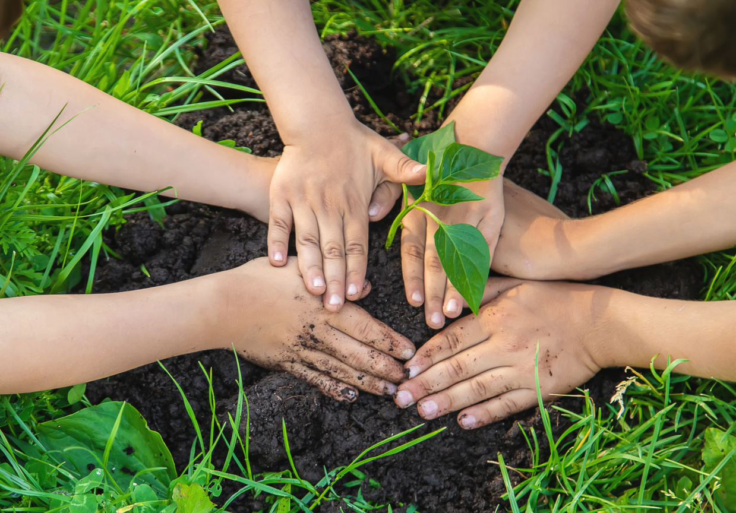
UN International Day of Peace
To cultivate something, such as a plant, means to grow and care for it.
What do you think would help peace to flourish? Create a ‘recipe’ for peace - what would the ingredients be?

Slide 4
UN International Day of Peace
‘Bless those who persecute you; bless and do not curse them. Rejoice with those who rejoice, weep with those who weep. Live in harmony with one another; do not be haughty, but associate with the lowly; do not claim to be wiser than you are. Do not repay anyone evil for evil, but take thought for what is noble in the sight of all. If it is possible, so far as it depends on you, live peaceably with all.’
Romans 12:14-18
This is an extract from a letter from St. Paul teaching about how we should act towards one another. What does it tell us about how to live peacefully?
Did you have any of the same ideas in your recipe for peace?

Slide 5

Catholic Nonviolence
Days of Action
The 21st September is also the beginning of the Catholic Nonviolence Days of Action. They continue until 2nd October, the UN Day of Nonviolence.
The days encourage us to think about and work for nonviolence in our everyday lives.

Slide 6
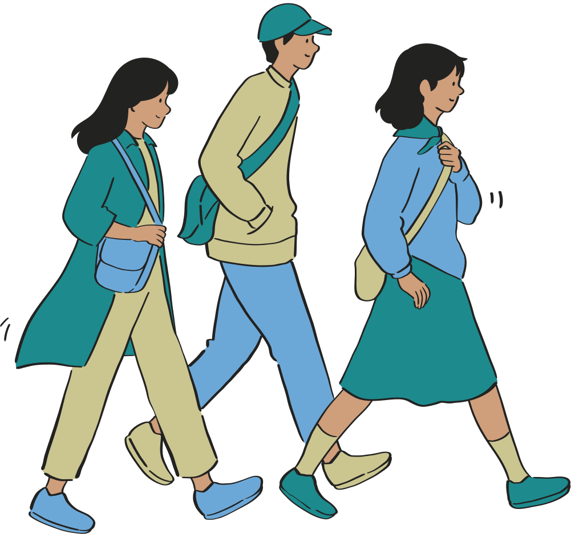
Catholic Nonviolence
Days of Action
This year, the theme of the days of action is ‘Walking Together Builds Unity and Nonviolence’.
Why would walking alongside each other and supporting each other be important for building peace? How could you do this in school?

Slide 7

Prayer
Creator God,
Help us to be peacemakers, building a world where everyone can live in dignity.
Help us to walk alongside others when they need our help.
Help us to work together to build a community where we are all cared for and valued.
Amen

Slide 8
Further activities and resources
  You may want to create posters using the recipe for peace ideas and make them into a display.
  Visit the webpage for the UN Day of Peace for more information and resources from the United Nations: https://www.un.org/en/observances/international-day-peace
  For information and further resources on the Catholic Nonviolence Days of Action, including videos, have a look at this specially created dossier (https://paxchristi.net/wp-content/uploads/2024/09/CNI-CNVDA-2024-DOSSIER.pdf) or visit the website: https://nonviolencejustpeace.net
  To find other resources on peace and nonviolence, including our Elements of Peace activity cards, visit our peace education pages: https://paxchristi.org.uk/peace-education/secondary/workshop-resources/

Slide 9

www.paxchristi.org.uk
Information on UN Day of Peace: United Nations (2024). International Day of Peace. [online] United Nations. Available at: https://www.un.org/en/observances/international-day-peace.
Bible quote: New Revised Standard Version Bible: Catholic Edition, copyright © 1989, 1993 the Division of Christian Education of the National Council of the Churches of Christ in the United States of America. Used by permission. All rights reserved.

