Slide 1
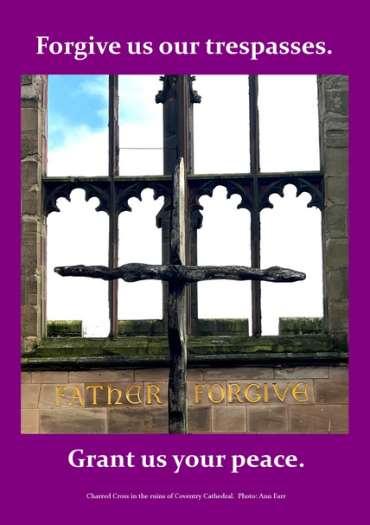
Peace Sunday 2025
Forgive us our trespasses:
grant us your peace

Slide 2
Where do we hear the phrase ‘Forgive us our trespasses’?
What do you think it means?
What does it mean to forgive other people’s trespasses?

Slide 3
What is Peace Sunday?
Each year, the Pope releases a message on 1st January for the World Day of Peace. Pax Christi England and Wales, a Catholic peace organisation, encourages parishes, schools and communities to promote this message around the third Sunday in January, which this year is 19th January.
Each year the message has a different theme and this year’s theme is ‘Forgive us our trespasses: grant us your peace’. The message talks about forgiveness, hope, justice and peace.

Slide 4

In the message, the Pope talks about forgiveness as a sign of God’s mercy and love, which gives us hope.
It ties in with 2025 as a Jubilee Year in the church, a year which focusses on forgiveness, working for justice and bringing hope to all.
Pope Francis recognises that we need to remember we are all siblings, equal and loved by God.

Slide 5

Peace does not only come with the end of wars but with the dawn of a new world, a world in which we realize that we are different, closer and more fraternal than we ever thought possible.
Pope Francis, World Day of Peace Message 2025
What do you think Pope Francis is trying to say in this quote?
Do you agree? Why/ why not?

Slide 6
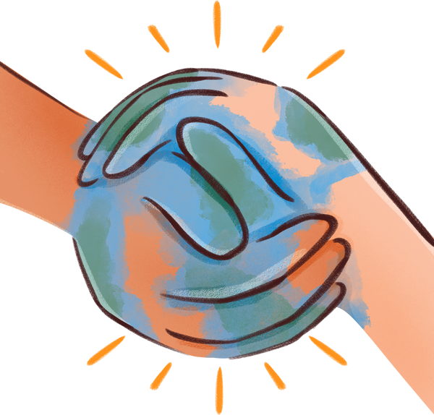
The Pope gives lots of suggestions in the message about how to build hope and peace.
He talks about how we could create peace globally by using money usually spent on weapons to help to tackle inequality and injustice instead. He says richer countries should cancel international debts that mean poorer countries owe them lots of money and that countries should get rid of the death penalty.

Slide 7

But Pope Francis also talks about what we can do on a personal level. He talks about us having hearts that are open, loving, forgiving and hopeful for the future. He reminds us that small actions, such as a smile or being kind, can help build peace.
What small actions could you do to show peace and hope in your everyday life?

Slide 8

Creator God,
We pray for your gift of peace.
We pray for an end to war and that everyone may live in peace and freedom.
We are sorry for the times we have hurt others and your creation, and ask for your forgiveness, confident in your mercy.
Help us to learn to forgive others. May we always treat other people with love, respect and kindness.
May we be peacemakers, signs of your peace, hope and justice in the world.
May we never forget your love for us, and share it with others wherever we go.
Amen

Slide 9
Activities
  Have a look at our Activities and Prayers for Children resource on our Peace Sunday webpage: https://paxchristi.org.uk/peace-sunday-2025/.
  Have a look at our ‘Elements of Peace’ activity and reflection cards to explore different peace themes, including being a peacemaker and loving your enemies: https://tinyurl.com/3dev6f6n
  Cut out some paper hearts and write in them either values or small actions that people could do to build peace. You could use them to create a display or as part of a prayer liturgy.
  Taking the idea of using money usually spent on weapons to tackle inequality and justice instead, hold a vote to decide where your students would spend that money. Discuss how they could challenge that inequality or injustice at a local level or even in school.

Slide 10

For more information and resources, visit our website at www.paxchristi.org.uk
You can access the Pope’s message for the World Day of Peace at: https://www.vatican.va/content/francesco/en/messages/peace.html

