Slide 1

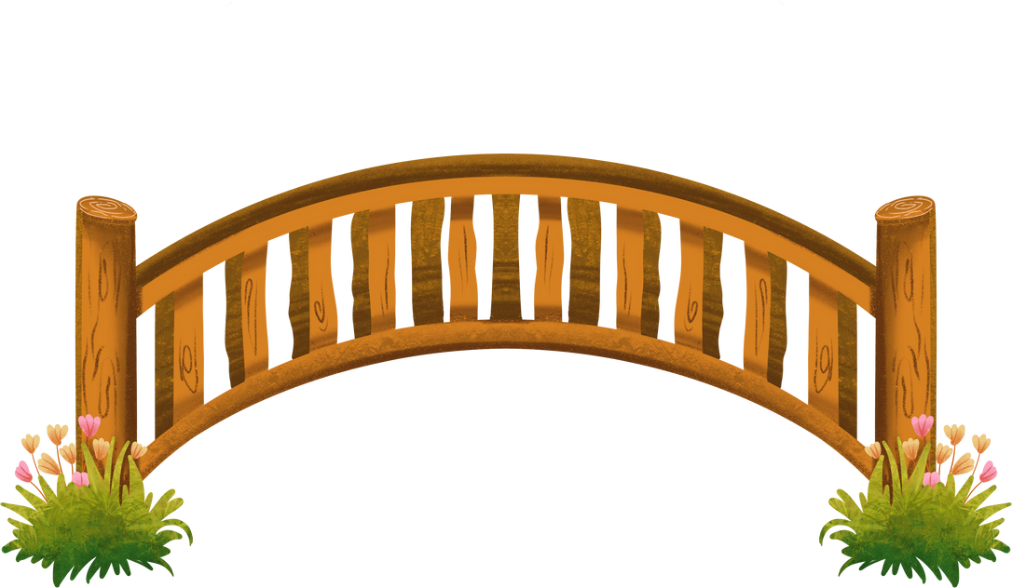
Catholic Nonviolence Days of Action 2025
Building Bridges for a Nonviolent Tomorrow

Slide 2
What are the Catholic Nonviolence Days of Action?
The Catholic Nonviolence Days of Action run from 21st September (the International Day of Peace) to 2nd October (Mahatma Gandhi’s birthday).
During these days, people are encouraged to explore nonviolence and ways we can build peace.

Slide 3
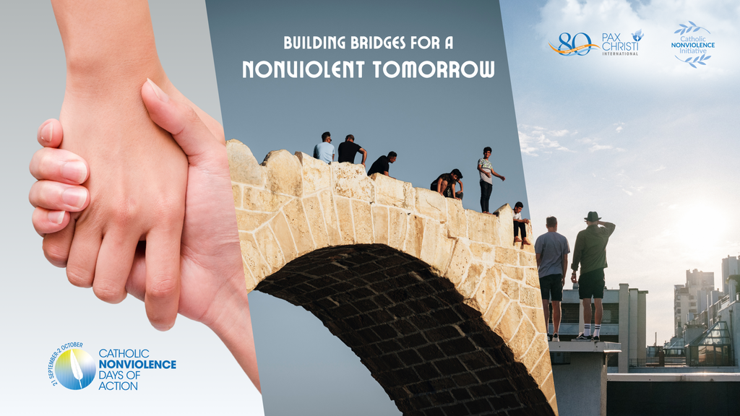
‘Building Bridges for a Nonviolent Tomorrow’
This year, the theme for the days is ‘Building Bridges for a Nonviolent Tomorrow’.
  What do you think it means to ‘build bridges’?
  Who might we build bridges with?
  Why do you think it’s important to build bridges if we want peace?

Slide 4
What does our faith say?
“So let us do all we can to live in peace. And let us work hard to build up one another.”
Romans 14:19, NIRV
Have a look at this quote from St Paul.
What do you think he was trying to tell us?

Slide 5
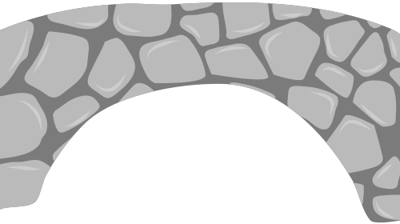
Building bridges
Think of one small action you could do to build bridges or be a peacemaker.
Write it on a piece of rectangular paper. Gather all the pieces of paper together and stick them on the wall or board in the shape of a bridge.
Together these pieces of paper show how all our small actions can build bridges for a nonviolent tomorrow.

Slide 6
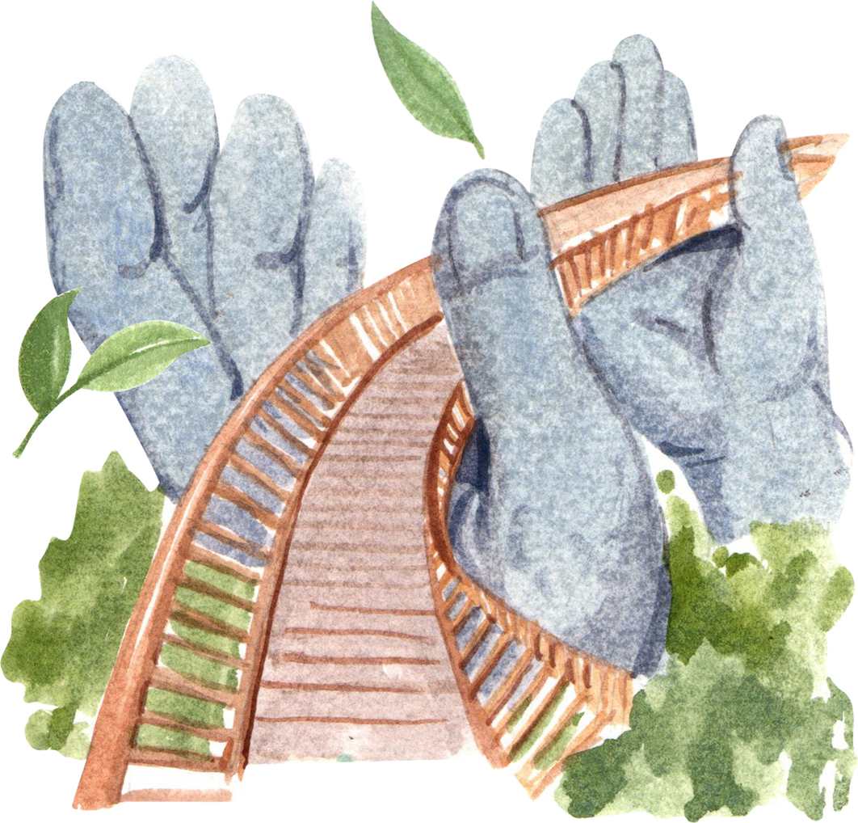
Prayer
Loving Creator,
In these days of nonviolence, help us find ways to build bridges so we can live in peace with each other.
Help us to be peacemakers, working for justice, listening to others and saying no to violence and conflict.
Amen

Slide 7
Further information and resources
  For more information on the Catholic Nonviolence Days of Action, visit the Pax Christi International website: https://paxchristi.net/2025-catholic-nonviolence-days-of-action/ or the Pax Christi England and Wales website: https://paxchristi.org.uk/resources/nonviolence-in-action/
  Watch the Pope’s video and prayer for August 2025 on mutual coexistence: https://www.youtube.com/watch?v=mU2JBABYZhA
  For more resources on nonviolence have a look at previous Catholic Nonviolence Days of Action resources at https://tinyurl.com/34krpj4x or https://tinyurl.com/mpmsr33s. We also have an Elements of Peace card on nonviolence: https://tinyurl.com/3dev6f6n
  The Catholic Nonviolence Days of Action start on the same day as the UN International Day of Peace. The theme this year is ‘Act Now For a Peaceful World’. You may want to look on their website for more ideas: https://www.un.org/en/observances/international-day-peace

