Slide 1

A Christian Response
to Conflict

Slide 2
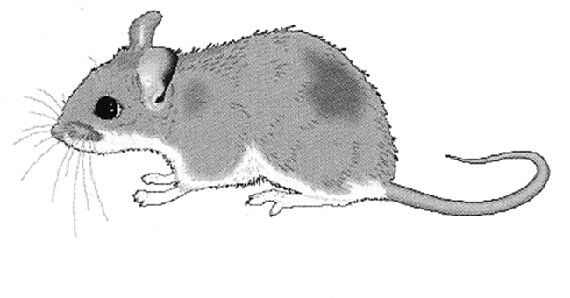
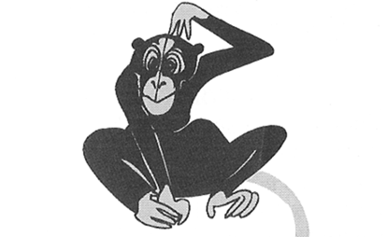
Looking at the images
around the room
Stand near the animal which best represents how you respond to conflict.

Slide 3
Looking at the images
around the room
Why have you chosen your animal?
What are the advantages and disadvantages of this style of response?
Is this method likely to solve the problem?

Slide 4
Read Matthew 5: 38-39
³⁸ You have heard that it was said, ‘Eye for eye, and tooth for tooth.’ ³⁹ But I tell you, do not resist an evil person. If anyone slaps you on the right cheek, turn to them the other cheek also.

Slide 5
Read Matthew 5: 38-39
³⁸ You have heard that it was said, ‘Eye for eye, and tooth for tooth.’ ³⁹ But I tell you, do not resist an evil person. If anyone slaps you on the right cheek, turn to them the other cheek also.
What is Jesus’ message here?

Slide 6
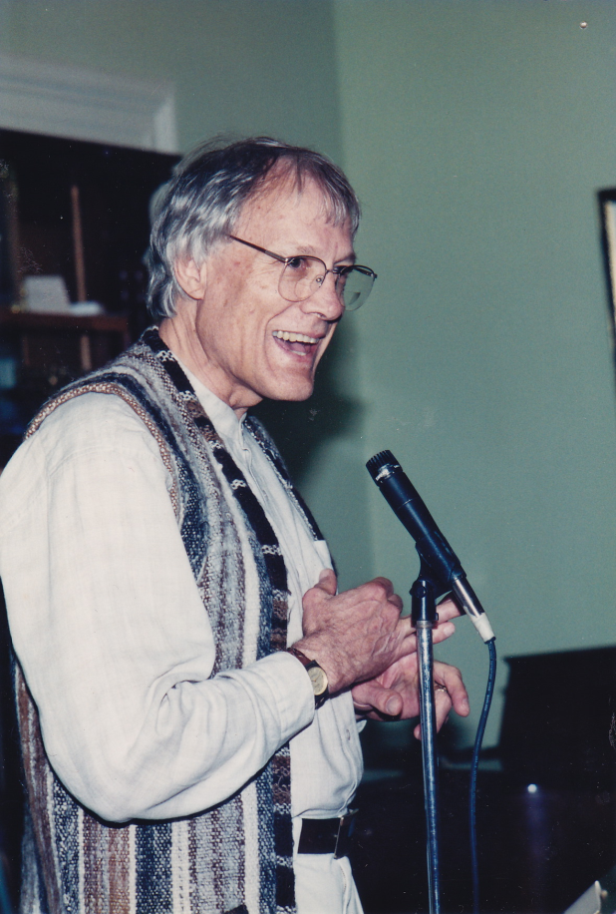
We are going to look at one interpretation of this passage, by a bible scholar called Walter Wink.

Slide 7
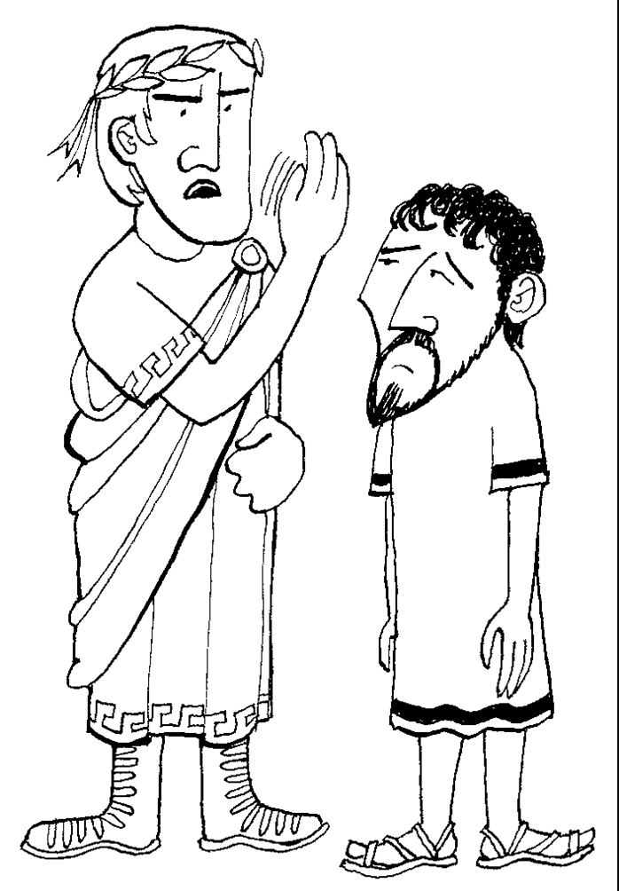
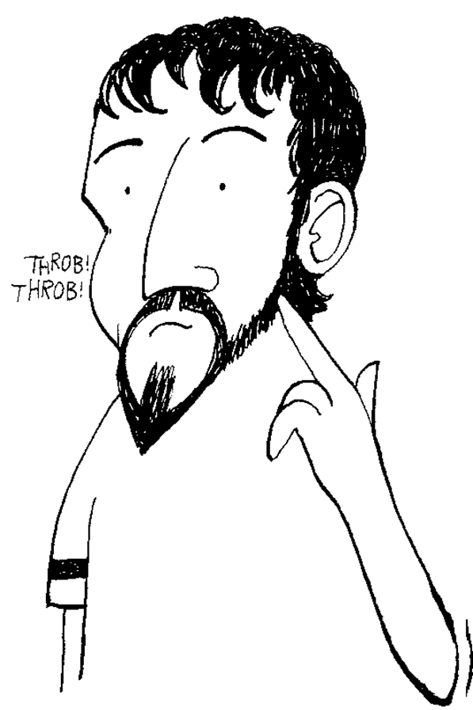
Turn the other cheek

Slide 8
Next in Matthew’s gospel Jesus tells us…
⁴³You have heard that it was said, ‘you shall love your neighbour and hate your enemy.’ ⁴⁴But I say to you, Love your enemies and pray for those who persecute you, ⁴⁵so that you may be children of your Father in heaven.

Slide 9
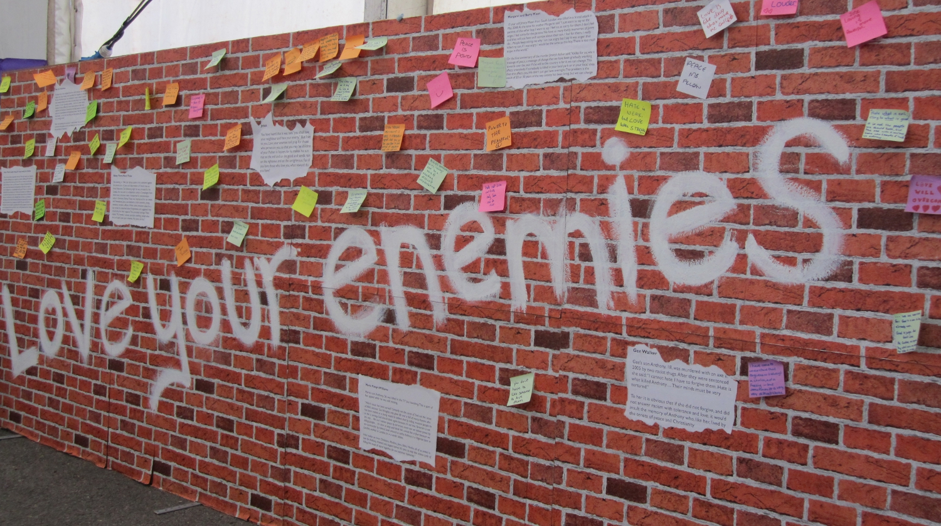
What does it mean to love your enemies?

Slide 10
Read the story carefully.
Add your own thoughts and reflections beneath it.
You will have three minutes with each story.

Slide 11


What are the messages of
Matthew 5:38-39 & 43-45
Look back at your thoughts on these passages at the start of the lesson. Has your opinion changed? Why/Why not?
What do these teachings tell us about how Christians should respond to conflict?

Slide 12

www.paxchristi.org.uk
Twitter: @PaxChristiUK
facebook.com/PaxChristiUK
Credits
Animal Conflict Styles are from, Peacebuilding: a Caritas Training Manual, (Vatican City, Caritas Internationalis, 2002)
Photo of Walter Wink is from the Fellowship of Reconciliation USA and is used with permission through the Creative Commons Attribution-ShareAlike license
Illustrations of Turn the other cheek are by David Rumsey
Scripture quotations are from the New Revised Standard Version
All other images and materials are by Pax Christi UK

