Slide 1


GOSPEL NONVIOLENT RESPONSE
Experiences and lessons to Organize Hope

Slide 2
01
What do we know?
What have we learnt?
FROM LIVED EXPERIENCES OF GOSPEL NONVIOLENCE
02
What can we do with the things we have learnt?
03
What can we Hope?

Slide 3

Catholic Nonviolence Initiative
Building Community
Catholic Institute for Nonviolence
Organizing Hope
Some Key Lessons on Nonviolence
Turning Faith into Action

Slide 4






CATHOLIC NONVIOLENCE INITIATIVE
goals since 2016
1
Nonviolence is central to Catholic life and cross-cutting in Catholic Social Teaching
The Church regularly applies a nonviolence-centered framework and well developed nonviolent strategies to contemporary reality
2
Church structures teach and promote nonviolence to educate and mobilise Catholics
3

Slide 5

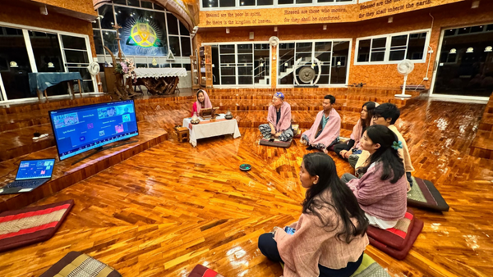
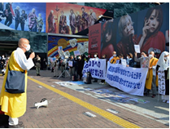

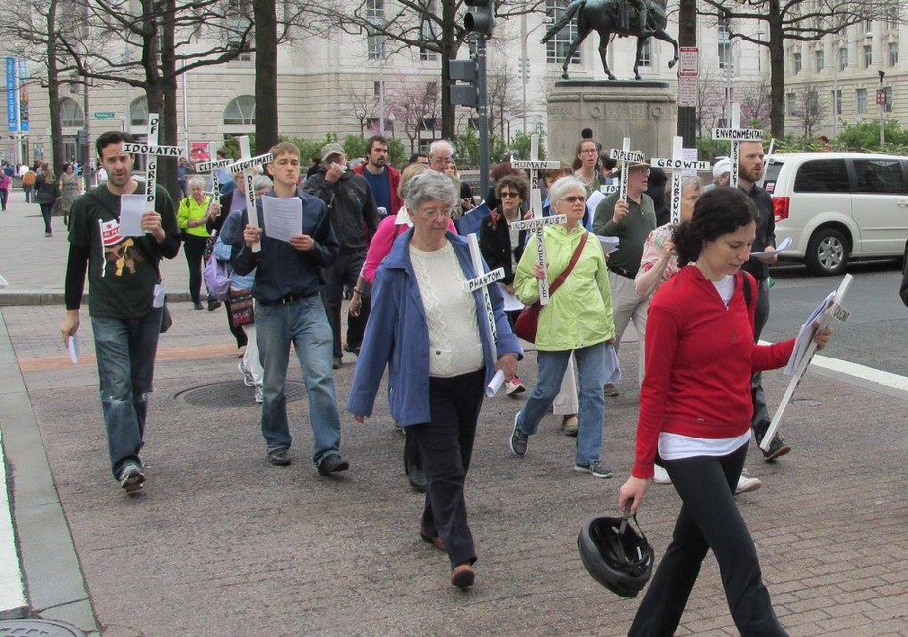
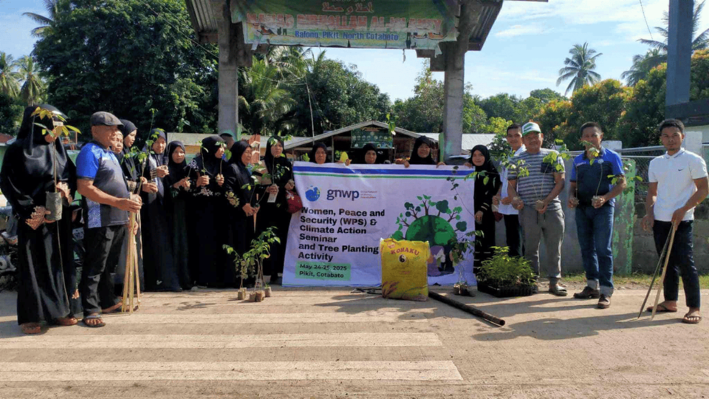
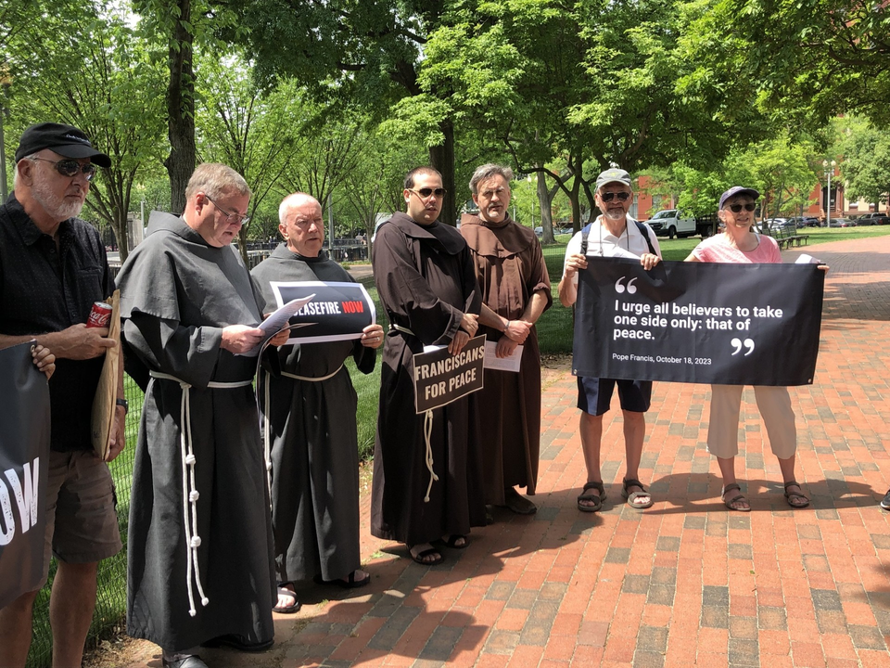
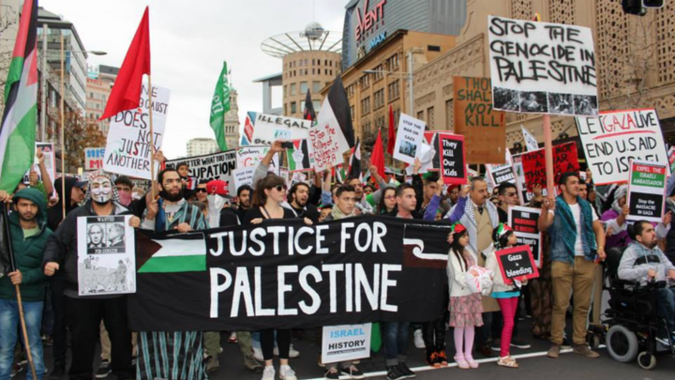

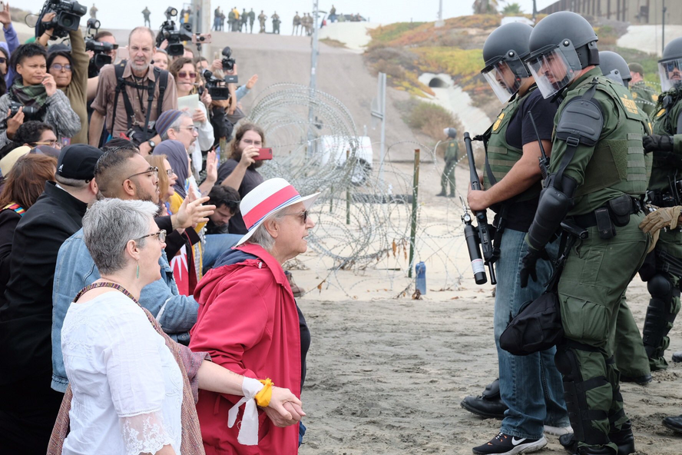
A global movement
Walking together

Slide 6
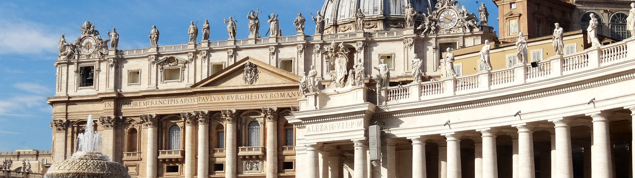
THE CATHOLIC INSTITUTE FOR NONVIOLENCE
A project of Catholic Nonviolence Initiative
The mission of the Catholic Institute for Nonviolence, established in September 2024, is to make nonviolence research, resources and experience more accessible to Catholic Church leaders, communities and institutions in order to deepen Catholic understanding of and commitment to the practice of Gospel nonviolence.

Slide 7

Three areas of concentration
Catholic Institute for Nonviolence
Gospel Nonviolence
Contextual experiences of nonviolence
Nonviolent practices and strategic power

Slide 8
What are we talking about when we talk about Gospel Nonviolence?
FRAMEWORK

Slide 9
POPE LEO XIV
“...the Gospels do not hide the fact that what troubled the disciples was his nonviolent response: a path that they all, Peter first among them, contested; yet the Master asked them to follow this path to the end”

Slide 10
WHAT DOES THIS ENTAIL?
As Christians, nonviolence is not “an alternative”. It is Jesus´ response. It is Gospel answer.
01
02
It is an anwer that troubles.
Nonviolent strategies and tools are at the service of the spiritual call and commitment to follow Jesus´ nonviolent response. Research, knowledge and rationality can contribute to this path.
03
04
Gospel Nonviolence is a lived experience. Reality is superior to the idea. Nonviolence starts from the reality of the conflicts and violence lived and suffered by the people of God.
05
The four dimensions of nonviolence:

Slide 11





GOSPEL NONVIOLENCE
A SPIRITUALITY
Reconciliation, courage, empathy, solidarity, accompaniment and humility rooted in the life of the God of peace and nonviolence.
A POTENTIAL UNIVERSAL ETHIC
NONVIOLENCE
A WAY OF LIFE
Unarmed and diarming peace centered on Gospel nonviolence. Prioritizing nonviolence in personal and societal decision-making. Harmony and right relationships among humans and with the whole Creation.
The power of Jesus´love in action resisting and disarming violence, promoting human dignity, fostering reconciliation, justice, and peace through nonviolent means.
Formation, practices,
and community building for the nonviolent life, including respect, constructive communication,
inclusivity, participation, and interconnectedness.
A METHOD FOR CHANGE
Spectrum of effective nonviolent cross-cutting approaches for preventing or ending violence, transforming conflict, protecting human beings and Creation, and building a more just and
peaceful world.

Slide 12
WHAT WE HAVE LEARNT ABOUT NONVIOLENCE

Slide 13
Nonviolence is effective - and faster
(Erica Chenoweth & Maria J. Stephan) (Ilker kalin)
1
2
Nonviolence effectivenes is related with high levels of participation
(Erica Chenoweth & Maria J. Stephan) (Ilker Kalin)
Cohesion (organizational structure) increases the possibility that a movement will use nonviolence
(Wendy Pearlman)
3
4
Training in nonviolence increases effectiveness and reduces state violence
(Consuelo Amat, Jonathan Pinckney, Jawhara Kanu)

Slide 14
5
International support can speed up success
(Ilker Kalin)
6
Nonviolence is dynamic, imitative, mimetic.
Civic courage is contagious
(Brian Palmer)
7
Church can play a crucial role and a very specific one in contexts of extreme repression
(Consuelo Amat)
The systematic study of nonviolence and experience over the years offers a wealth of methods that can be adapted to the reality of each context
8

Slide 15
WHAT CAN WE DO?
Some suggestions to Organize Hope

Slide 16
  Build ties and bonds: Build community.
  Offer spaces and design specific times for nonviolent experiences of joint participation. For some people, these spaces and times may be their only experiences of peace.
  Initiate processes. Synodality as a nonviolent experience of participation and a house of peace.
  Offer organizational structure.
  Learn and train in nonviolent tools. Training for trainers.
  Socialize conflicts. Socialize hope. Build networks of solidarity.
  Share experiences and testimonies. Nonviolence is imitative, dynamic, contagious.
  Protect institutional spaces for peace. Start with the family and school.
  Incorporate nonviolence into formal and informal education.
  Create spaces and experiences of peace in the digital world as well.
  Put our bodies on the line. Accompany.
  Disarm language.

Slide 17
WHAT CAN WE HOPE?

Slide 18
FOR CHRISTIANS NONVIOLENCE IS
“the attitude of one who is so convinced of God’s love and power that he or she is not afraid to tackle evil with the weapons of love and truth alone”
POPE BENEDICT XVI

Slide 19
FOR CHRISTIANS HOPE IS
A MANDATORY VIRTUE
POPE JOHN PAUL I

Slide 20


